Slide 1
Harnessing LLMs for Complex Math Reasoning
Speaker: Wenhu Chen
Collaborations: Tianle Li, Xueguang Ma, Xinyi Wang, Alex Zhuang, William Cohen

Slide 2
Large Language Models

Slide 3
Large Language Models
Large Language Models has become the de-facto for many tasks.
Single model for all tasks.
Models use transfer learning to generalize.
Only a few examples are needed.
Models textual fluency and coherence perfectly.
Large Language Models
Not perfect at complex reasoning tasks like math problems.
Not perfect at symbolic reasoning like knowledge graph.

Slide 4
Reasoning Large Language Models
How to utilize LLMs to solve numerical reasoning tasks.
Math problem
Finance Problem
Data Science Problem
How to utilize LLMs to query large-scale knowledge base.
Extract information from KBs.
Answer questions regarding KBs.

Slide 5
Program of Thoughts Prompting: Disentangling Computation from Reasoning for Numerical Reasoning Tasks
Wenhu Chen, Xueguang Ma, Xinyi Wang, William Cohen
https://arxiv.org/abs/2211.12588

Slide 6
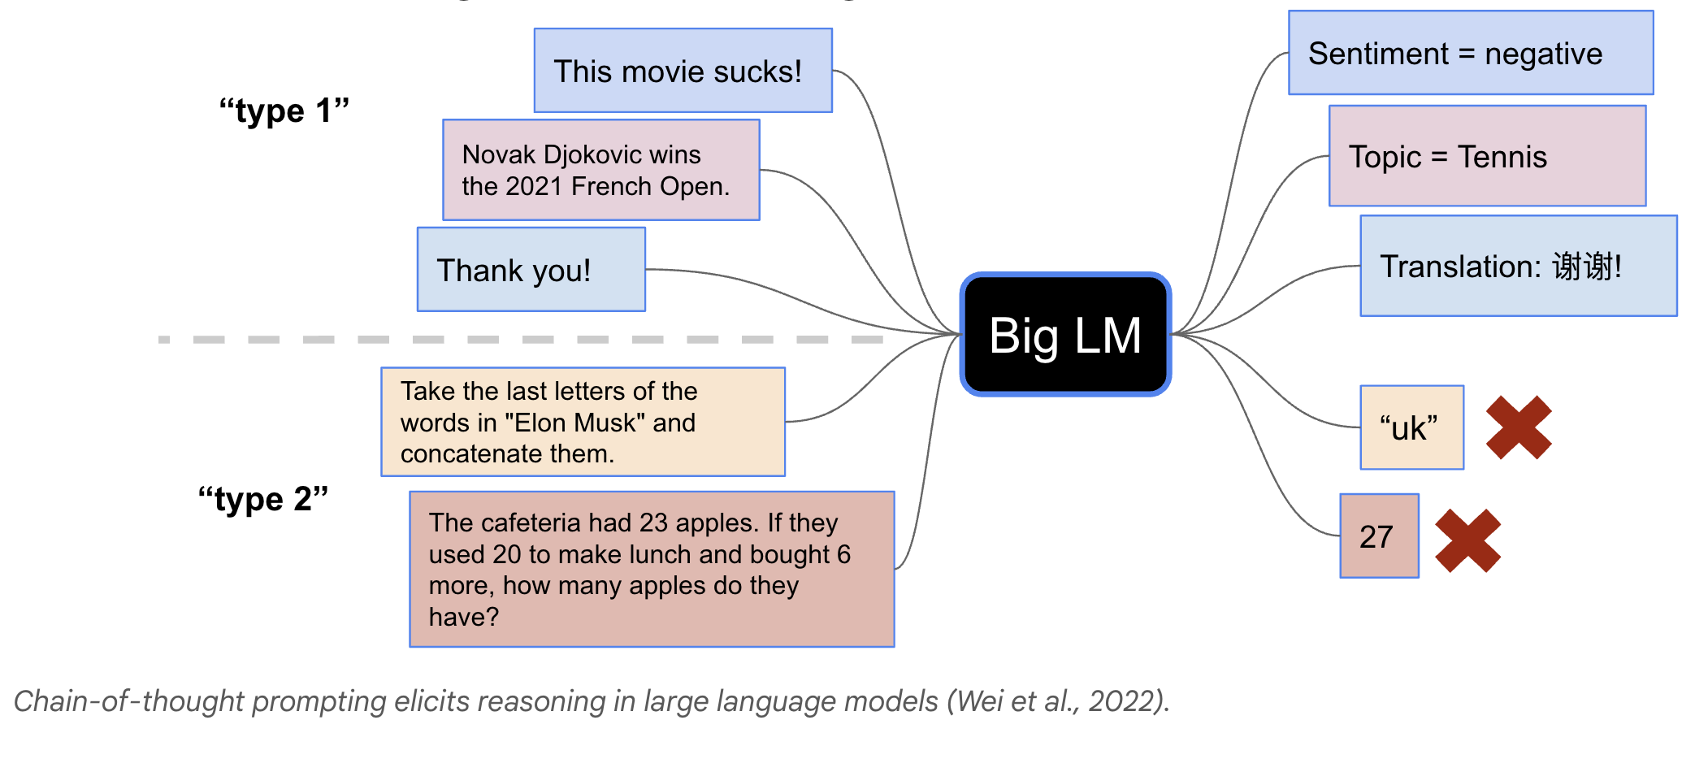
Direct Prompting in LLM

Slide 7
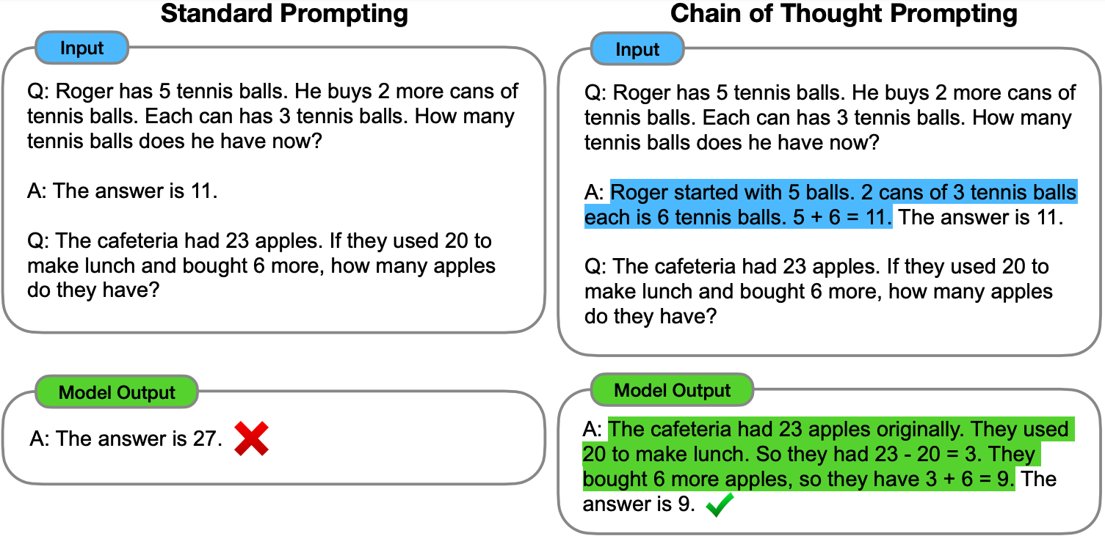
Chain of Thoughts in LLM

Slide 8
Chain of Thoughts in LLM

Slide 9
Chain of Thoughts in LLM
Relying on natural language to solve tasks.
Computation and Reasoning are both expressed in NL.
Some symbolic operations are too complex to be expressed with NL.
Some tasks require calling APIs to accomplish.
Let’s take a look at some cases.

Slide 10
Is NL the best reasoning means?
In Fibonacci sequence, it follows the rule that each number is equal to the sum of the preceding two numbers, what is the 50th number in Fibonacci sequence?
The first number is 0, the second number is 1, therefore, the third number is 0+1=1. The fourth number is 1+1=2. The fifth number is 1+2=3. The sixth number is 2+3=5. The seventh number is 3+5=8. The eighth number is 5+8=13.
..... (Skip 1000 tokens)
The 50th number is 32,432,268,459.

Slide 11
What about Programs as Thought
In Fibonacci sequence, it follows the rule that each number is equal to the sum of the preceding two numbers, what is the 50th number in Fibonacci sequence?
length = 50
fibonacci = np.zeros(length)
fibonacci[0] =0
fibonacci[1] = 1
for i in range(3, length):
fibonacci[i] = fibonacci[i-1] + fibonacci[i-2]
return fibonacci[-1]
Concise
Accurate

Slide 12
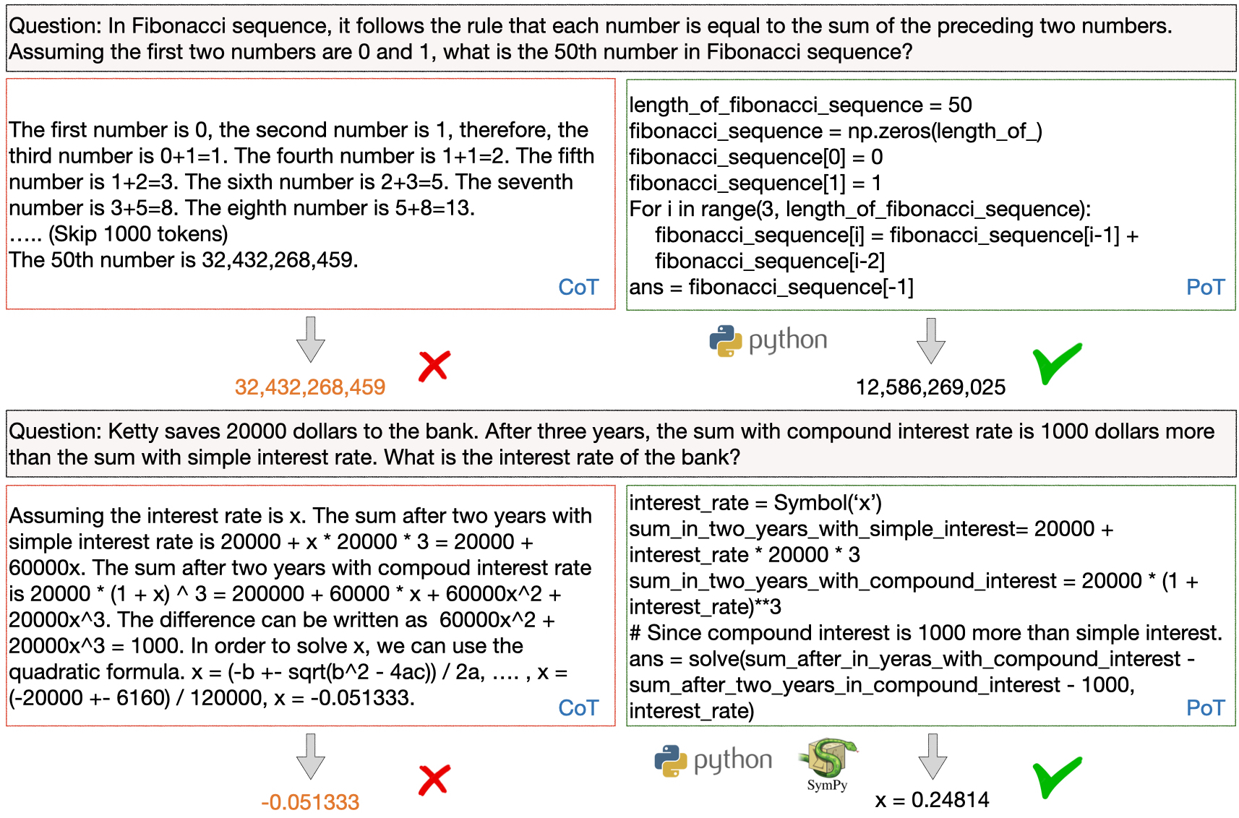
Program of Thoughts

Slide 13
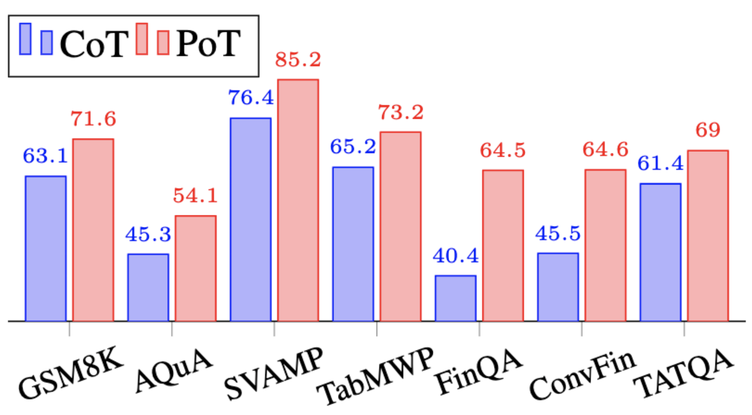
Few-Shot Results on Math Problem Dataset

Slide 14
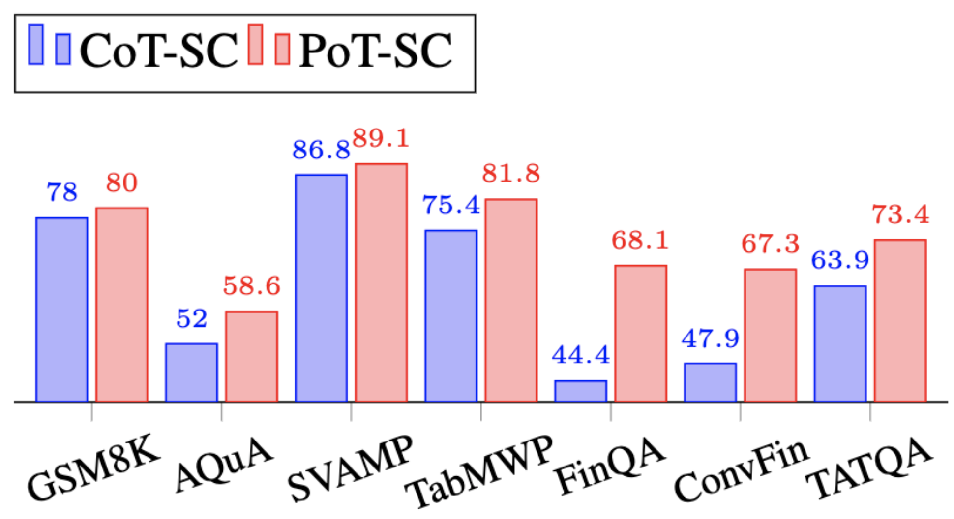
Few-Shot (SC) Results on Math Problem Dataset

Slide 15
Zero-Shot Evaluation

Slide 16
Zero-Shot Results on Math Problem Dataset

Slide 17
Ablation Studies
Meaningful Binding
length = 50
fibonacci = np.zeros(length)
fibonacci[0] =0
fibonacci[1] = 1
for i in range(2, length):
fibonacci[i] = fibonacci[i-1] + fibonacci[i-2]
return fibonacci[-1]
No Binding
x0 = 0
x1 = 1
for _ in range(2, 50):
tmp = x0 + x1
x0 = x1
x1 = tmp
return x1

Slide 18
Takeaways
Program-of-thoughts can disentangle the computation process from the reasoning process, where the computation is done via executor.
Such disentanglement can significantly boost the performance.
Program-of-Thoughts achieve state-of-the-art performance on all of the math problem datasets.

Slide 19
TheoremQA: A Theorem-driven Question Answering dataset
Wenhu Chen, Ming Yin, Max Ku, Elaine Wan, Xueguang Ma, Jianyu Xu, Tony Xia, Xinyi Wang, Pan Lu
https://arxiv.org/abs/2305.12524

Slide 20
Existing Math Dataset

Slide 21
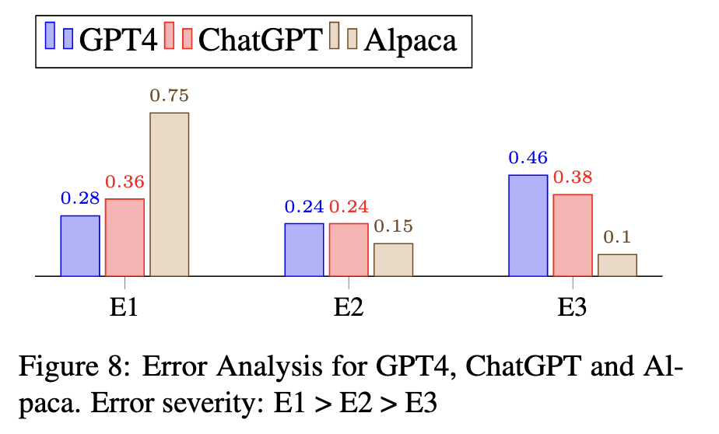
Error Analysis
E1: model does not even know the theorem
E2: model know the theorem, but use the wrong formula/algorithm
E3: model only makes minor calculation mistake

Slide 22
Performance of GPT-4

Slide 23
What’s Next?
GPT-4 with Program-of-Thoughts can further improve the performance of most datasets to 90%+ under zero-shot setting.
Does it mean we already solve math reasoning?
No, the caveat is that these datasets are grade-school math problems, which only requires simple arithmetic operations.
More complex computation like integration, or matrix multiplication is still not covered in these datasets.
We are working on collecting a more university-level science QA dataset to test LLMs’ capabilities to use theorems to solve problems.

Slide 24
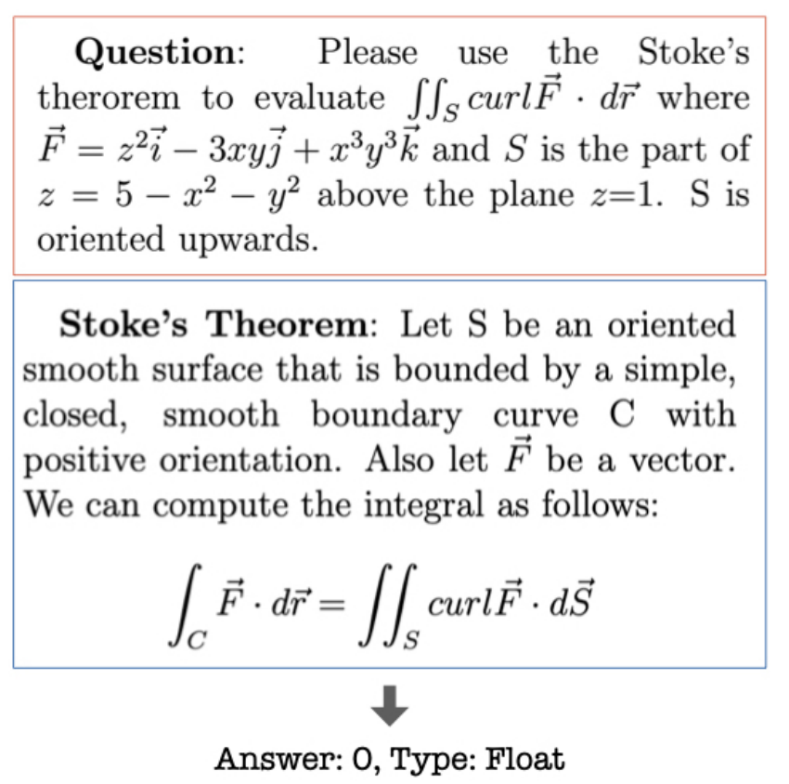
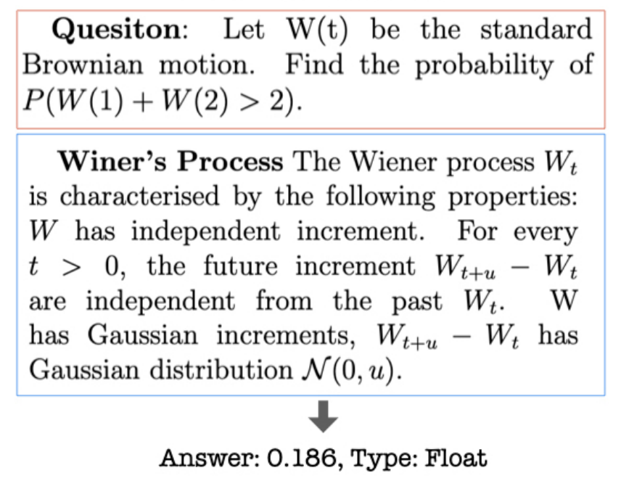
More challenging Math Questions

Slide 25
Question Annotation
Collecting Theorems
Prompting LLMs to enumerate theorems
Expert Complementing theorems
Theorem-driven Question Seeking
We feed the theorem as keyword to search the web to find related questions.
We search for related sections in textbooks to find questions
Answer Type
We consider the following answer types: number, list, bool, option
We will rewrite the question if it doesn’t fit into these types.
If the original question asks about “matrix”, we change to “trace of matrix”

Slide 26
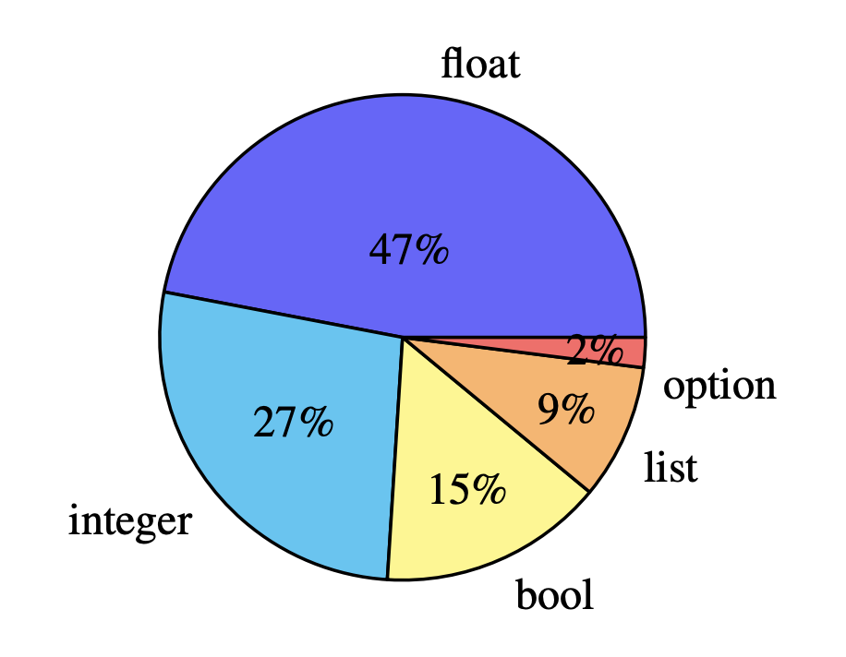
Dataset Overview
We cover 800 questions
442 Math, 146 CS&EE, 131 Physics, 81 Finance
199 Math, 48 CS&EE, 52 Physics, 55 Finance theorem
Answer Distribution:

Slide 27
Theorem Overview

Slide 28
Method
Models
GPT-*, Claude, Alpaca/Vicuna/OpenAssistant/MOSS/StarChat/T5Coder+
Prompt
Chain of Thoughts Prompting
Few-shot for base models
Zero-shot for instruction-tuned models
Program of Thoughts:
Few-shot for base models
Zero-shot for instruction-tuned models

Slide 29
Experimental Results

Slide 30
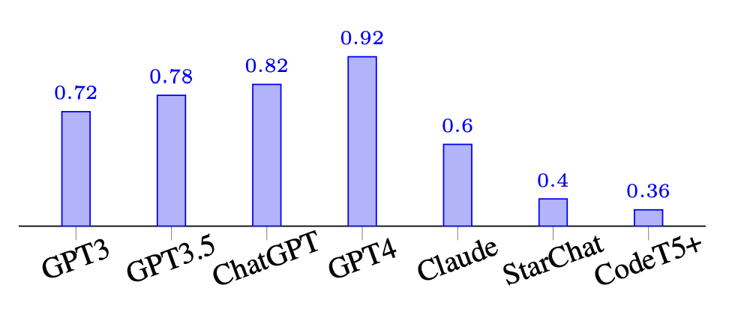
Executability of Programs (PoT)
We evaluate how much of the generated programs from different models are actually executable
Results:

Slide 31
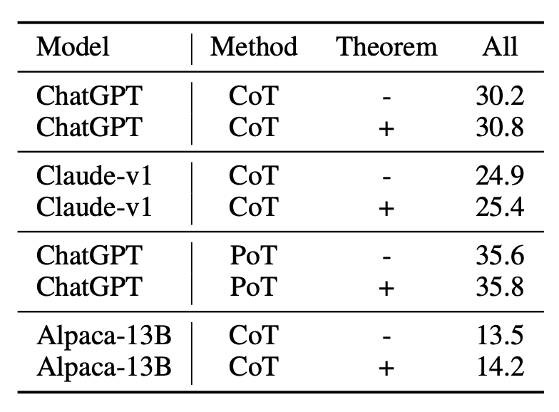
Theorem Augmentation
Augmenting the prompt with theorem
Generate theorem definition with GPT-4
Provide the theorem into the prompt
Help the model ground on the the theorem
Results:

Slide 32
Case Studies

Slide 33
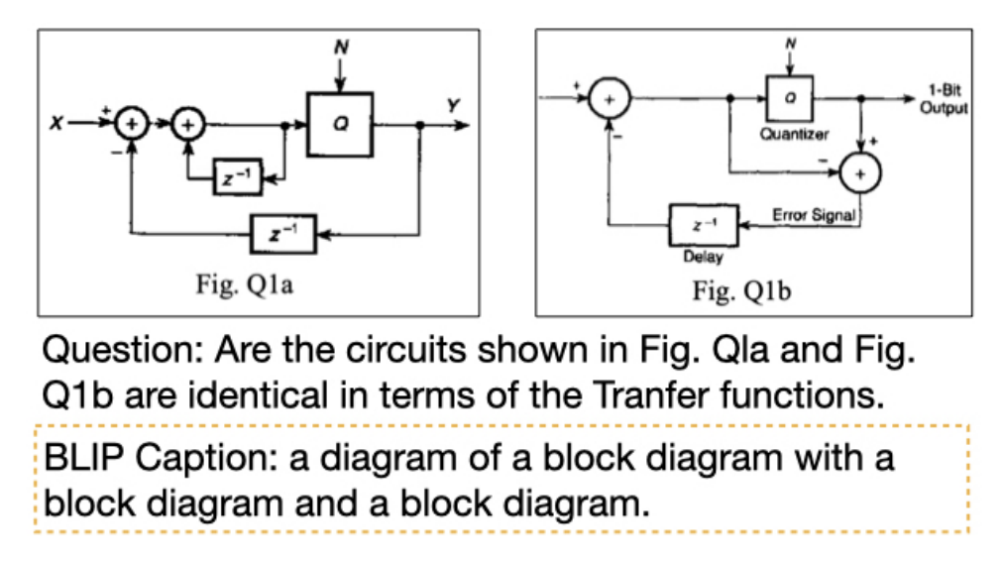
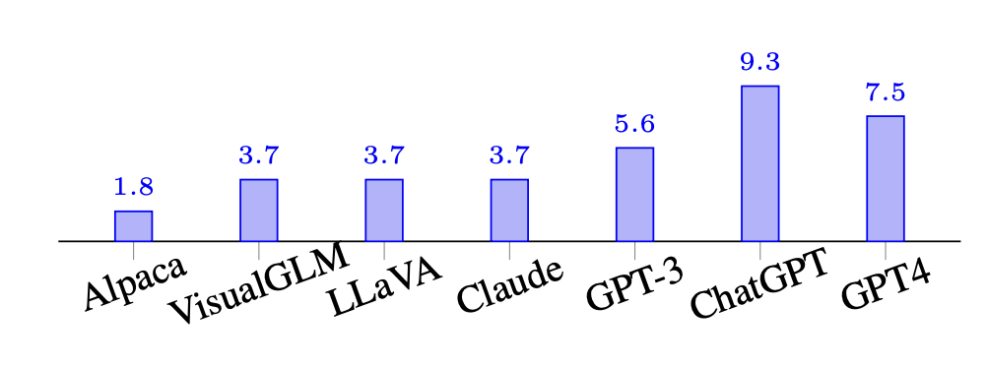
Multimodal Questions
Some questions require reading additional images as condition
We adopt the two strategies
We only provide the image caption as the input
We adopt visual-tuned LLM

Slide 34
Takeaways
GPT-4 is very strong problem solver
50% of its errors are actually minor, which can be easily fixed
Program-of-Thoughts can significantly boost the performance by utilizing Python library as tools
There is a huge moat between GPT-3.5/4 and other models
The multimodal problems are really hard, model can only achieve 10% accuracy

