Slide 1
Reasoning with Foundation Models
TIGER-Lab at University of Waterloo
Speaker: Wenhu Chen

Slide 2
Outline
Scaling Instruction Training Data from the Web.
Towards more robust foundation model benchmarks.
Future Directions

Slide 3
MAmmoTH2: Scaling Instructions from the Web
Xiang Yue, Tuney Zheng, Ge Zhang, Wenhu Chen
[NeurIPS 2024 Dataset Track]

Slide 4
LLM Training Paradigm

Slide 5
Instruction Tuning
Fine-tune on labeled datasets to improve models’ performance on specific tasks.
Pre-trained Language models have been trained extensively to encapsulate strong abilities.
The ability is not being activated for task-solving.

Slide 6
Instruction Tuning as Alignment
A popular view claims that the instruction tuning is only for aligning the model.
Less is More: we can simply adopt a small dataset as few as 3K examples to align LLMs to downstream tasks.
Common Beliefs: Instruction Tuning cannot improve models’ general capabilities.

Slide 7
Exiting Datasets

Slide 8
Can We Escalate Instruction Tuning?
We emphasize both quality and quantity.
Previous work adopts:
Human labels
Augmentation + Verifier
How to ensure quality and quantity?
Mine existing instruction pairs from the web.

Slide 9
Natural Instruction on the Web
Available Resources: Forums, Educational Website, Quiz

Slide 10
How to mine them?
Highly dispersed across the web.
Containing lots of unrelated information.
Missing lots of useful information

Slide 11
Pipeline
Efficient classifier-based recall.
Mine the useful URLs from our own CC.
Group and identify most useful domains.
Web information extraction.
Customized content extraction from raw web page.
Information Completion.
Refine the extracted information from the web with LLMs.

Slide 12
Recall Step
Identifying the seed data we desire.
Curating enough seed data for classifier training.
Train an initial version of classifier.
Recall from the web.
Group URLs based on domain and then use GPT-3.5 to select the most useful domains.
Gather the web page from the useful domains and re-train classifier with larger data.
Recall again from the web.
Group URLs based on domain and then use GPT-4 to select the final documents

Slide 13
Extraction Step
Customized rule-based web parsing for the top domains.
Further utilize LLMs to select the span for instruction and response.
Break down the web page content into instruction pairs.

Slide 14
Refine Step
Utilizing LLMs like Mixtral-22B and Qwen-72B for refining
Refine the content format and remove noise.
Complete the response if it’s missing, especially in educational websites.

Slide 15
Pipeline Example

Slide 16
Top Domains

Slide 17
Domain Type Distribution

Slide 18
Successful Case

Slide 19
Failed Case

Slide 20
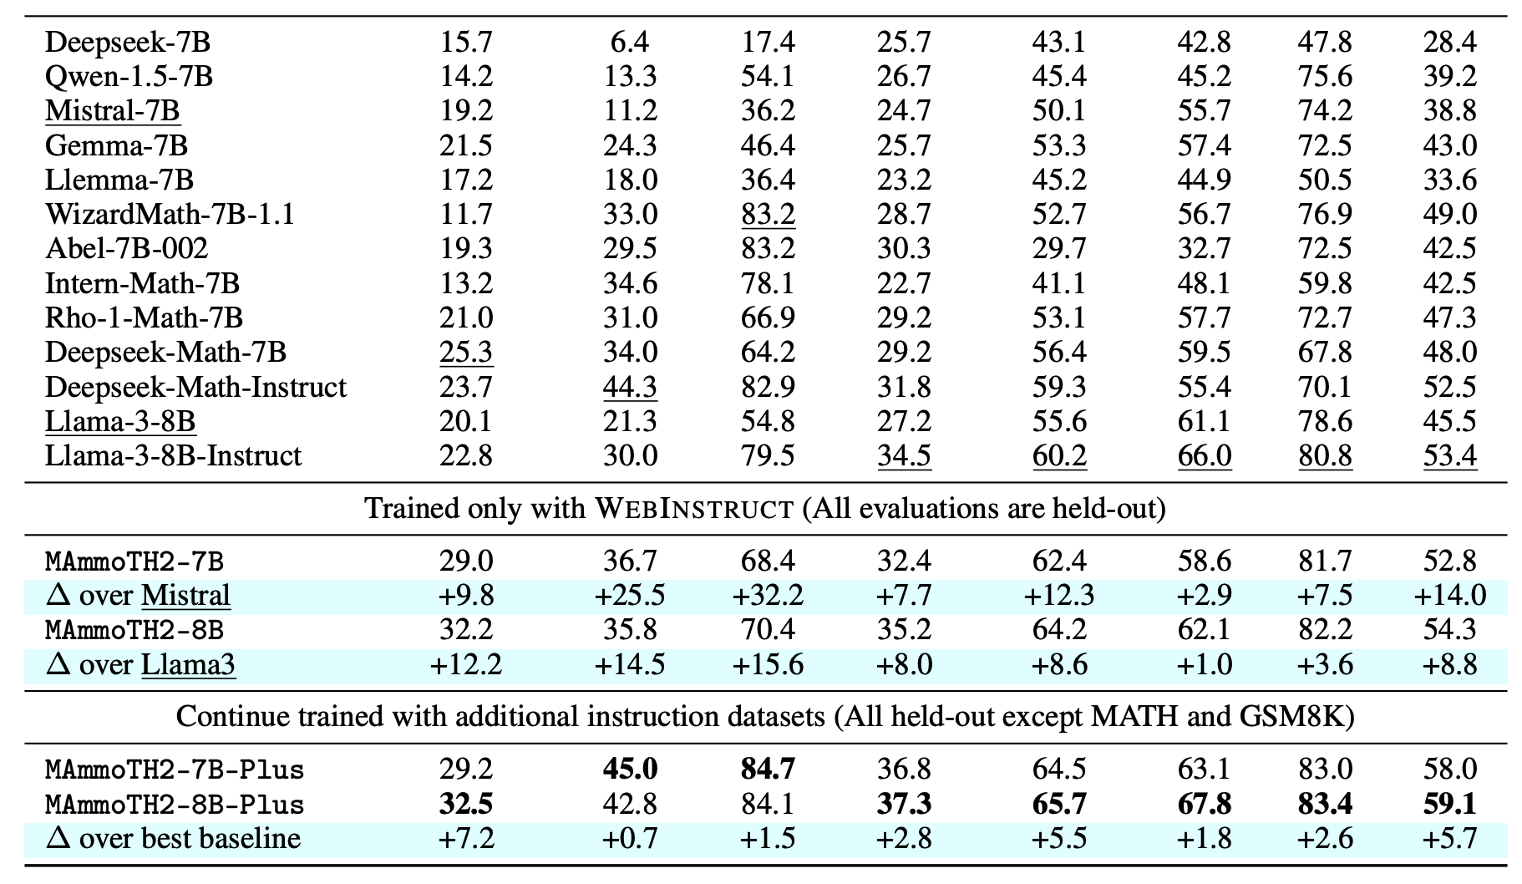
Experimental Results (Reasoning)

Slide 21
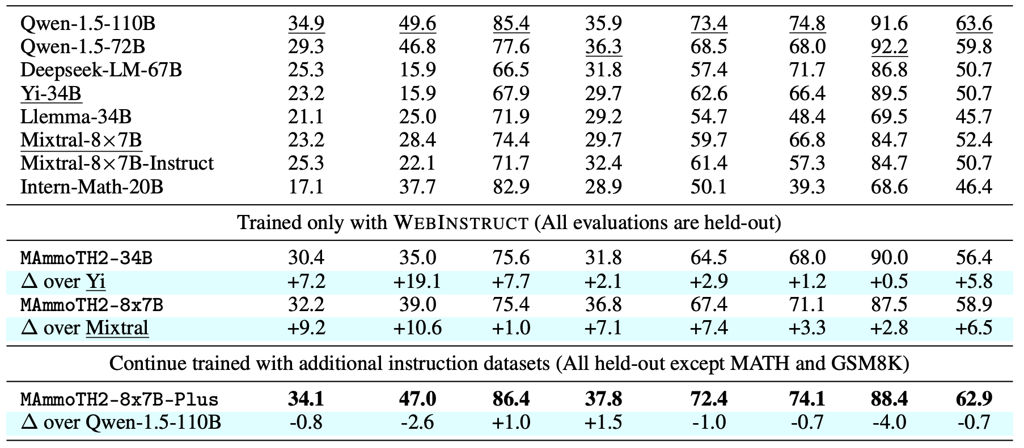
Experimental Results (Reasoning)

Slide 22
Experimental Results (General)

Slide 23
Ablation Studies (Sources)

Slide 24
Ablation Studies (Steps)

Slide 25
Takeaways
Scaling up instruction tuning data is important.
Extraction and Refining are necessary steps to improve perf.
SFT loss is more effective than LM loss.
Utilizing more capable models in the middle could lead to further improvement. However, we don’t have the resources.

Slide 26
MMLU-Pro: A More Robust and Challenging Multi-Task Language Understanding Benchmark
Yubo Wang, Xueguang Ma, Ge Zhang, Yuansheng Ni, Abhranil Chandra, Shiguang Guo, Weiming Ren, Aaran Arulraj, Xuan He, Ziyan Jiang, Tianle Li, Max Ku, Kai Wang, Alex Zhuang, Rongqi Fan, Xiang Yue, Wenhu Chen
[NeurIPS 2024 Dataset Track]

Slide 27
Motivation
Performance saturation (90%+) on MMLU limits differentiation between advanced models
Knowledge-focused questions with 4 options enable shortcut exploitation rather than understanding
Dataset noise creates artificial performance ceiling, reducing benchmark effectiveness

Slide 28
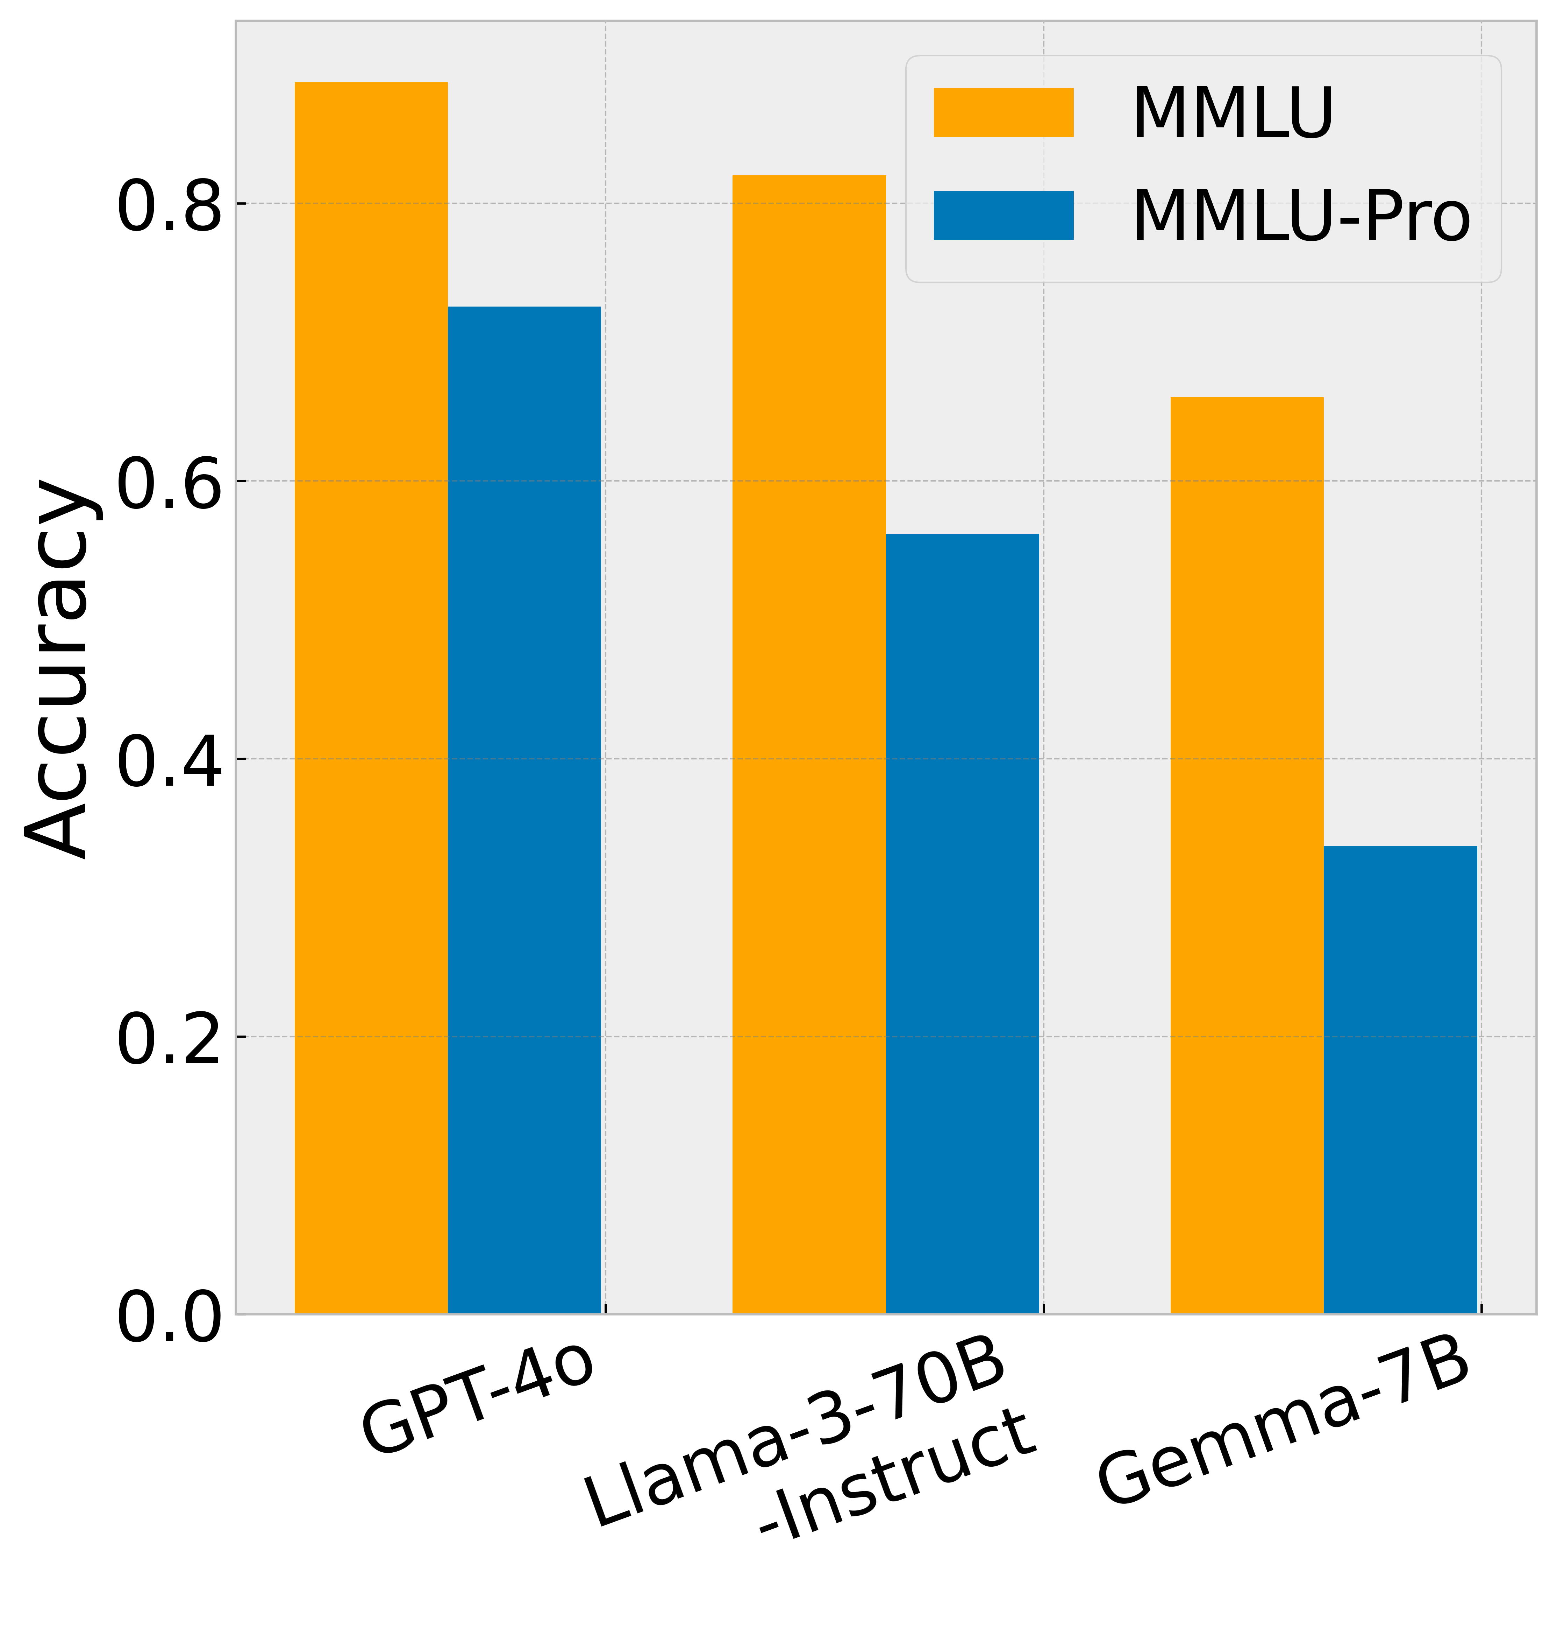
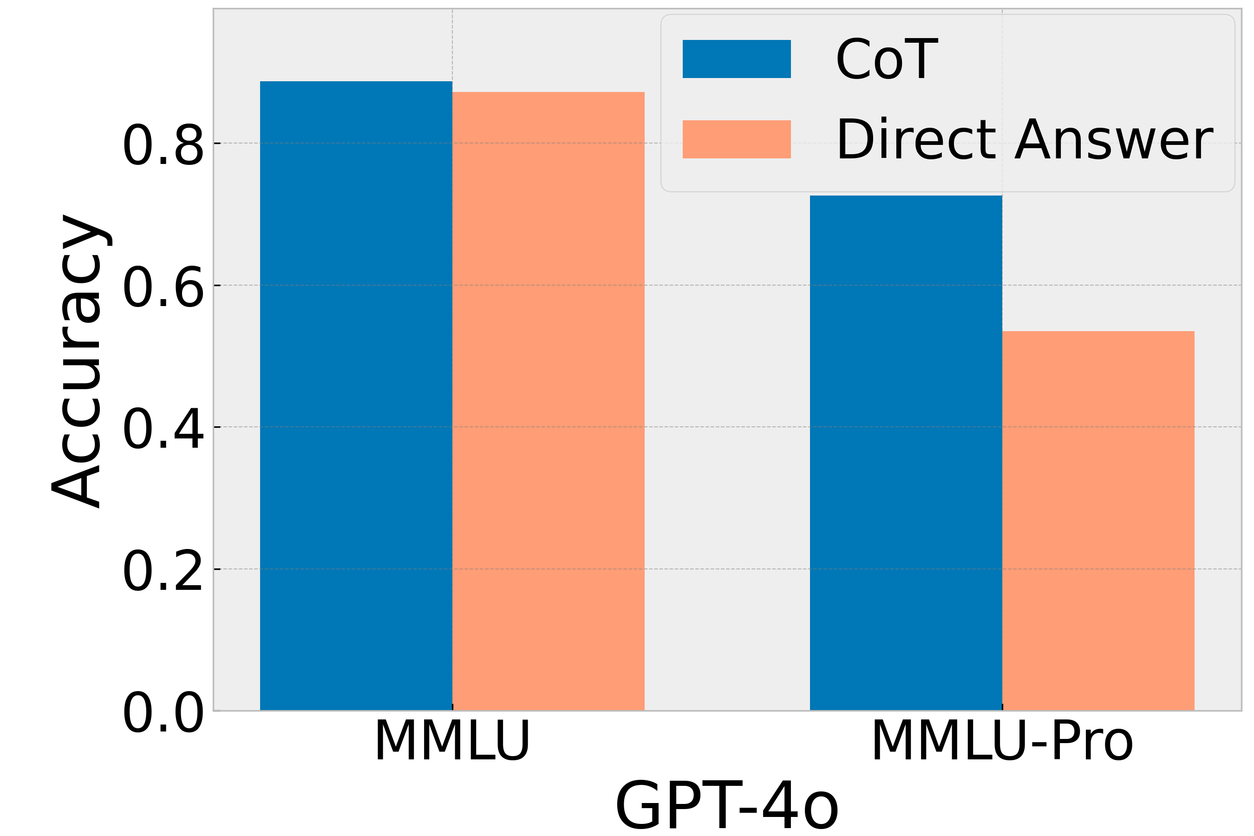
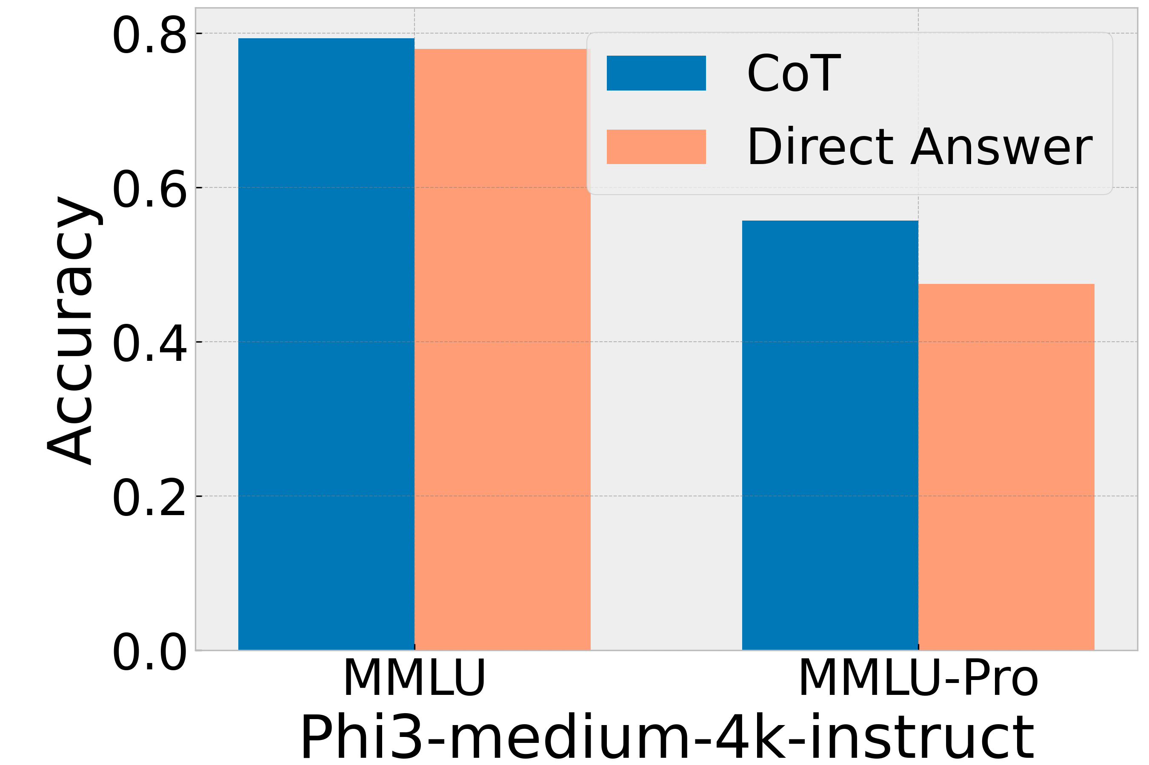
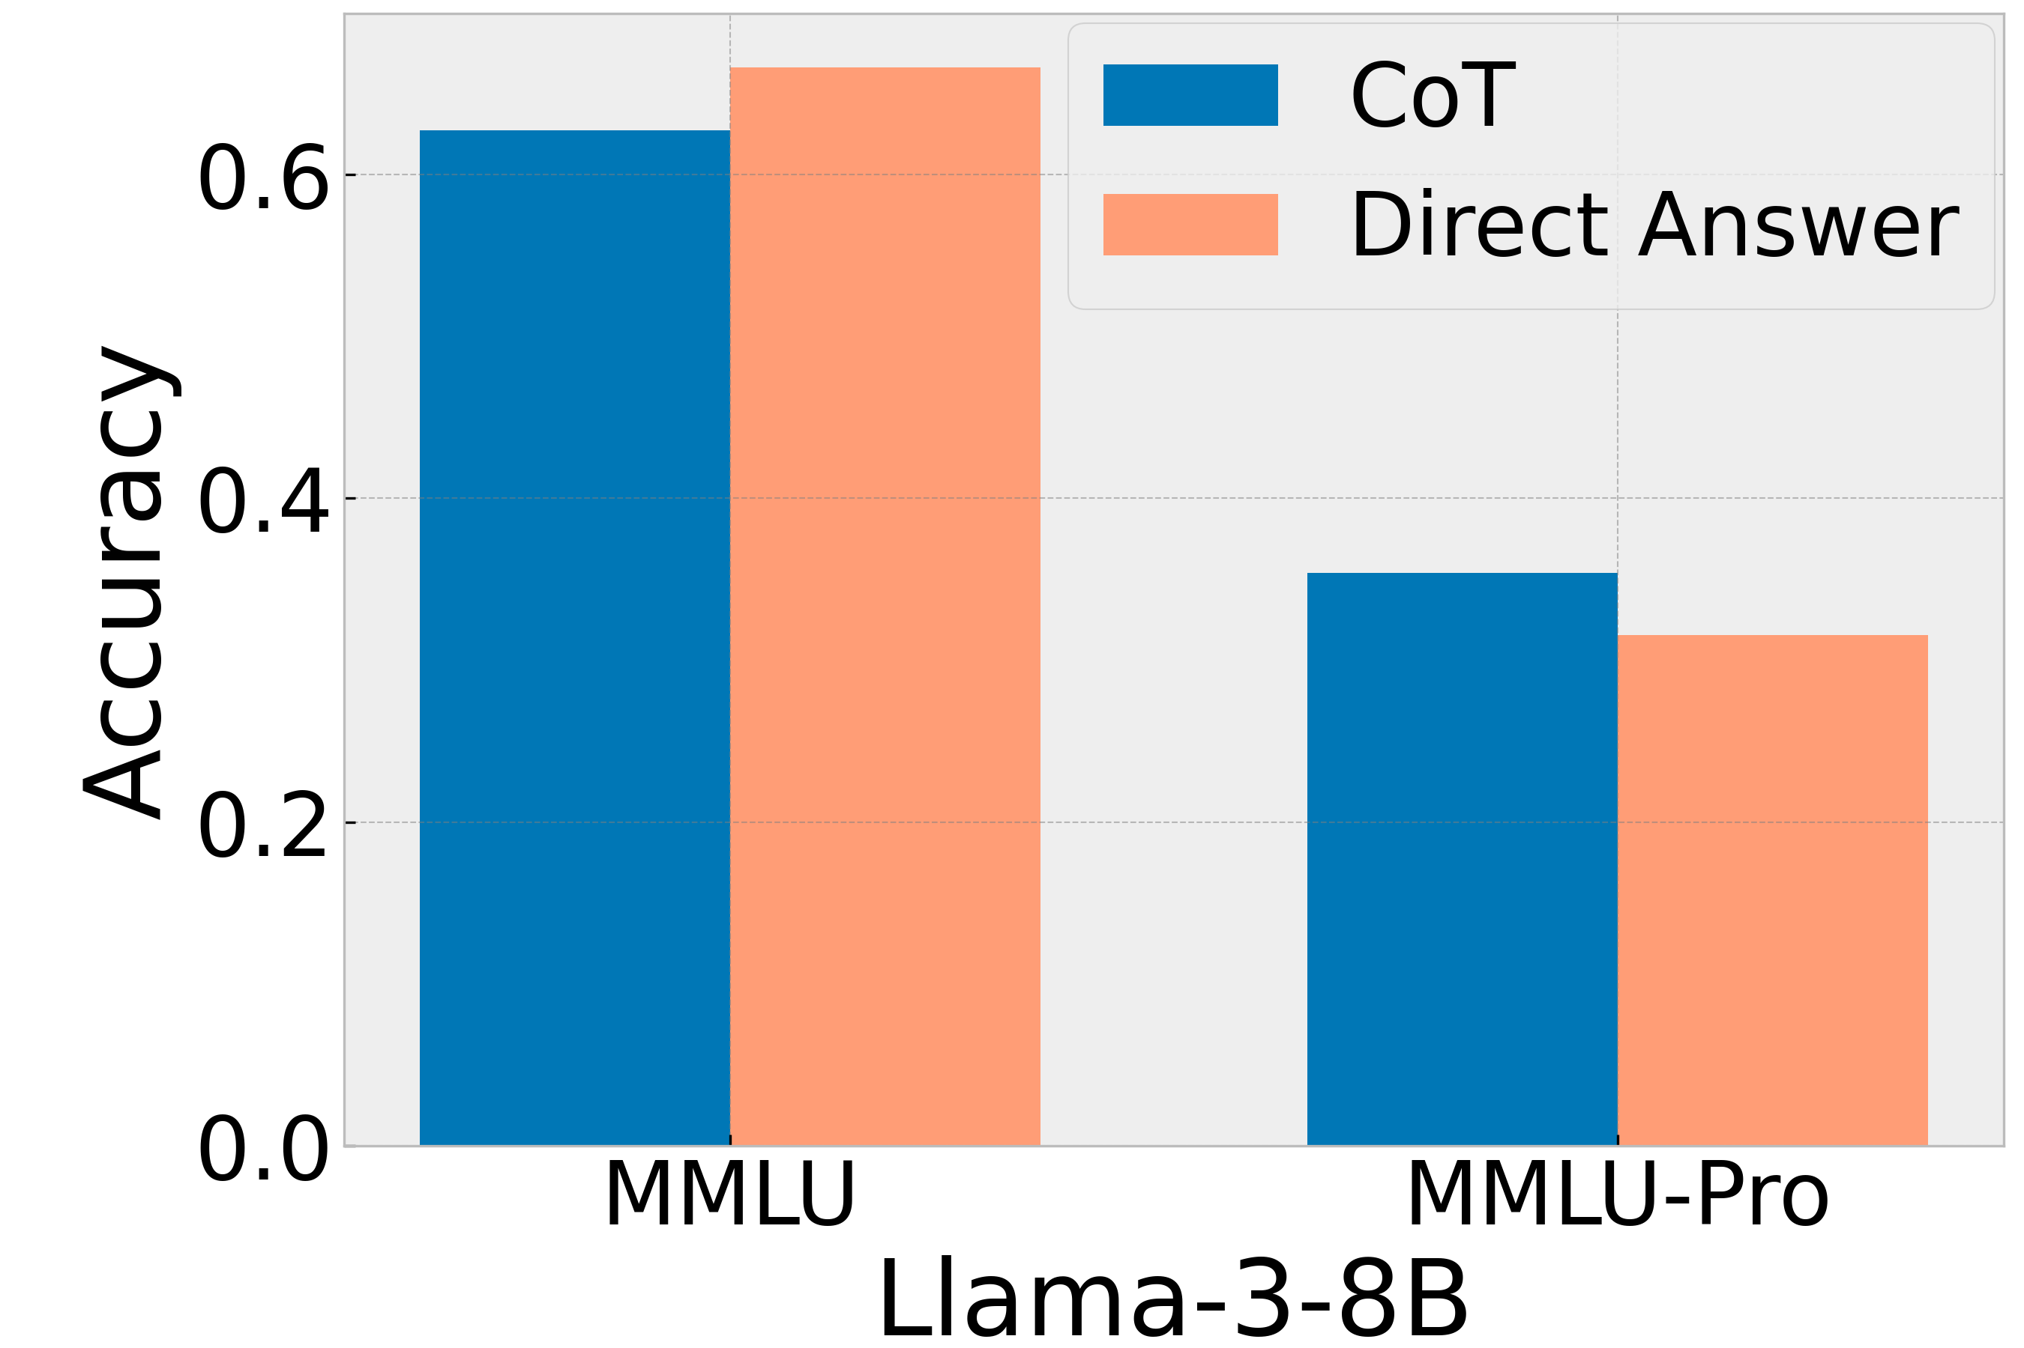
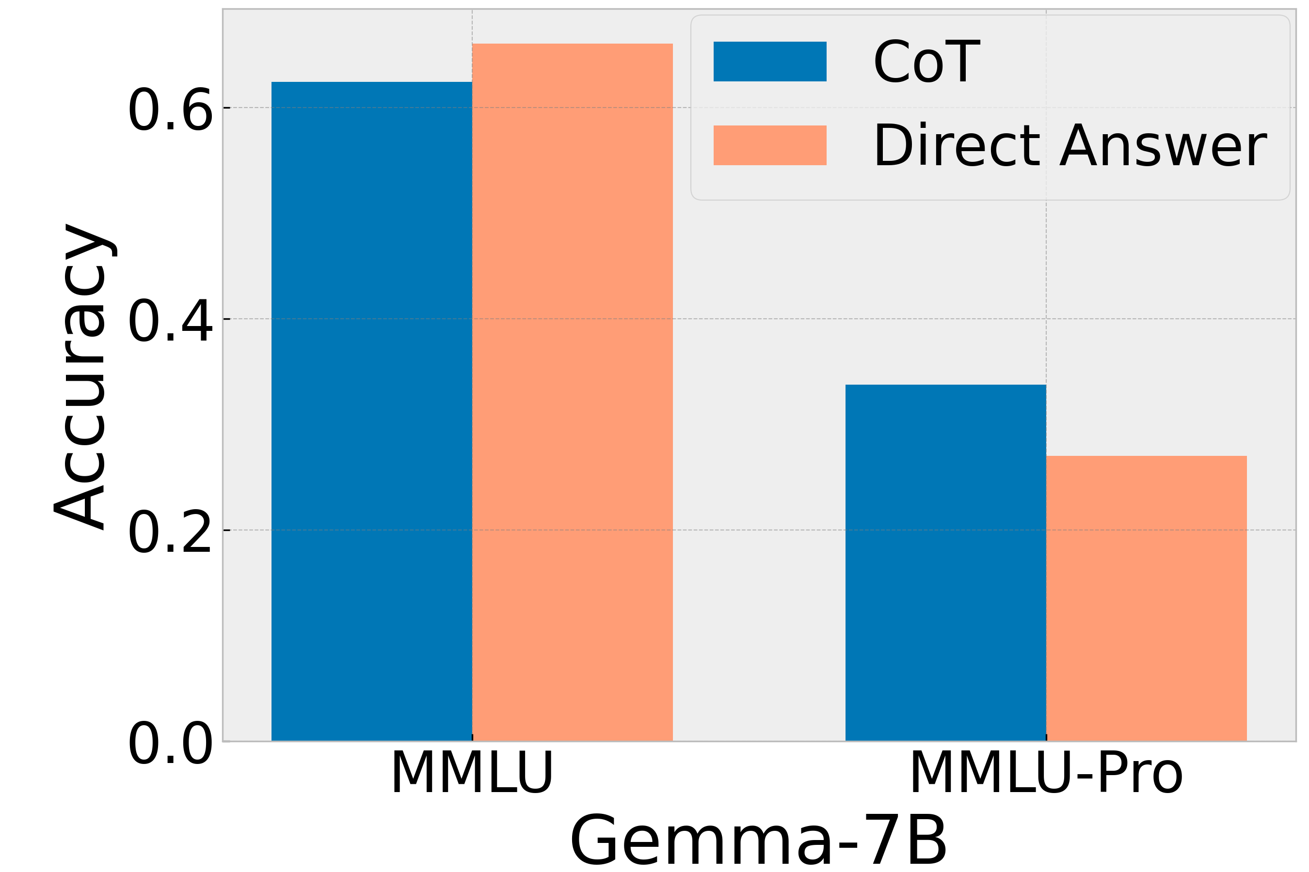
Key Differences from MMLU:
Expanded answer choices from 4 to 10 options, reducing random guess probability from 25% to 10%
Higher robustness to prompt variations, with sensitivity reduced from 4-5% (MMLU) to 2% (MMLU-Pro)
Enhanced focus on reasoning over knowledge-based questions, evidenced by 20% improvement with CoT reasoning

Slide 29
Dataset Construction
Initial Filtering
Question Collection
Option Augmentation
Expert Review
Notes:
Initial Filtering: Comprehensive review of original MMLU dataset to retain only high-quality, challenging questions.
Question Collection: Selected complex problems from STEM websites, TheoremQA, and SciBench, focusing on analytical reasoning capabilities.
Option Augmentation: Used GPT-4 to expand answer choices from 4 to 10 options, creating plausible distractors that require careful reasoning.
Expert Review: A panel of experts verified question quality, ensuring each item is challenging, comprehensive, and accurate for benchmarking.

Slide 30
Data Source
The dataset consolidates questions from several sources:
Original MMLU Questions: Part of the dataset comes from the original MMLU dataset. We remove the trivial and ambiguous questions.
STEM Website: Hand-picking high-quality STEM problems from the Internet.
TheoremQA: A high-quality collection of human-annotated questions specifically requiring theorem application to solve.
SciBench: Science questions from college exams.

Slide 31
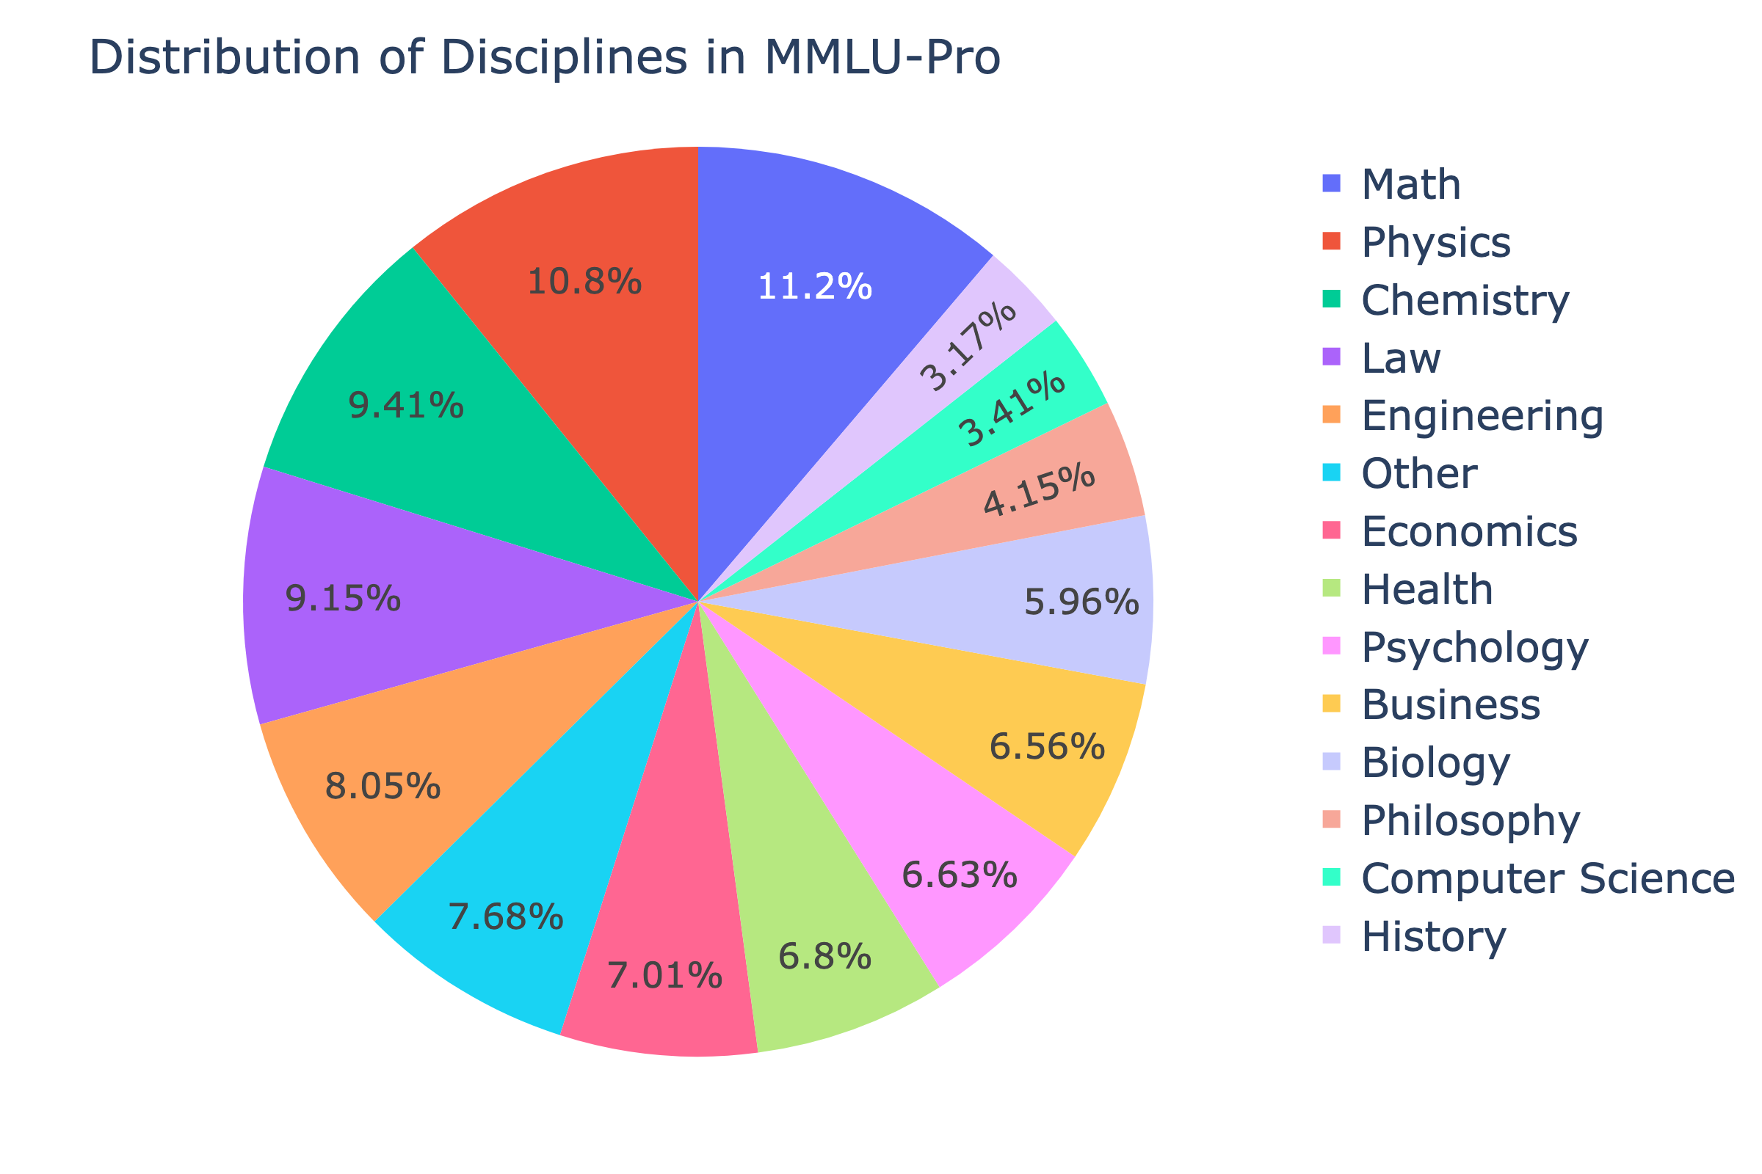
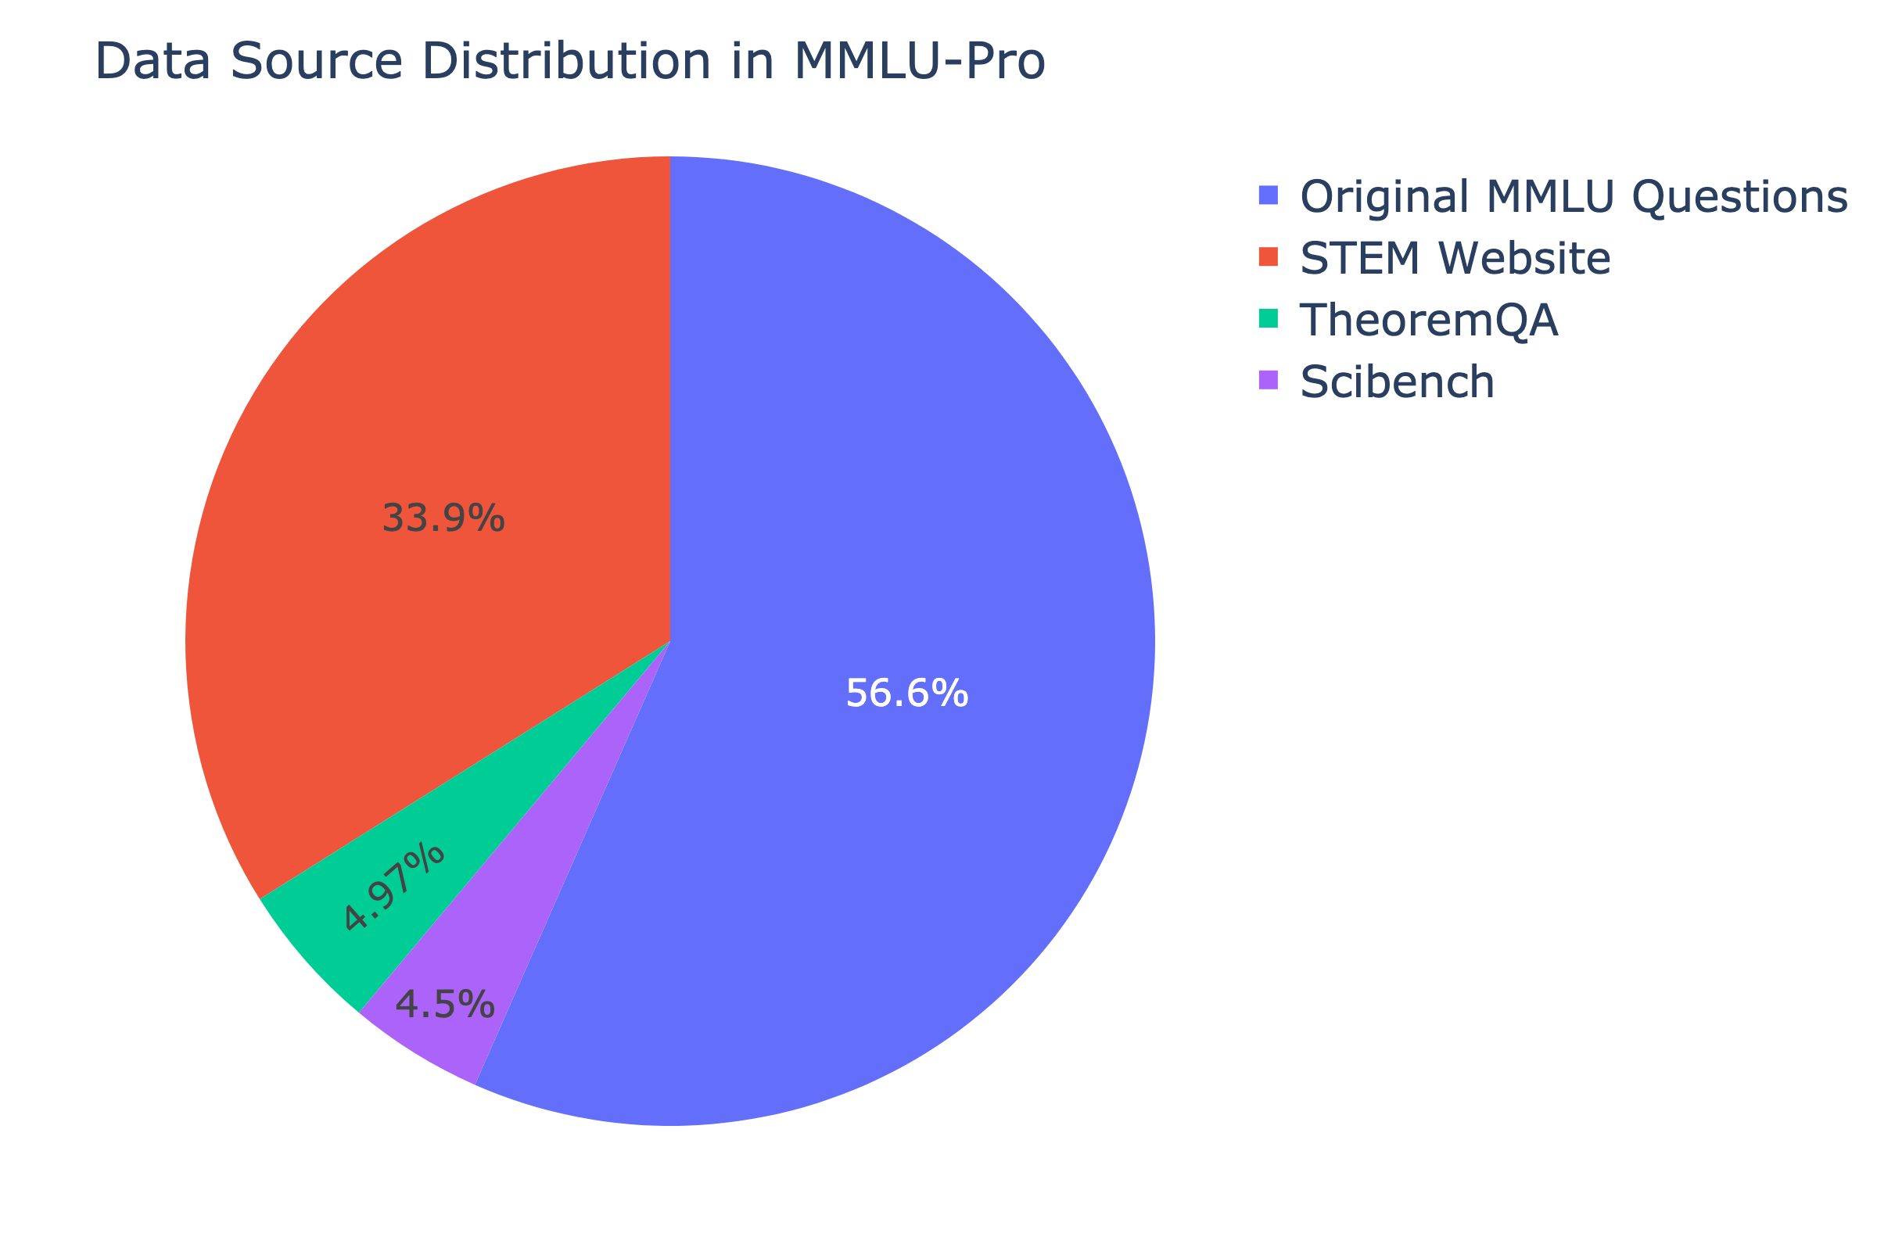
Data Distribution
Discipline | Number of Questions | From Original MMLU | Newly Added
Math | 1351 | 846 | 505
Physics | 1299 | 411 | 888
Chemistry | 1132 | 178 | 954
Law | 1101 | 1101 | 0
Engineering | 969 | 67 | 902
Other | 924 | 924 | 0
Economics | 844 | 444 | 400
Health | 818 | 818 | 0
Psychology | 798 | 493 | 305
Business | 789 | 155 | 634
Biology | 717 | 219 | 498
Philosophy | 499 | 499 | 0
Computer Science | 410 | 274 | 136
History | 381 | 381 | 0
Total | 12032 | 6810 | 5222

Slide 32
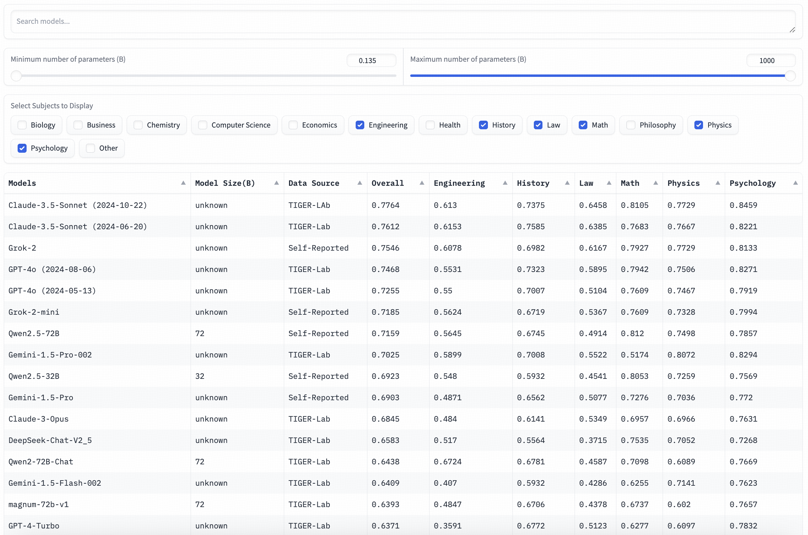
Leaderboard
Platform & Scale
Hosted on Hugging Face Space
Features 100+ popular models
Includes both open-source and closed-source models
Model Coverage
Open-source models: 135M - 399B parameters
Features
Search by model name
Filter by parameter count and subject areas

Slide 33
Analysis
1. Difficulty Level
2. Reasoning Level
3. Robustness Degree

Slide 34
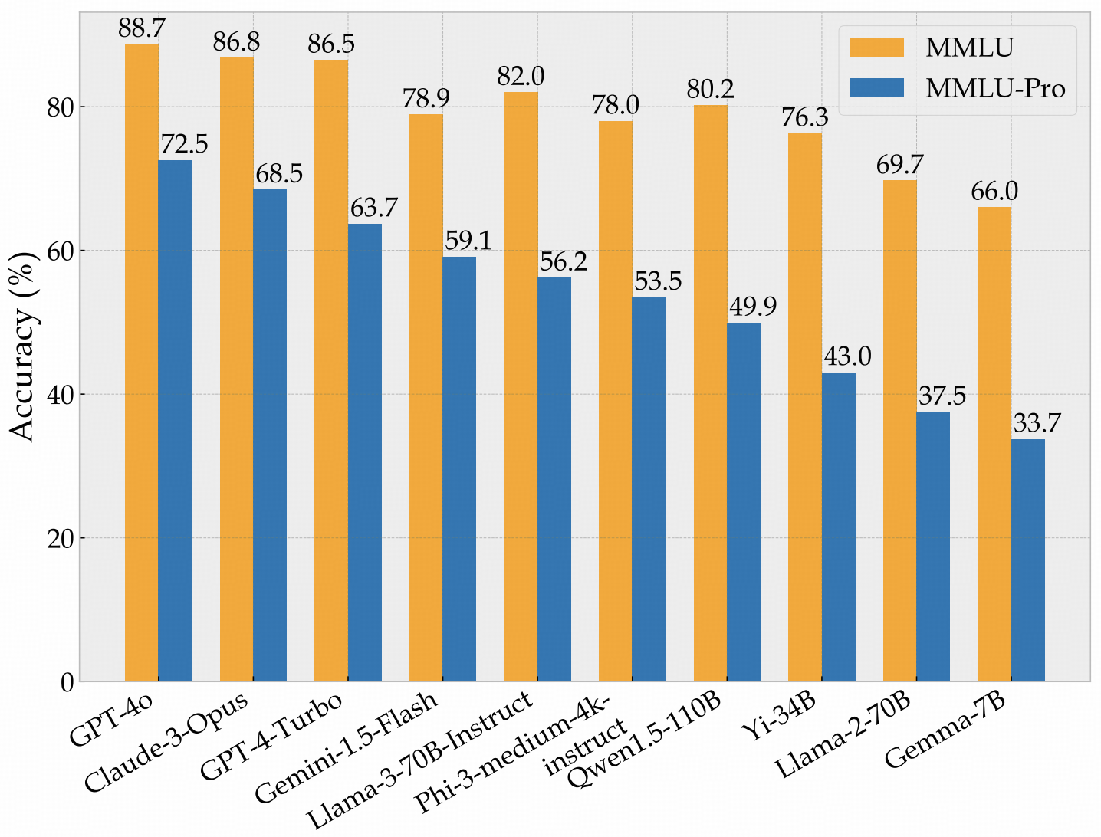
Analysis 1: Difficulty Level
MMLU vs MMLU-Pro Model Performance Analysis
Score Clustering in MMLU
Better Differentiation
Room for Improvement
Notes:
MMLU vs MMLU-Pro Model Performance Analysis
1. Score Clustering in MMLU
Recent models (Gemini-1.5-Flash, Llama-3-70B, etc.) cluster within 78-82%
Only 4% range difference makes model comparison difficult
2. Better Differentiation in MMLU-Pro
Expands performance range to ~10%
Leading models (GPT-4o, Claude-3-Opus, GPT-4-Turbo) show 9% difference vs 2% in MMLU
3. Room for Improvement
MMLU: 11.3% improvement margin left
MMLU-Pro: 27.4% improvement margin left (with GPT-4o at 72.6%)

Slide 35
Analysis 2: Reasoning Level
CoT vs Direct Answering: Performance Analysis
Overall Performance Trend
Model-Specific Improvements
Key Implications
Notes:
CoT vs Direct Answering: Performance Analysis
1. Overall Performance Trend
Chain of Thought (CoT) shows greater improvements on MMLU-Pro compared to MMLU
Demonstrates MMLU-Pro's focus on complex reasoning skills
2. Model-Specific Improvements
GPT-4o: +1.5% on MMLU vs +19.1% on MMLU-Pro
GPT-4-Turbo: -0.2% on MMLU vs +15.3% on MMLU-Pro
Similar trends observed in other models (Phi3, Llama-3-8B, Gemma-7B)
3. Key Implications
MMLU-Pro effectively tests deeper reasoning capabilities
CoT's success indicates benchmark's alignment with professional-level problem-solving

Slide 36
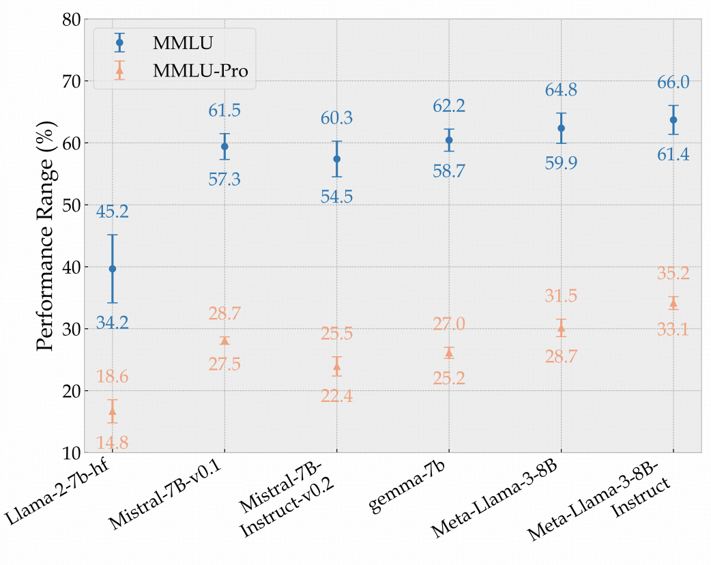
Analysis 3: Robustness Degree
Tested using 24 different reasonable prompts
Benchmark Comparison
MMLU:
General variation: 4-5%
Maximum variation: 10.98%
MMLU-Pro:
General variation: ~2%
Maximum variation: 3.74%
Performance Variability under Different Prompts on MMLU and MMLU-Pro

Slide 37
GPT-4o Error Analysis on MMLU-Pro
Methodology
Analysis of 120 randomly selected errors
Evaluated by expert annotators
Reasoning Errors: 39%
Logical inconsistencies
Pattern recognition vs true understanding
Knowledge Gaps: 35%
Lack of specialized domain knowledge
Issues with technical applications
Calculation Errors: 12%
Correct formulas but wrong computations

Slide 38
What would the future AI look like?

Slide 39
What would the future AI look like?

Slide 40
What’s new?
Most of the information will feed in the model in the form of perception instead of text.
Images
Videos
Audios
How to deal with the really long context in multimodal models?
Self-attention with 10M tokens?
More efficient architecture?

Slide 41
Ongoing Projects
Building hybrid CNN-Transformer or Mamba-Transformer models to process very long input information.
Building efficient token selection (KV sparsification) mechanism to deal with super long inputs.
Building “Scaling up multimodal reasoning dataset”.

Slide 42
Ongoing Projects
Computer Agent for Information Seeking Queries.
Manipulate cursors to seek information
Search for information in multimodality
Text-to-Video Generation
Better quantization Mechanism
Acceleration with Distillation

