Slide 1
Harnessing Large LMs for Complex Math Reasoning
Speaker: Wenhu Chen

Slide 2
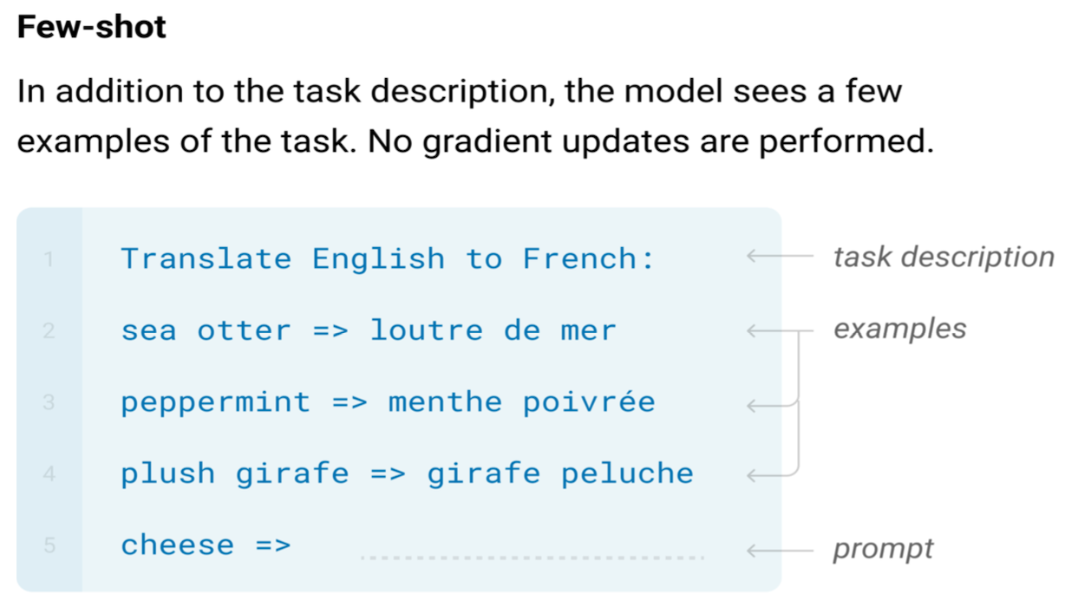
Large Language Models

Slide 3
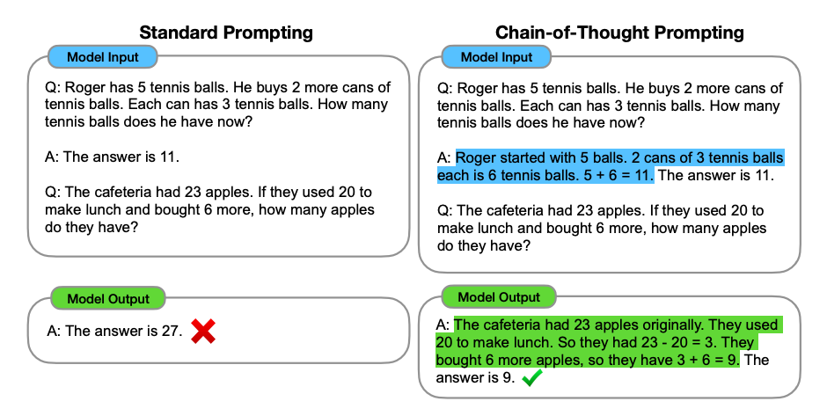
Large Language Models

Slide 4
Pros/Cons of Chain of Thoughts
Pros of CoT
Scratchpad: allows the model to output intermediate results to derive the results step by step.
Flexibility: applicability to any reasoning task.
Cons of CoT
Not able to interact with the external world.
Lacking the ability to utilize tools.
The generated intermediate reasoning steps could be unreliable.

Slide 5
Program of Thoughts Prompting: Disentangling Computation from Reasoning for Numerical Reasoning Tasks
Wenhu Chen, Xueguang Ma, Xinyi Wang, William Cohen
https://arxiv.org/abs/2211.12588 (TMLR 2023)

Slide 6
Chain of Thoughts in LLM
Relying on natural language to solve tasks.
Computation and Reasoning are both expressed in NL.
Some symbolic operations are too complex to be expressed with NL.
Let’s take a look at some cases.

Slide 7
Is NL the best reasoning means?
In Fibonacci sequence, it follows the rule that each number is equal to the sum of the preceding two numbers, what is the 50th number in Fibonacci sequence?
The first number is 0, the second number is 1, therefore, the third number is 0+1=1. The fourth number is 1+1=2. The fifth number is 1+2=3. The sixth number is 2+3=5. The seventh number is 3+5=8. The eighth number is 5+8=13.
..... (Skip 1000 tokens)
The 50th number is 32,432,268,459.

Slide 8
What about Programs as Thought?
In Fibonacci sequence, it follows the rule that each number is equal to the sum of the preceding two numbers, what is the 50th number in Fibonacci sequence?
length = 50
fibonacci = np.zeros(length)
fibonacci[0] =0
fibonacci[1] = 1
for i in range(3, length):
fibonacci[i] = fibonacci[i-1] + fibonacci[i-2]
return fibonacci[-1]
Concise
Accurate

Slide 9
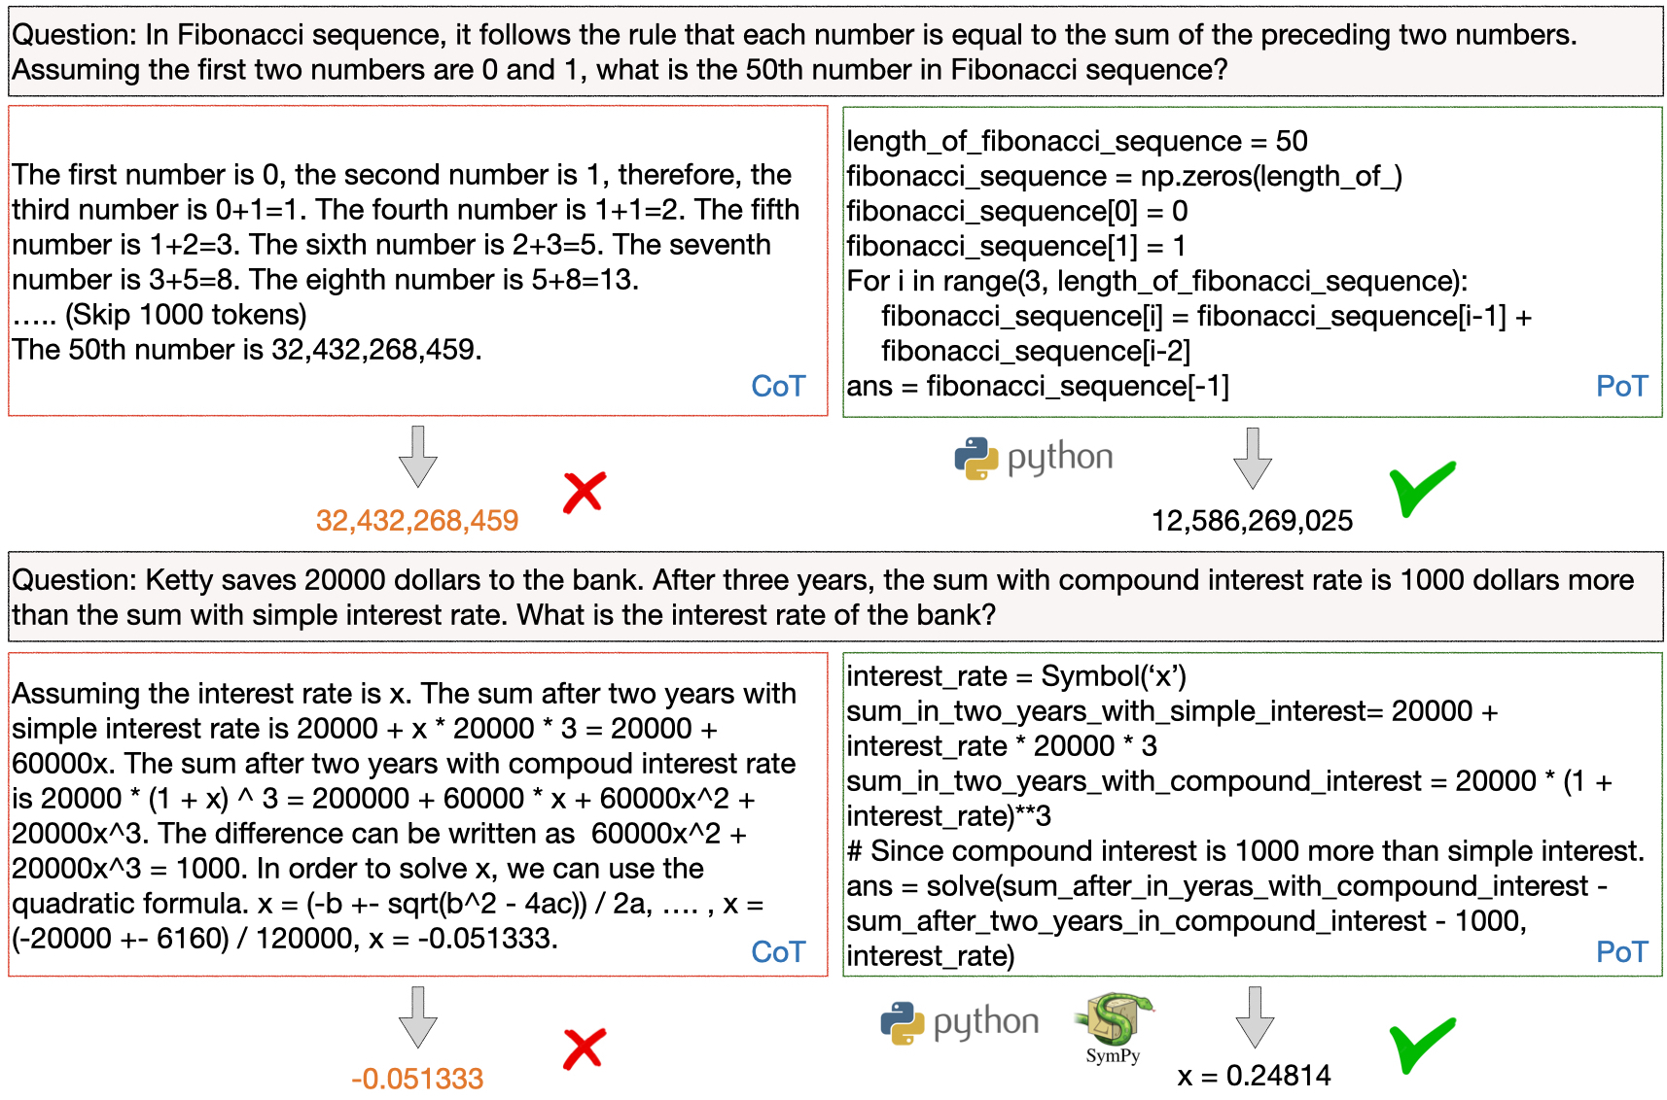
Program of Thoughts

Slide 10
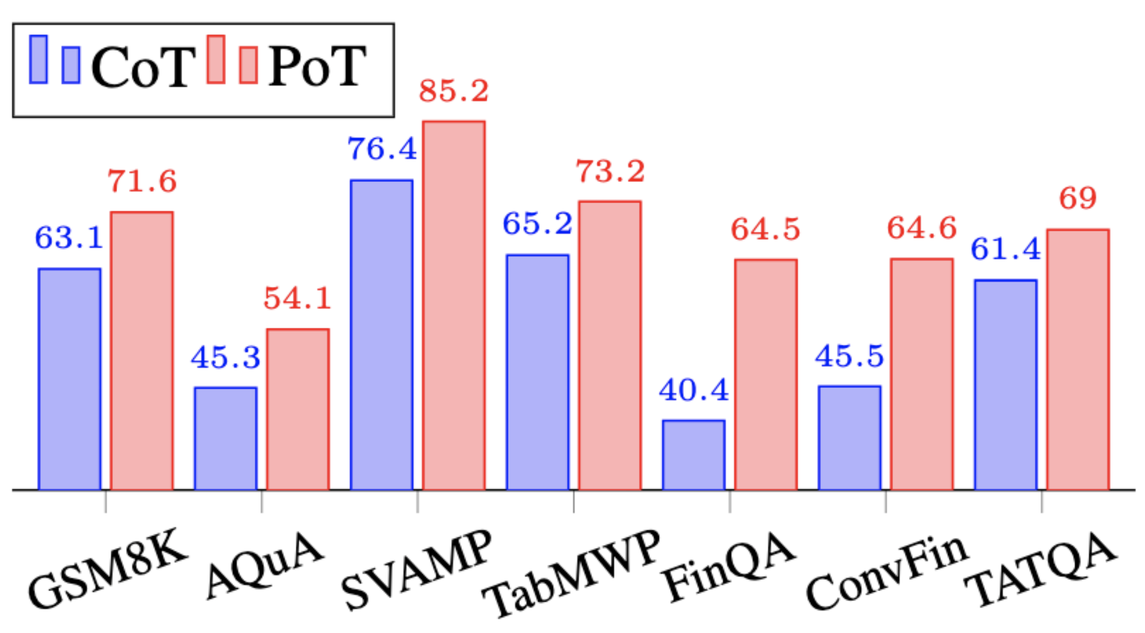
Few-Shot Results on Math Problem Dataset

Slide 11
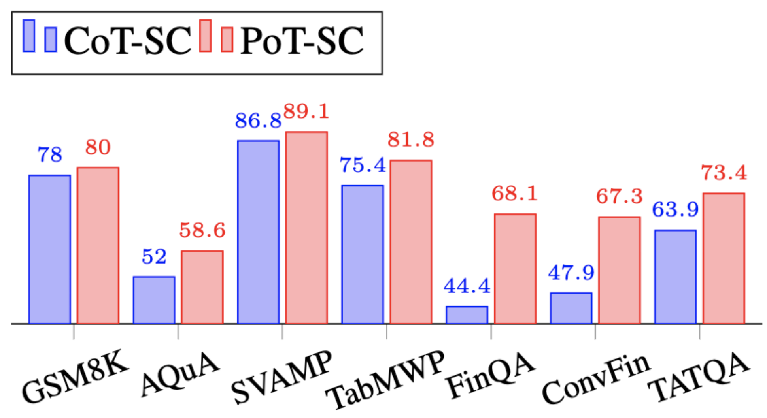
Few-Shot (SC) Results on Math Problem Dataset

Slide 12
Zero-Shot Evaluation

Slide 13
Zero-Shot Results on Math Problem Dataset

Slide 14
Ablation Studies
Meaningful Binding
length = 50
fibonacci = np.zeros(length)
fibonacci[0] =0
fibonacci[1] = 1
for i in range(2, length):
fibonacci[i] = fibonacci[i-1] + fibonacci[i-2]
return fibonacci[-1]
No Binding
x0 = 0
x1 = 1
for _ in range(2, 50):
tmp = x0 + x1
x0 = x1
x1 = tmp
return x1

Slide 15
Takeaways
Program-of-thoughts can disentangle the computation process from the reasoning process, where the computation is done via executor.
Such disentanglement can significantly boost the performance.
Program-of-Thoughts achieve state-of-the-art performance on all of the evaluated math QA datasets.

Slide 16
TheoremQA: A Theorem-driven Question Answering dataset
Wenhu Chen, Ming Yin, Max Ku, Elaine Wan, Xueguang Ma, Jianyu Xu, Tony Xia, Xinyi Wang, Pan Lu
https://arxiv.org/abs/2305.12524 (EMNLP 2023)

Slide 17
Existing Math Dataset

Slide 18
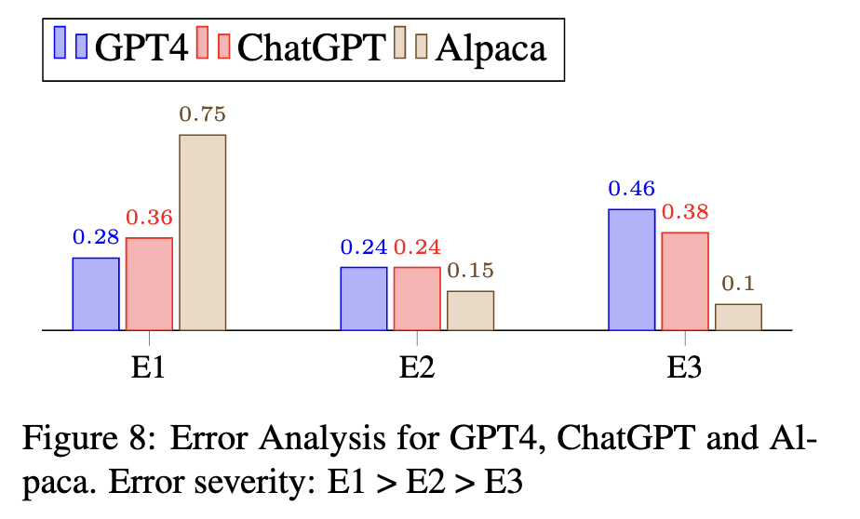
Error Analysis
E1: model does not even know the theorem
E2: model know the theorem, but use the wrong formula/algorithm
E3: model only makes minor calculation mistake

Slide 19
Performance of PoT w/ GPT-4

Slide 20
What’s Next?
GPT-4 with Program-of-Thoughts can further improve the performance of most datasets to 90%+ under zero-shot setting.
Does it mean we already solve math reasoning?
No, the caveat is that these datasets are grade-school math problems, which only requires simple arithmetic operations.
More complex computation like integration, or matrix multiplication is still not covered in these datasets.
We are working on collecting a more university-level science QA dataset to test LLMs’ capabilities to use theorems to solve problems.

Slide 21
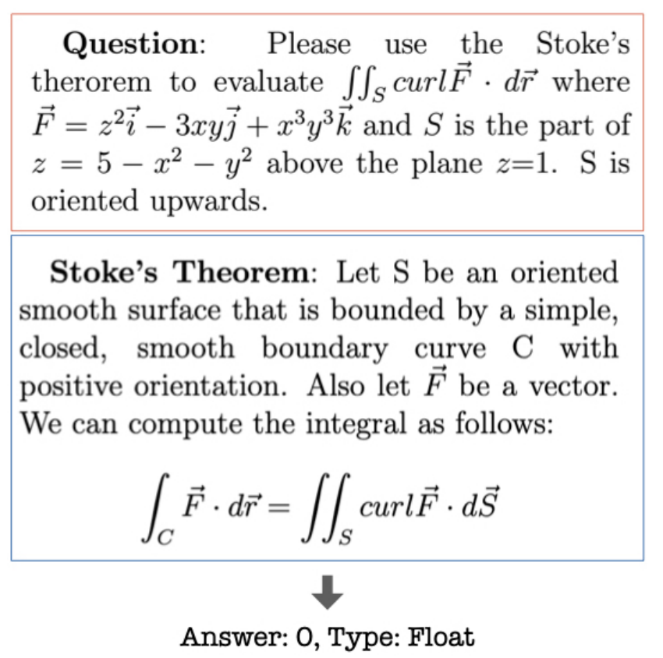
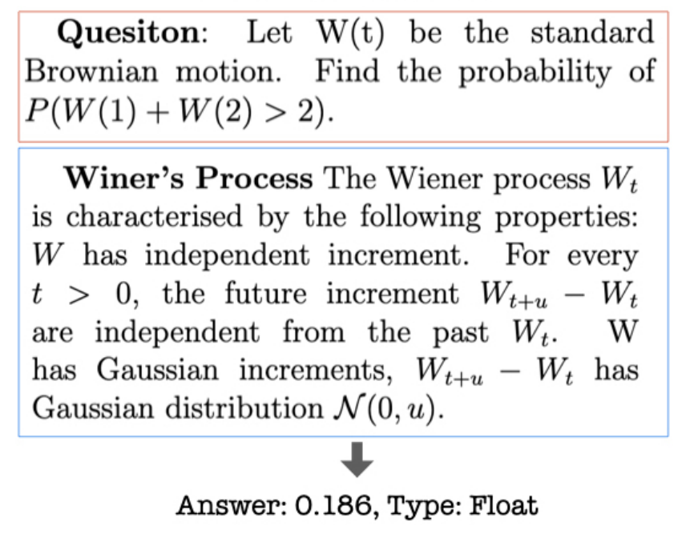
More challenging Math Questions

Slide 22
Question Annotation
Collecting Theorems
Prompting LLMs to enumerate theorems
Expert Complementing theorems
Theorem-driven Question Seeking
We feed the theorem as keyword to search the web to find related questions.
We search for related sections in textbooks to find questions
Answer Type
We consider the following answer types: number, list, bool, option
We will rewrite the question if it doesn’t fit into these types.
If the original question asks about “matrix”, we change to “trace of matrix”

Slide 23
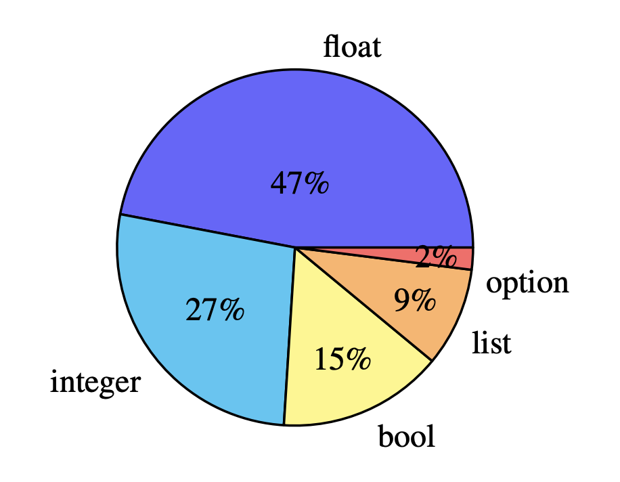
Dataset Overview
We cover 800 questions
442 Math, 146 CS&EE, 131 Physics, 81 Finance
199 Math, 48 CS&EE, 52 Physics, 55 Finance theorem
Answer Distribution:

Slide 24
Theorem Overview

Slide 25
Method
Models
GPT-*, Claude, Alpaca/Vicuna/OpenAssistant/MOSS/StarChat/T5Coder+
Prompt
Chain of Thoughts Prompting
Few-shot for base models
Zero-shot for instruction-tuned models
Program of Thoughts:
Few-shot for base models
Zero-shot for instruction-tuned models

Slide 26
Experimental Results

Slide 27
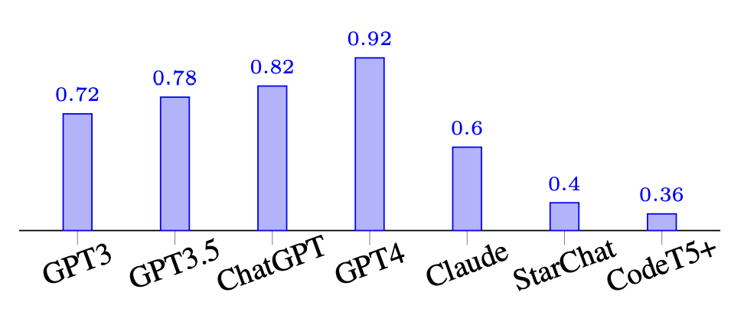
Executability of Programs (PoT)
We evaluate how much of the generated programs from different models are actually executable
Results:

Slide 28
Case Studies

Slide 29
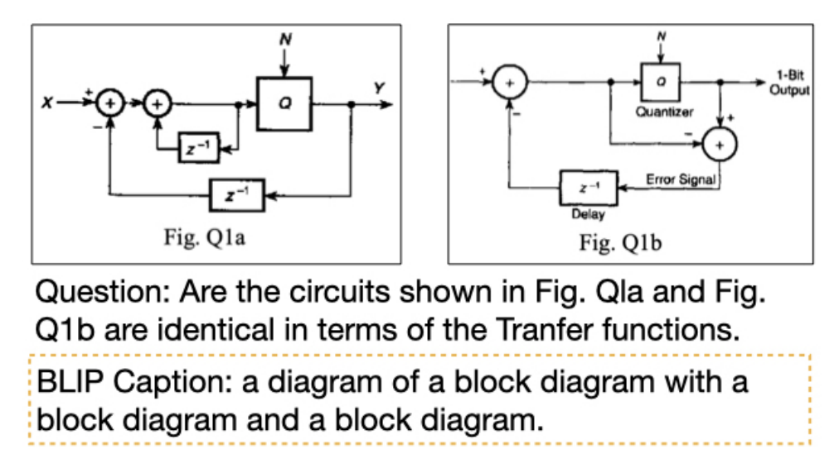
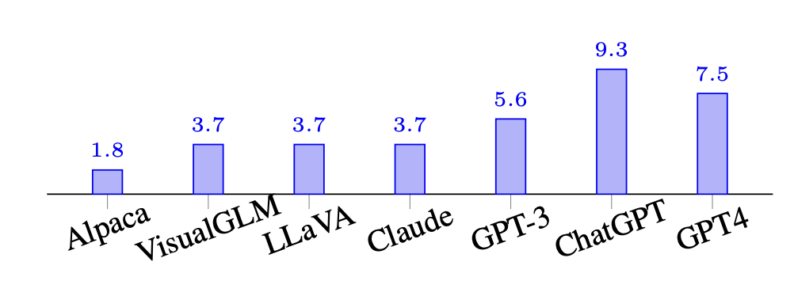
Multimodal Questions
Some questions require reading additional images as condition
We adopt the two strategies
We only provide the image caption as the input
We adopt visual-tuned LLM

Slide 30
Takeaways
GPT-4 is very strong problem solver
50% of its errors are actually minor, which can be easily fixed
Program-of-Thoughts can significantly boost the performance by utilizing Python library as tools
There is a huge moat between GPT-3.5/4 and other models
The multimodal problems are really hard, model can only achieve 10% accuracy

Slide 31
MAmmoTH: Building Math Generalist Models through Hybrid Instruction Tuning
Xiang Yue*, Xingwei Qu, Ge Zhang, Yao Fu, Wenhao Huang, Huan Sun, Yu Su, Wenhu Chen*
https://arxiv.org/abs/2309.05653 (Manuscript)

Slide 32
Open-Sourced Models in MathQA
Open-sourced models are significantly lagging behind in chain-of-thought prompting.
Open-sourced models cannot even perform program-of-thought prompting.

Slide 33
Potential Solutions
MINERVA and Galactica
Continue pre-training on 100B+ tokens crawled from the open web containing enough math and science corpus.
Expensive and time-consuming.
Task-specific tuning
Continue training on a specific mathQA dataset like GSM/MATH to increase its performance on the given datasets.
Task specific and cannot generalize well.

Slide 34
Hybrid Instruction Tuning
Instruction tuning.
Compiling a reasonable amount of training set.
Diversified enough to help the model generalize to unseen tasks.
Computationally economical
Hybrid CoT & PoT
Combining both CoT and PoT rationale data
Assemble both rationale to activate models’ capability in both aspects

Slide 35
Hybrid Instruction Tuning
The trained model is capable to perform both PoT and CoT prompting

Slide 36
Hybrid Decoding
MAmmoTH uses PoT to generate program p
Execute p -> output
If output == None:
MAmmoTH uses CoT to generate rationale c
Extract answer from c, Return Answer
Else:
Return Answer

Slide 37
Training Dataset Analysis

Slide 38
Evaluation Dataset Analysis

Slide 39
Experimental Results (7B Scale Held-in)

Slide 40
Experimental Results (30B Scale Held-in)

Slide 41
Experimental Results (7B Scale Held-out)

Slide 42
Experimental Results (30B Scale Held-out)

Slide 43
Ablation Study

Slide 44
Takeaways
Open-sourced models are actually very strong math problem solver, however, their problem-solving capability needs to be activated.
Open-sourced models can also do PoT prompting and achieve very strong performance on mathQA datasets
Hybrid CoT and PoT training can lead to mutual benefits. The performance can improve over CoT-only or PoT-only.

