Slide 1
The Frontier of Multimodal Reasoning
Speaker: Wenhu Chen

Slide 2
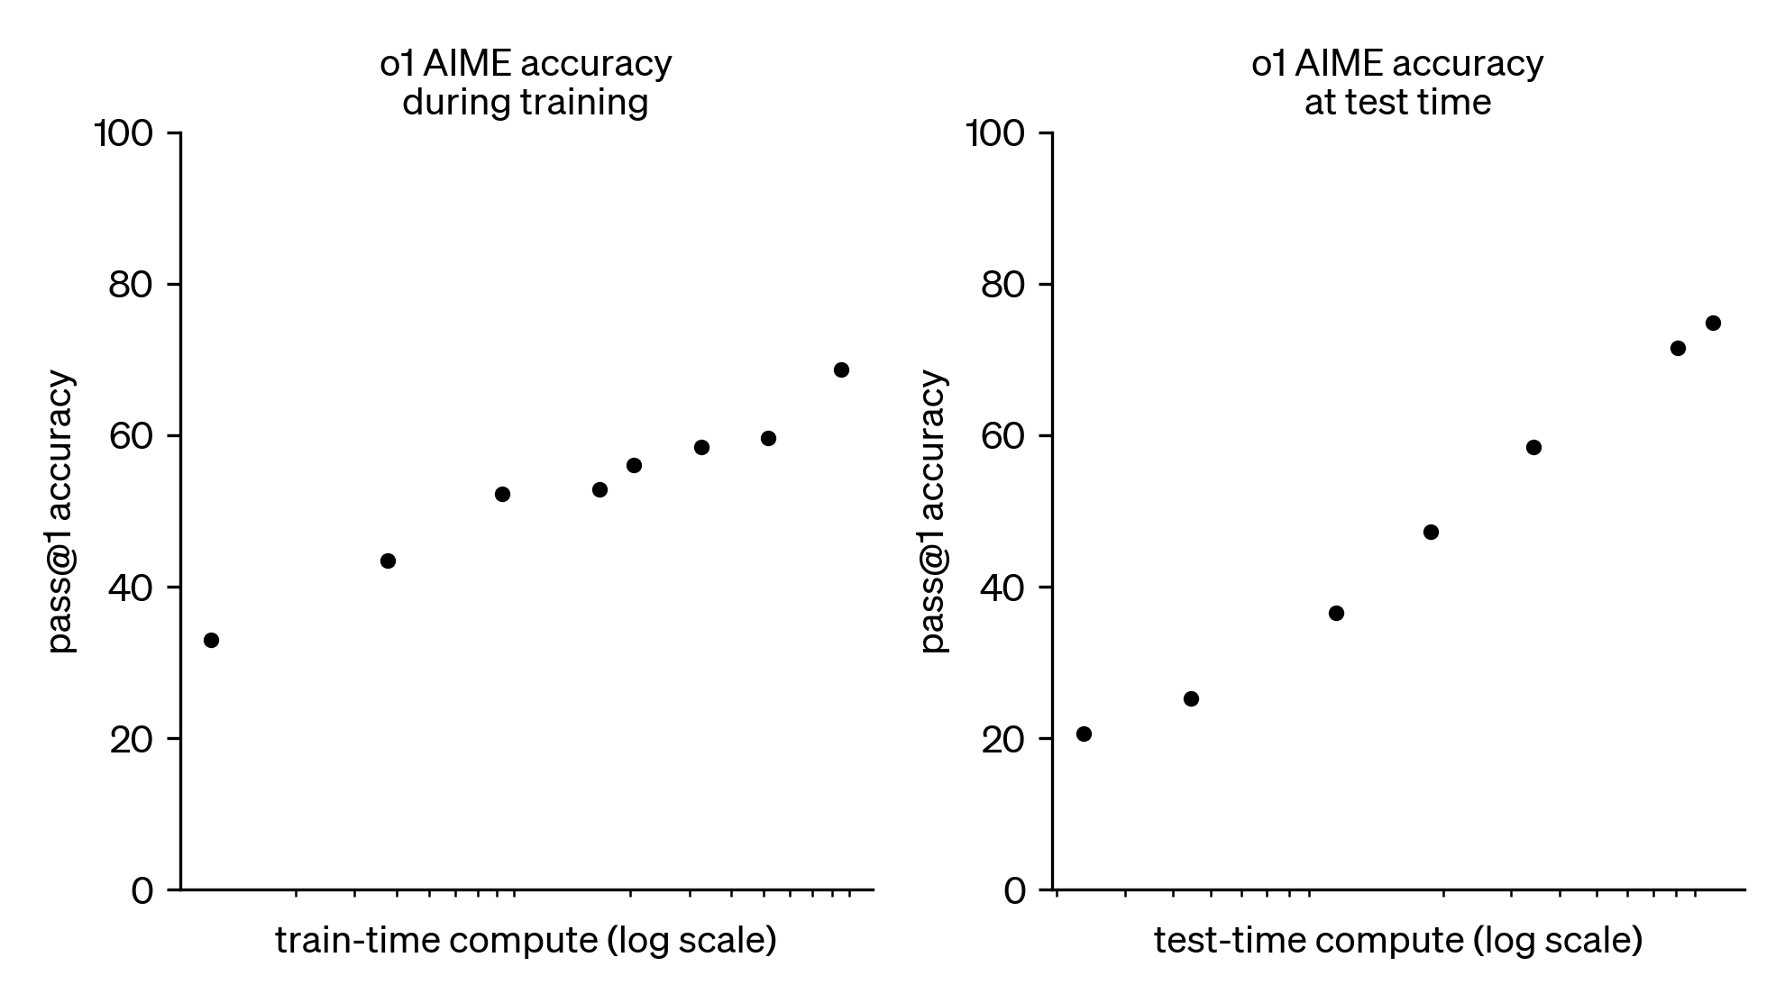
Language Model Reasoning

Slide 3
Multimodal Reasoning
MMMU: A Massive Multi-discipline Multimodal Understanding and Reasoning Benchmark for Expert AGI

Slide 4
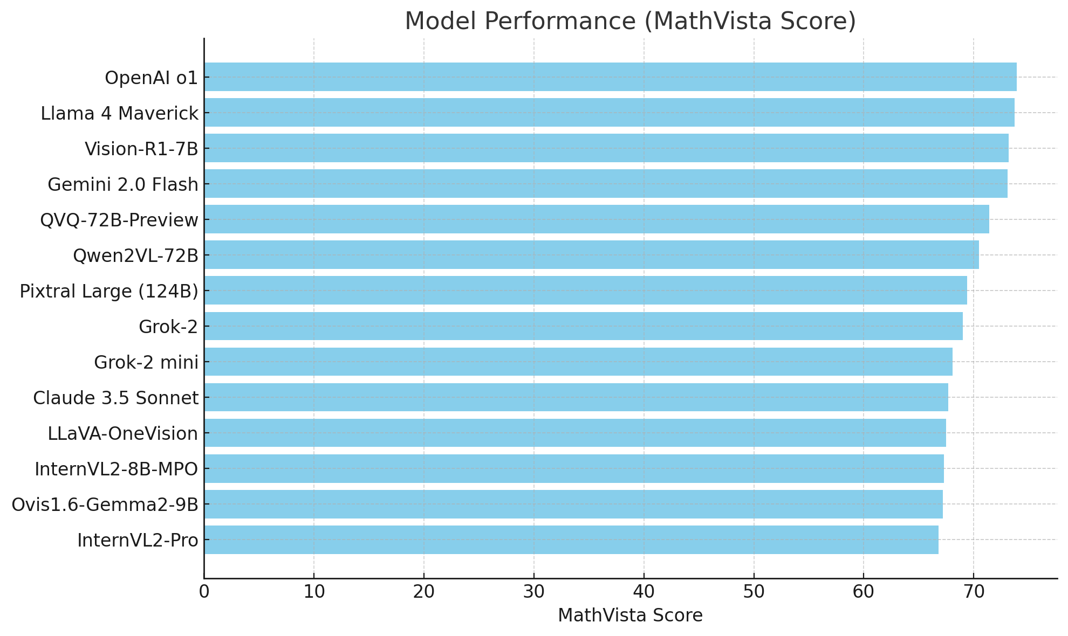
Progress in Multimodal Reasoning

Slide 5
Talk Overview
Multimodal
Supervised Fine-Tuning
Multimodal
Reinforcement Learning
Multimodal
Agents

Slide 6
Sec 1: Multimodal Supervised Fine-Tuning
VisualWebInstruct: Scaling up Multimodal Instruction Data through Web Search

Slide 7
Existing Training Dataset
Issues of the existing datasets:
The existing datasets are mostly focused on narrow domains.
Many of these datasets are synthesized by rules.
The difficulty level is mostly in primary school level.

Slide 8
Annotating Reasoning Data is Expensive!
VQA
STEM VQA
Affordable
Unaffordable

Slide 9
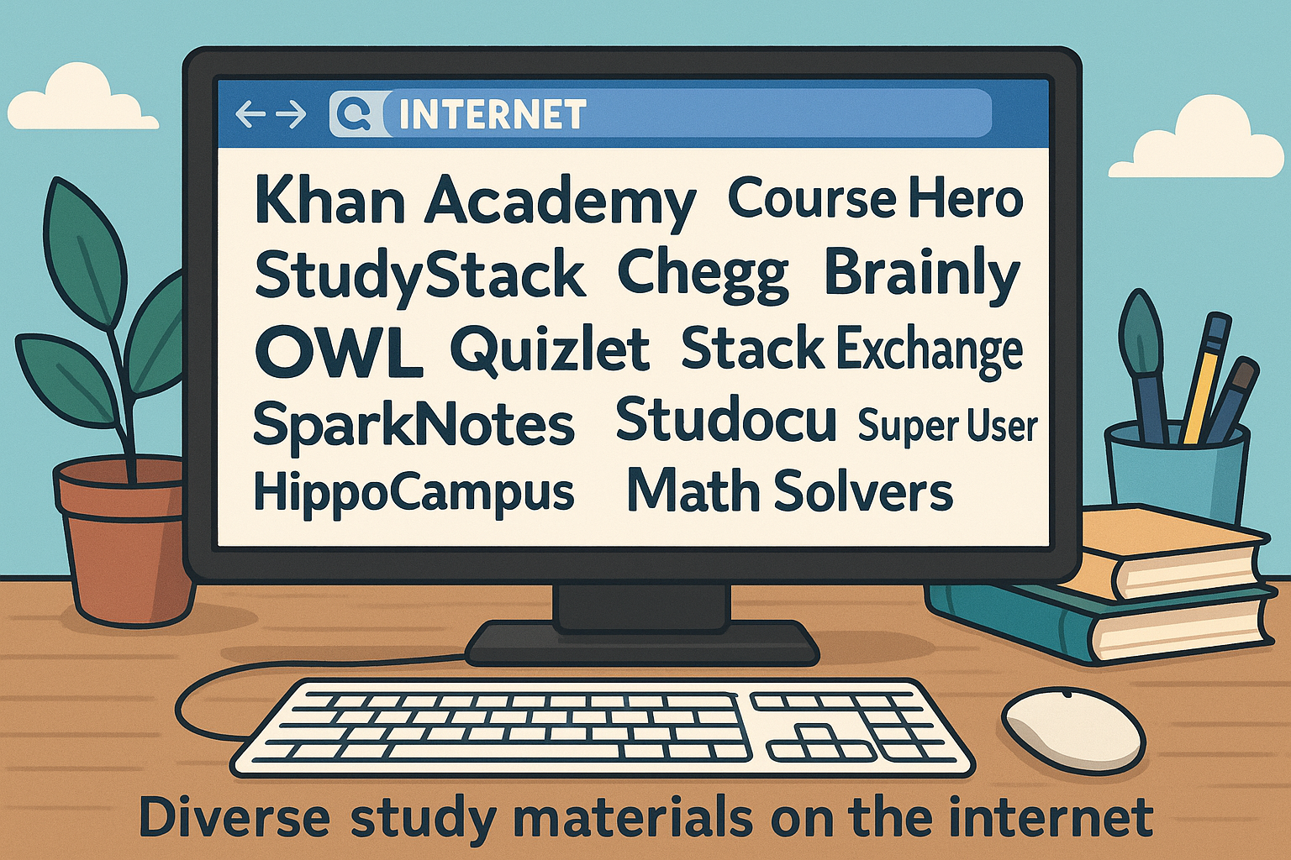
Finding Free Reasoning Data on the Web!

Slide 10
How to Identify These Questions?

Slide 11
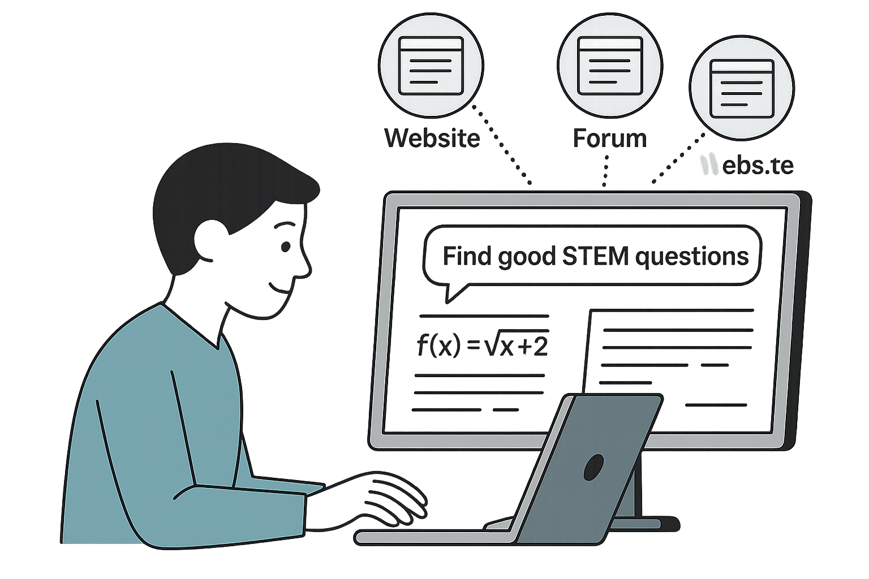
Stage 1.1: Collecting Seed Images
We need reasonable scale seed images to start with.
Balance different disciplines.
Distribute the work to multiple authors.
Identify good websites to crawl the images.

Slide 12
Stage 1.2: Utilizing Google Lens Search

Slide 13
Stage 1.3: Parsing Accessibility Tree
Extract Meaning Text and Image
Organize the content as a Tree
Greatly Reduce Tokens

Slide 14
Stage 1.4: Image-Question-Answer Extraction

Slide 15
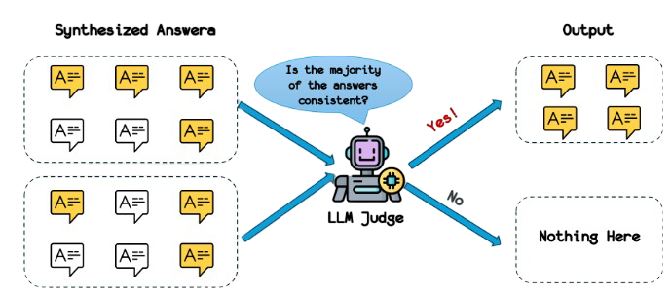
Stage 2.1: Answer Refinement
We need to refine the extracted answers.
Generate multiple responses with GPT-4o
Compare multiple responses to find their consensus.

Slide 16
Stage 2.2: Answer Alignment
If the answer can be found on the website.
Use the provided answer as reference.
This step ensure accuracy of generated answers.
match

Slide 17
Processing Details

Slide 18
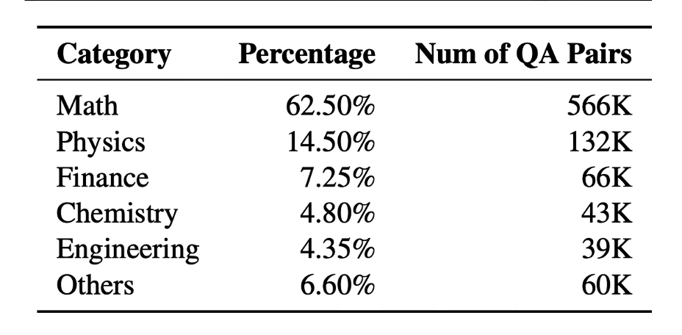
Dataset Statistics
30K Seed Images.
900K instruction Dataset.
347K with images.
553K without images.

Slide 19
Training Details
900K VisualWebInstruct.
100K Llava-CoT.
Training from MAmmoTH-VL.
Training on 8xA100 GPUs.
Input Image resolution is 384x384.
Sequence Length is 8K tokens.

Slide 20
Experimental Results

Slide 21
Ablation Results

Slide 22
Sec 2: Multimodal Reinforcement Learning
VL-Rethinker: Incentivizing Self-Reflection of Vision-Language Models with Reinforcement Learning

Slide 23
Multimodal Reasoning
SFT training is restrictive, which cannot incentivize VLMs’ internal reasoning capabilities. Therefore, the gain is limited.
We need reinforcement learning to incentivize that.
Most visual question answering has short answers, like option, string, number, etc. These are easy-to-verify format.

Slide 24
Problem Formulation
Given a multimodal input consisting of one or more images I and a textual query Q, the goal is to generate a textual response y.
We aim to optimize the end reward on a given dataset D.
$$\max_{θ}{𝔼_{x\sim D}𝔼_{y\sim π_{θ}(∙|x)}[r(y,x)]}$$

Slide 25
Group Relative Preference Optimization
$$\frac{1}{G} \sum_{i=1}^{G}{\frac{1}{|y_{i}|}\sum_{t=1}^{|y_{i}|}{min⁡[\frac{π_{θ}\left(y_{i,t} | x,y_{i,<t}\right)}{π_{old}(y_{i,t}|x,y_{i,<t}}\hat{A_{i,t}}, clip(\frac{π_{θ}\left(y_{i,t} | x,y_{i,<t}\right)}{π_{old}(y_{i,t}|x,y_{i,<t}}, 1−ε,1+ε)\hat{A_{i,t}}]}}$$

Slide 26
Existing Results with Multimodal RL
Directly RL on multimodal models is not as effective.
Negative Results:
MathVista => GPT-o1: 74% vs. Qwen2.5-VL-72B: 74.8%
MathVerse => GPT-o1: 57% vs. Qwen2.5-VL-72B: 57.4%
More:
QVQ-72B: 71.4% vs. Qwen2-VL-72B: 70.5% on MathVista

Slide 27
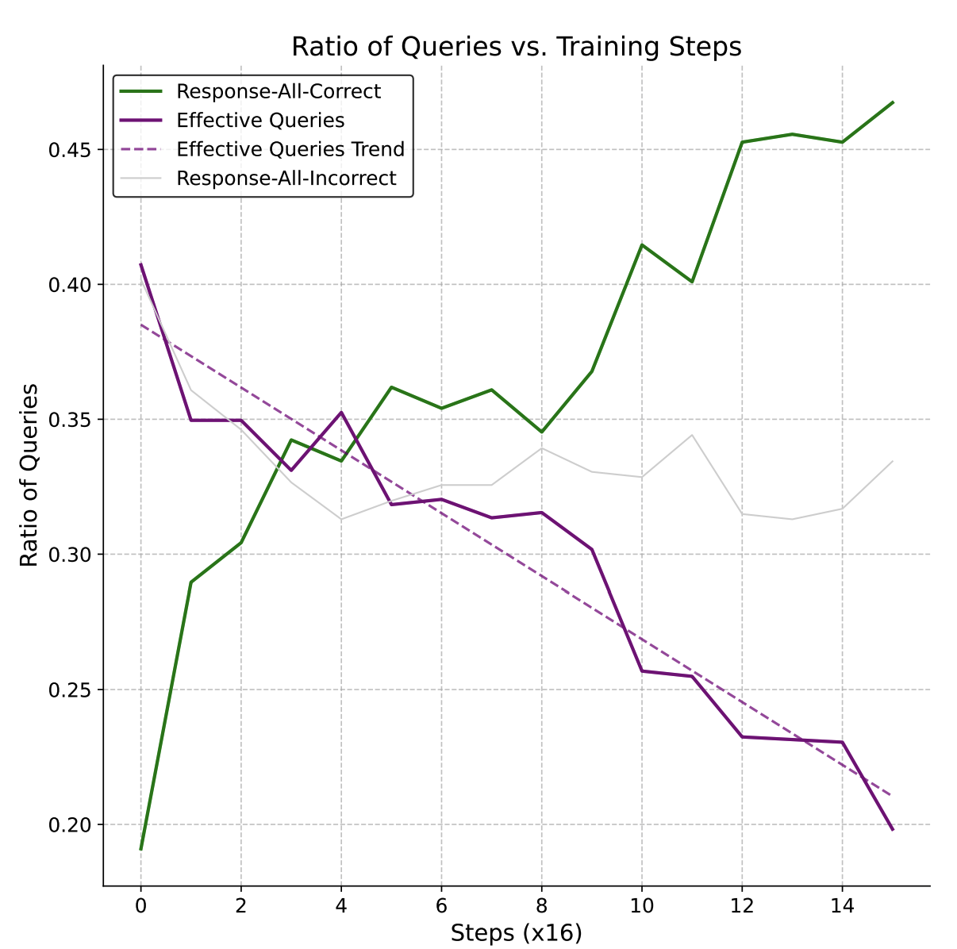
Issue 1: Vanishing Advantages
Advantages are calculated within the group.
On easy questions, all the responses are correct, so the advantages are zero
On hard questions, all the responses are wrong, so the advantages are also zero.
Without advantage, the gradient becomes zero, the model stops learning

Slide 28
Our Approach: Selective Sample Replay
We maintain a replay buffer B storing tuples ($x,y_{i},\hat{A_{i}}$).
The replay buffer will persist K training steps.
During each training step, we draw samples from the replay buffer.

Slide 29
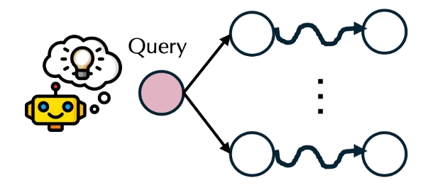
Issue 2: Non-Reflection
Text-only training can trigger self-reflection and self-verification easily. We can observe test time scaling with longer output sequence.
However, in multimodal training, we do not observe the emergence of self-reflection and self-verification.

Slide 30
Our Approach: Forced Rethinking
Simple Solution:
1. Do normal response rollouts.
2. Append “wait” token at the end
3. Continue generation

Slide 31
Entire Framework: VL-Rethinker
1. We first train VL-Reasoner with SSR.
2. We continue to train with Forced Rethinking Strategy.

Slide 32
Training Details
Training Dataset (16K)
Virgo, R1-Onevision, MM-Eureka
Filtering Mechanism: these 16K samples are filtered through pre-processing to discard examples too hard or too simple.
Evaluation Dataset
Math: MathVista, MathVerse, MathVision
Multi-discipline: MMMU, MMMU-Pro, EMMA
Mega-Bench
Training for 3 epochs with rollout size=8.

Slide 33
Experimental Results (72B)

Slide 34
Experimental Results (7B)

Slide 35
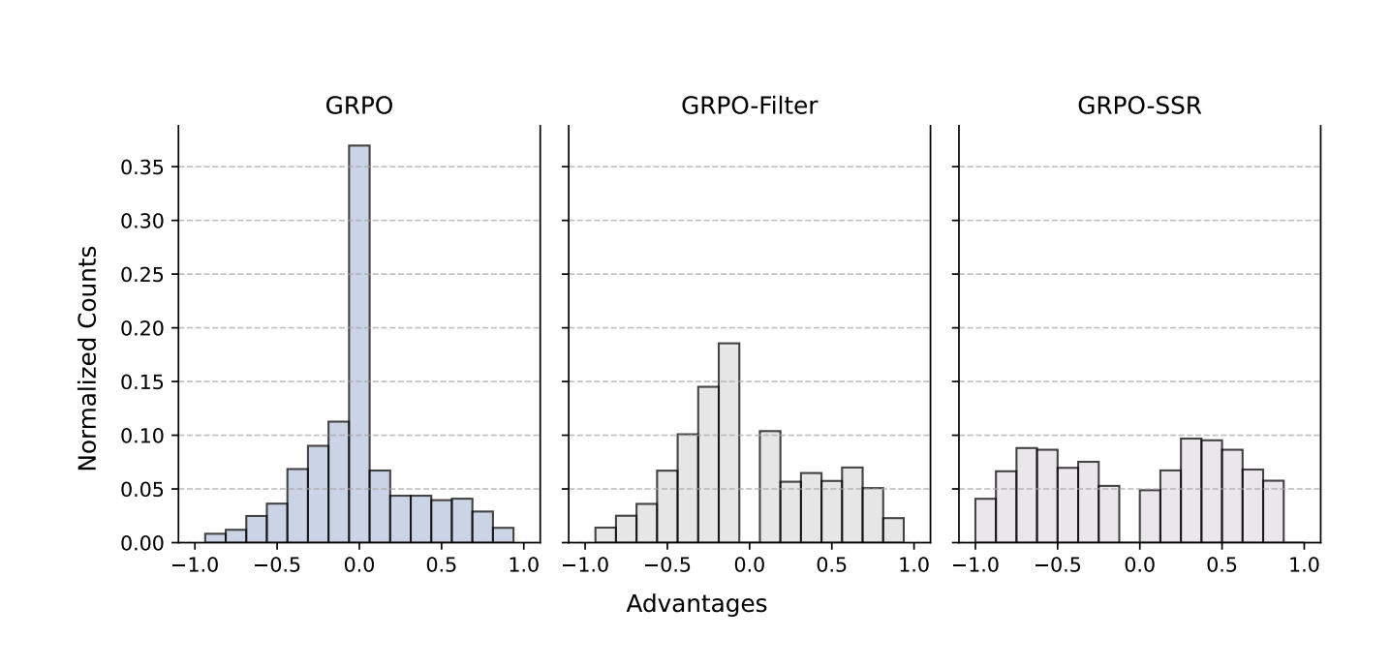
Ablation of SSR

Slide 36
Sec 3: Multimodal Tool Use
Pixel Reasoner: Incentivizing Reasoning in the Pixel Space with Reinforcement Learning

Slide 37
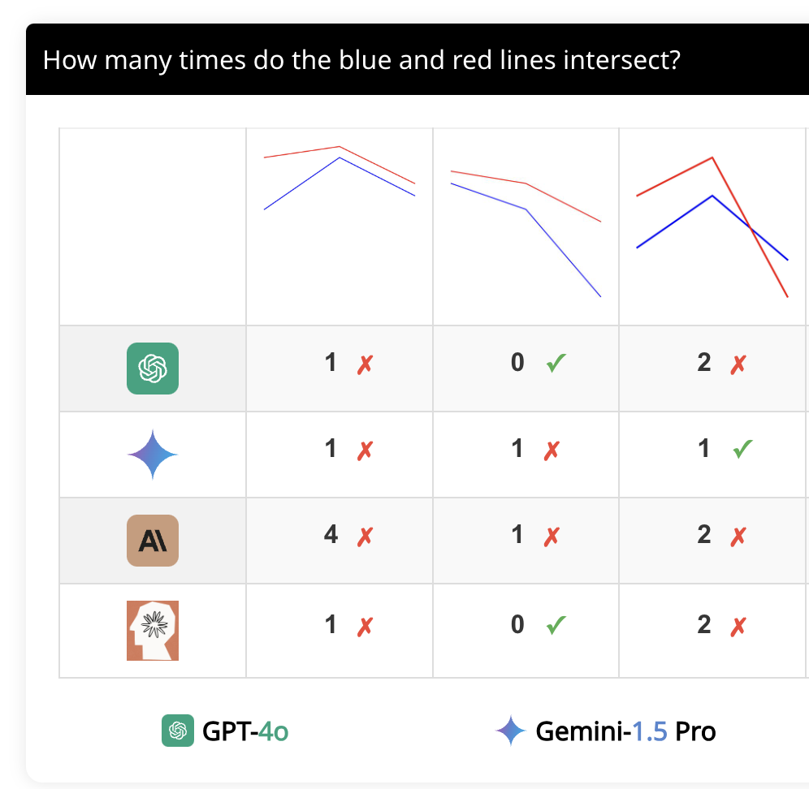
Status Quo of Multimodal Reasoning
Most Reasoning is happening in the text side.
Lack of Reasoning in Pixel Space.
100,000 tokens
Vision Enc
1000 tokens
Vision Enc
Reasoning VLMs

Slide 38
Increase Budget in Pixel-Level Reasoning
Incorporate pixel-level tools
Zoom in.
Crop.
Select Image from K inputs.
Highlight.

Slide 39
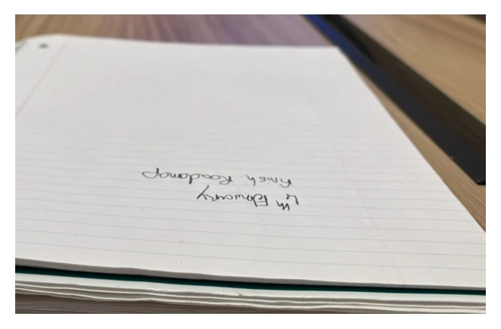
Pixel Level Reasoning
crop
output
4th February – finish roadmap
What is written on the notebook?

Slide 40
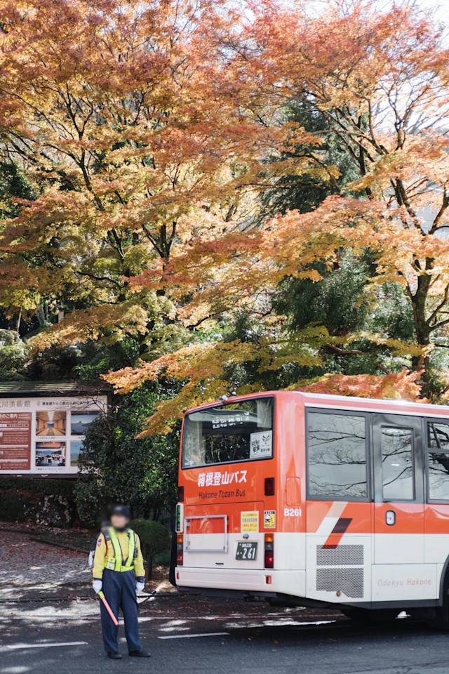
Training Dataset Synthesis
Where is this stop?
成川美術館
Identify interesting region
coordinate
Identify interesting question

Slide 41
SFT Training
maximize
maximize
coordinate
成川美術館
Where is this stop?

Slide 42
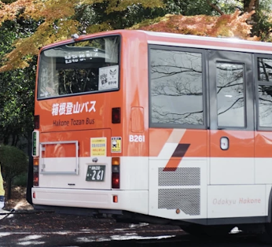
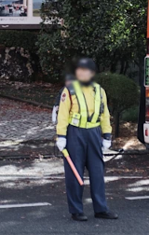
RL Training (GRPO)
成川美術館
Reward=+1
登山
Reward=-1
Outdoor
Reward=-1
Where is this stop?

Slide 43
Experimental Results
Model | Performance on V* bench | Performance on V* bench
Existing Methods
GPT-4o |  | 66.0
GPT-4o + SketchPad |  | 80.3
Gemini 1.0 Pro |  | 48.1
MM-React |  | 34.8
SEAL |  | 75.4
7B Models
Qwen2.5VL-7B |  | 33.5
Qwen2.5VL-7B-SFT |  | 73.3
Qwen2.5VL-7B-SFT-RL |  | 82.7

Slide 44
Q&A

