Slide 1
Long-context LLMs
Wenhu Chen

Slide 2
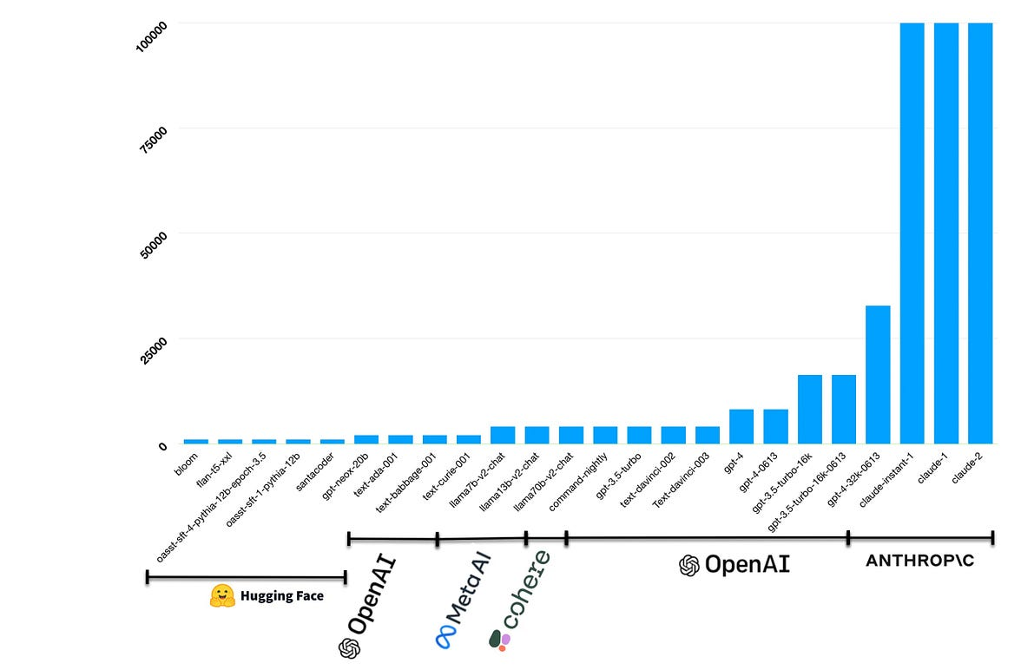
LLMs has Entered the Era of Long Context

Slide 3
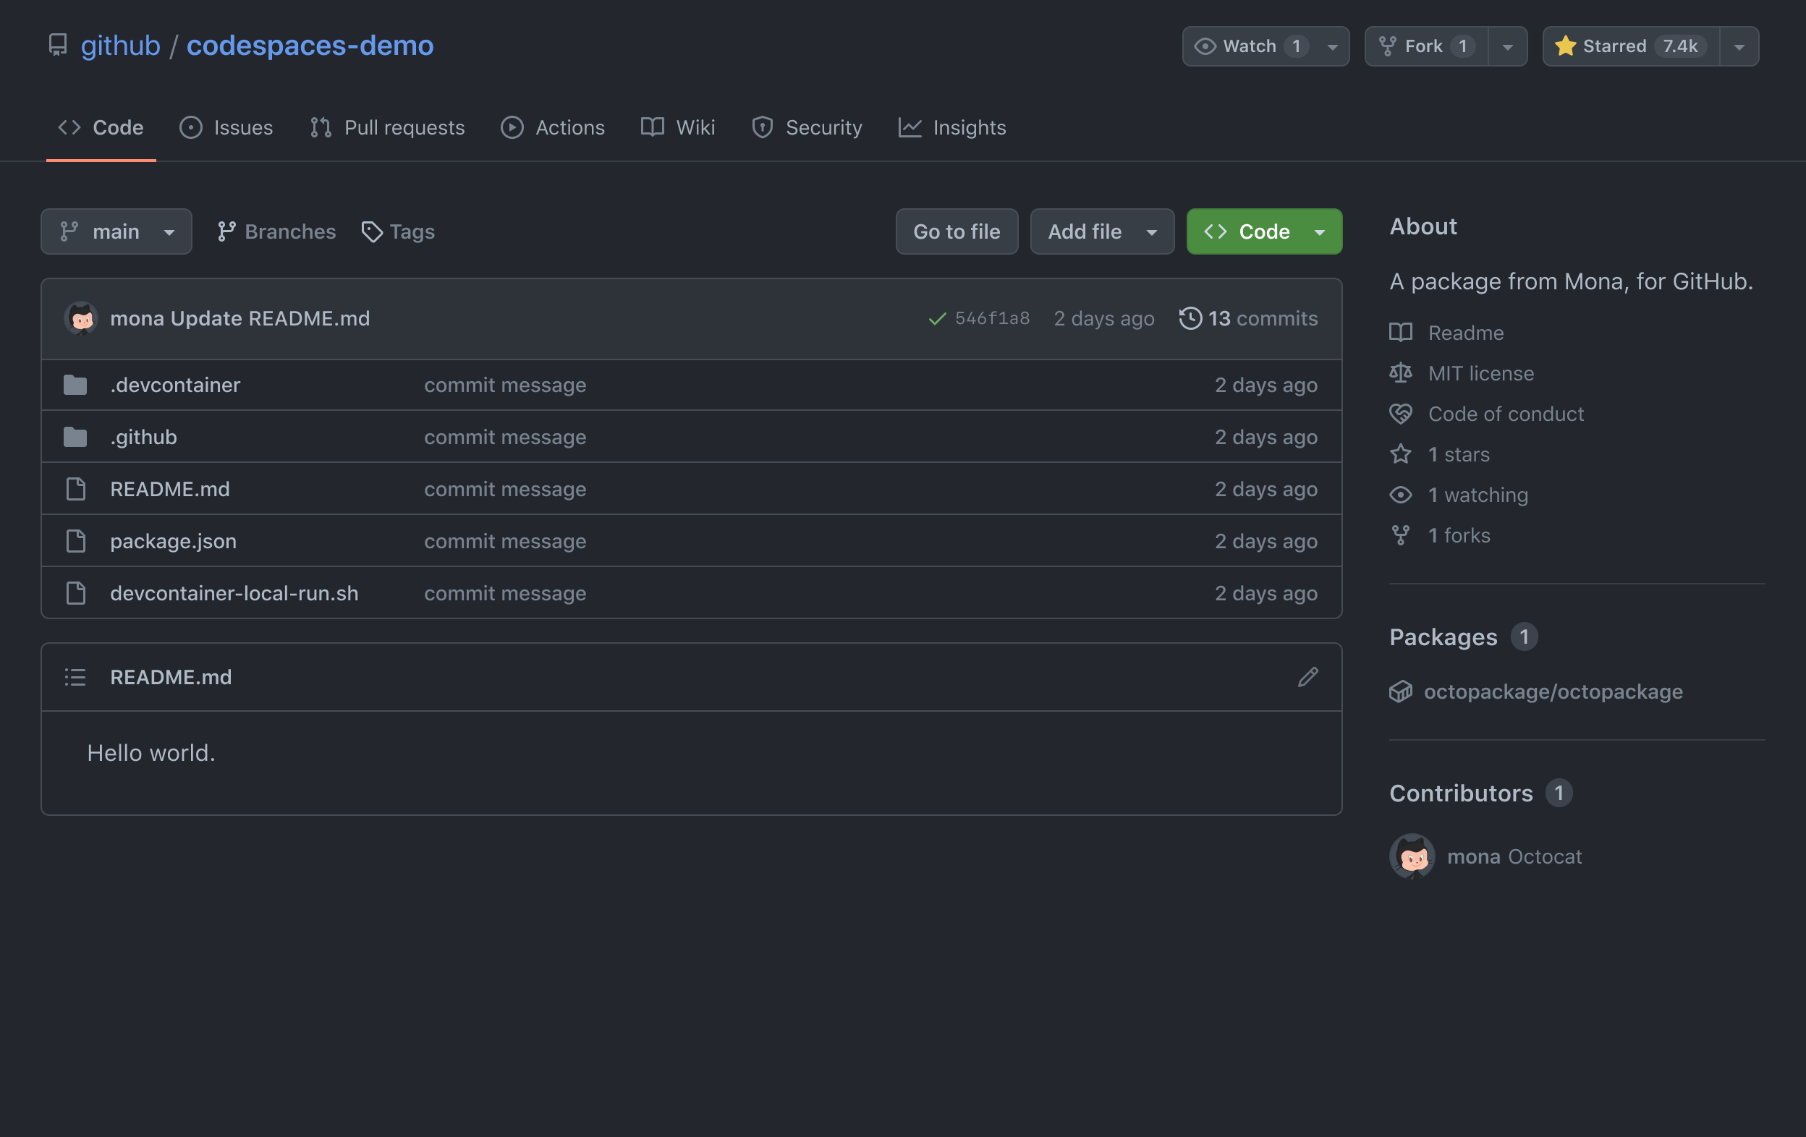
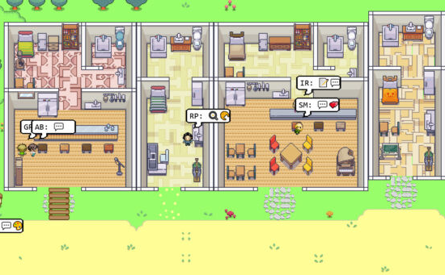
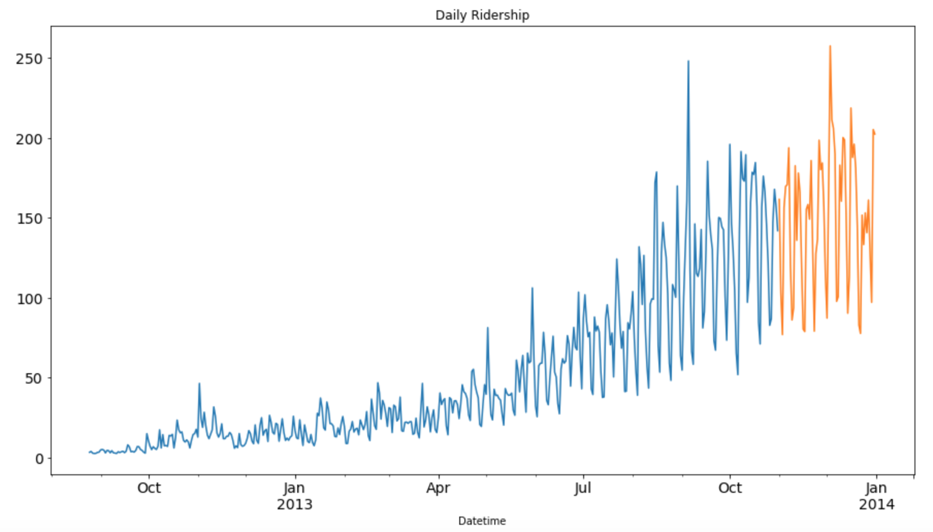
Why do we need long-context?
Model Long Documents
Repository Code Understanding
Video Understanding
Long Dialog Understanding
Role Playing
Time series Forecast

Slide 4
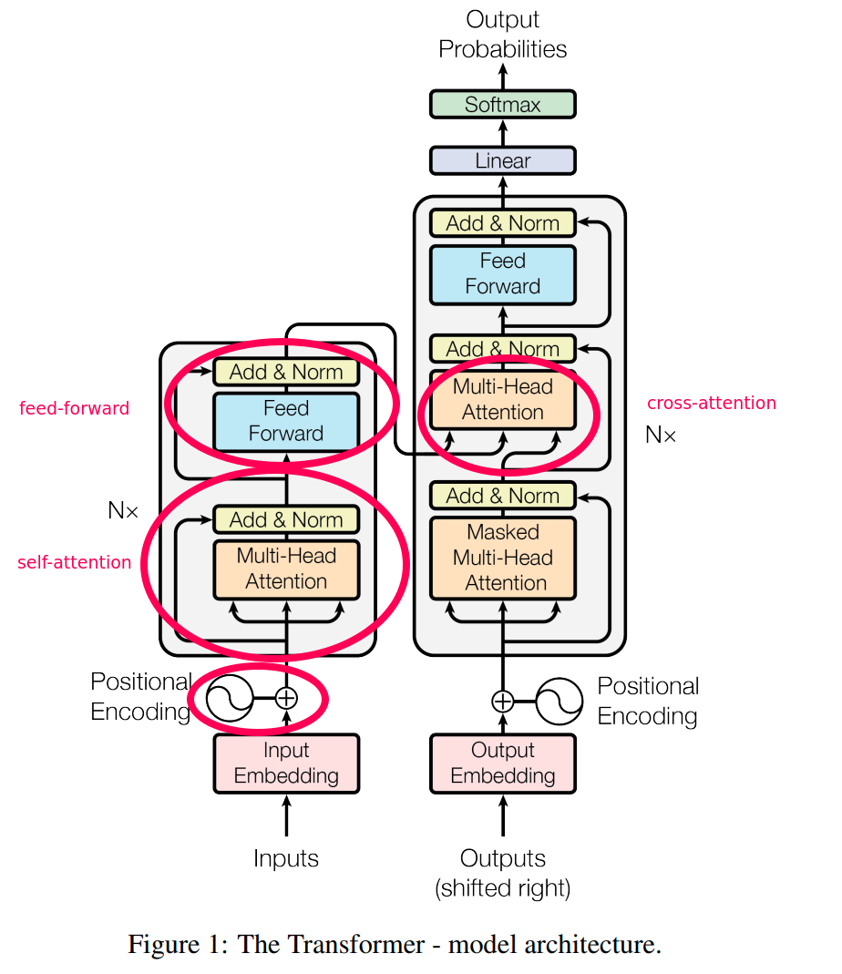
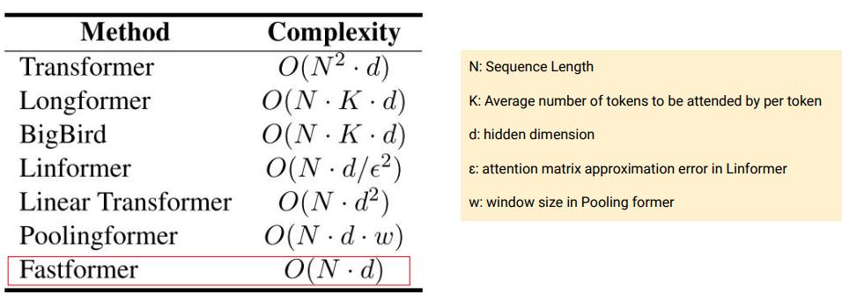
Transformer Attention Bottleneck

Slide 5
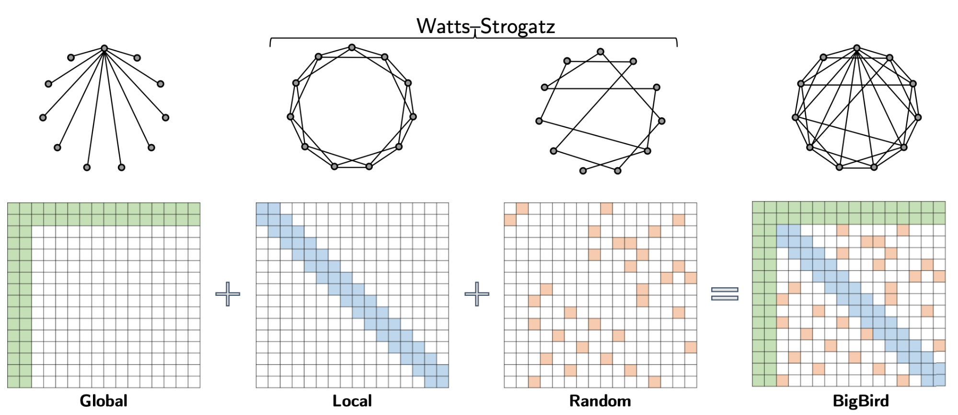
Basic Knowledge (Sparse Attention)
Sparse Attention

Slide 6
Basic Knowledge (Attention Complexity)
Let’s assume batch-size=|B|, sequence-length=|S|, the hidden dimension is |H|.
QKV computation: $6\left|B\right||S|{|H|}^{2}$
Attention matrix computation: $2\left|B\right|{|S|}^{2}\left|H\right|$
Attention over Value Matrix: $2\left|B\right|{|S|}^{2}\left|H\right|$
FFN (M-time dimension): $M\left|B\right|\left|S\right|{\left|H\right|}^{2}$
Total Computation: $L\left(\left(4M+8\right)\left|B\right|\left|S\right|{|H|}^{2}+4\left|B\right|{|S|}^{2}|H|\right)+ …$
Comparison: $\left|M+2\right|\left|H\right|$ vs $|S|$

Slide 7
Basic Knowledge (Attention Complexity)
$\left|M+2\right|\left|H\right|$ vs $|S|$
For LLaMA: M = 4, therefore, whenever sequence length > 6*hidden dimension, the computation/memory is dominated by attention.
For Gemma: M = 8, therefore, whenever sequence length > 10*hidden dimension, the computation/memory is dominated by attention.
For 7B-LLaMA, H = 4096, then long-context means |S| > 24K.
For 70B-LLaMA, H = 8192, then long-context means |S| > 48K.
For any sequence below 24K, we don’t need to optimize for long-context
NOTE: For sequence length around 32K, no sparse attention is needed
NOTE: Flash-Attention is full-attention with almost linear complexity

Slide 8
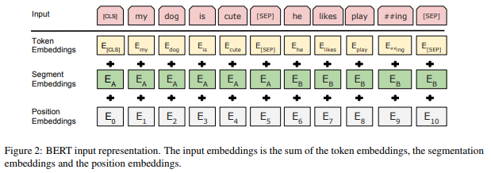
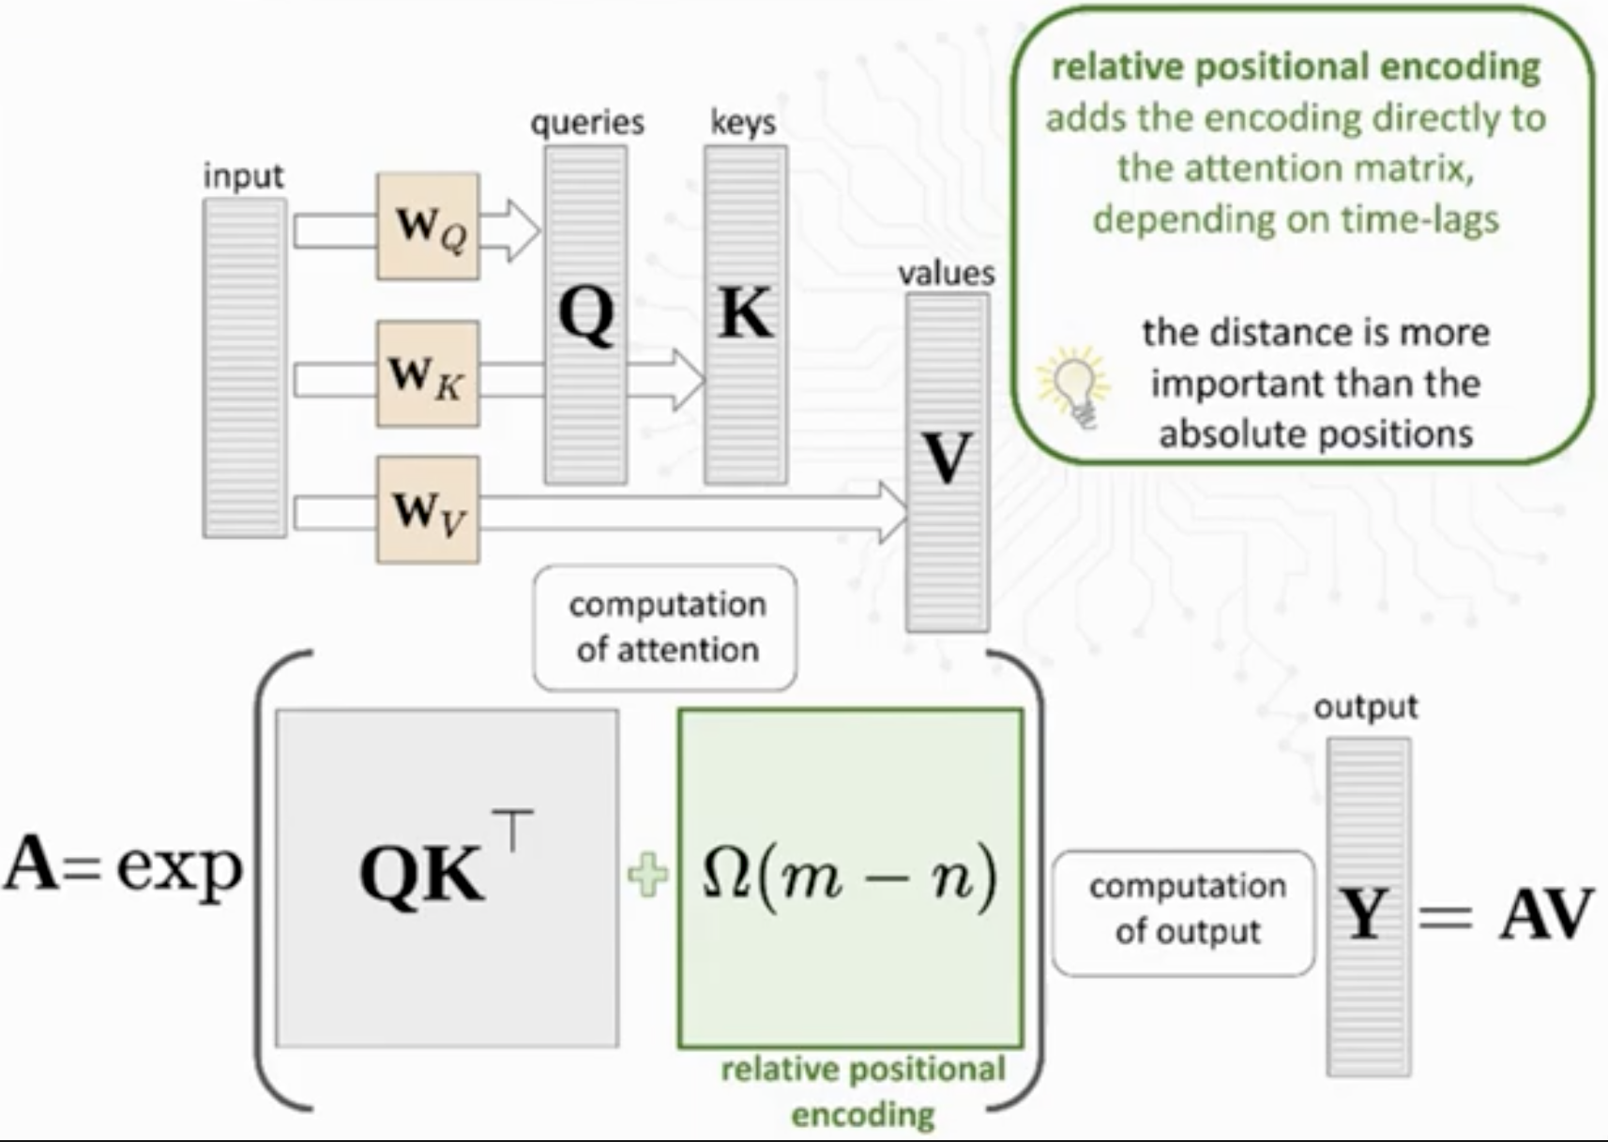
Basic Knowledge (Position Embedding)
How do we inject the position bias in LLM?
Absolute Position Embedding (BERT)
Cannot extrapolate
Relative Position Embedding
Requires additional computation

Slide 9
Speed Trade-off
- T5-bias needs to be re-calculated for each key-query pairs, which takes additional
computation during both training and inference.
- According to ALIBI, T5-bias would decrease the training/inference speed by at least 2x.
- We need something like an absolute position bias to avoid overhead.
Press, Ofir, Noah A. Smith, and Mike Lewis. "Train short, test long: Attention with linear biases enables input length extrapolation." arXiv preprint arXiv:2108.12409 (2021).

Slide 10
RoPE Embedding
Inject the position directly to key/query embedding, so that we don’t need to recalculate the attention score.
We still want to have some sort of relative position bias.
Su, Jianlin, et al. "Roformer: Enhanced transformer with rotary position embedding." Neurocomputing 568 (2024): 127063.

Slide 11
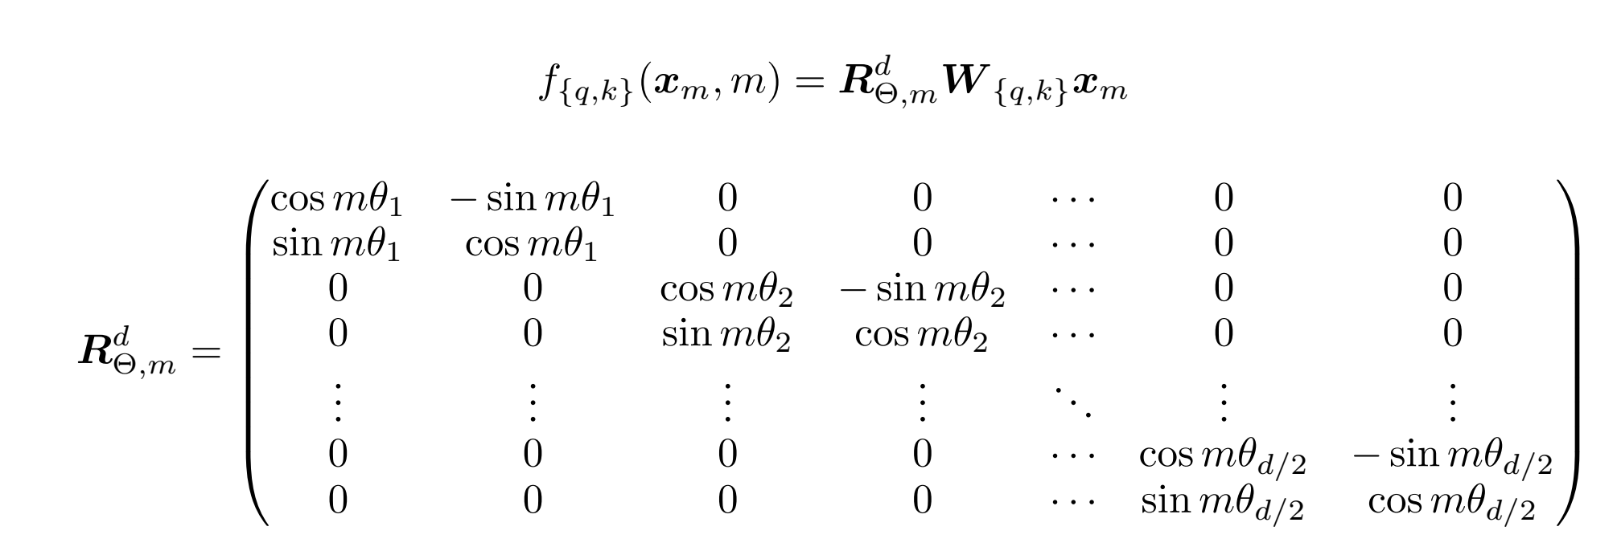
RoPE Embedding
Generalize this to d-dimensional space

Slide 12
RoPE Embedding

Slide 13
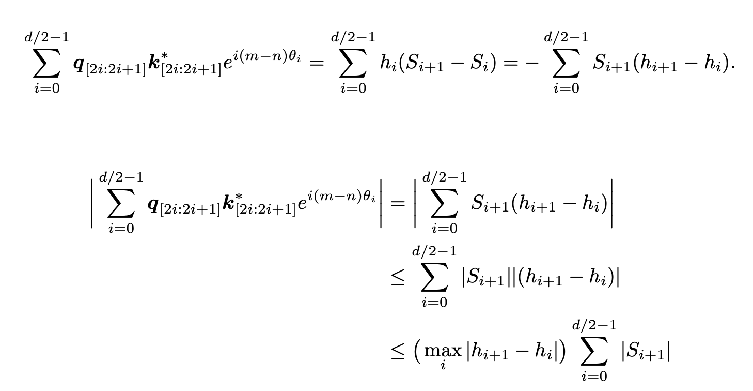
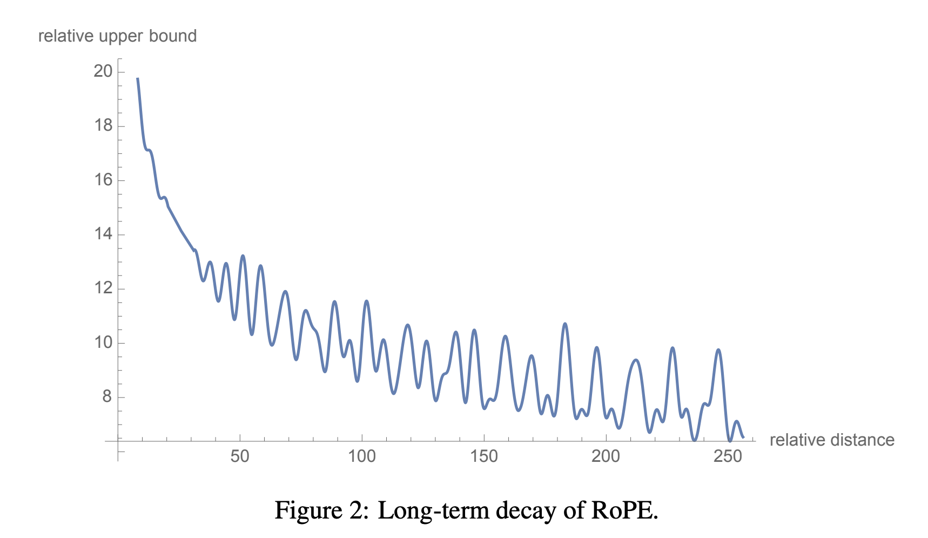
Long Range Decay in RoPE
By setting $h_{i}=q_{[2i:2i+2]}k_{[2i:2i+1]}$ and $S_{j}= \sum_{i=0}^{\frac{d}{2}−1}{e^{i\left(m−n\right)θ_{i}}}$
Note: base angle controls the decay rate;
default base is10K; We could enlarge it.

Slide 14
E^2-LLM: Efficient and Extreme Length Extension of Large Language Models
Jiaheng Liu, Zhiqi Bai, Yuanxing Zhang, Chenchen Zhang, Yu Zhang, Ge Zhang, Jiakai Wang, Haoran Que, Yukang Chen, Wenbo Su, Tiezheng Ge, Jie Fu, Wenhu Chen, Bo Zheng

Slide 15
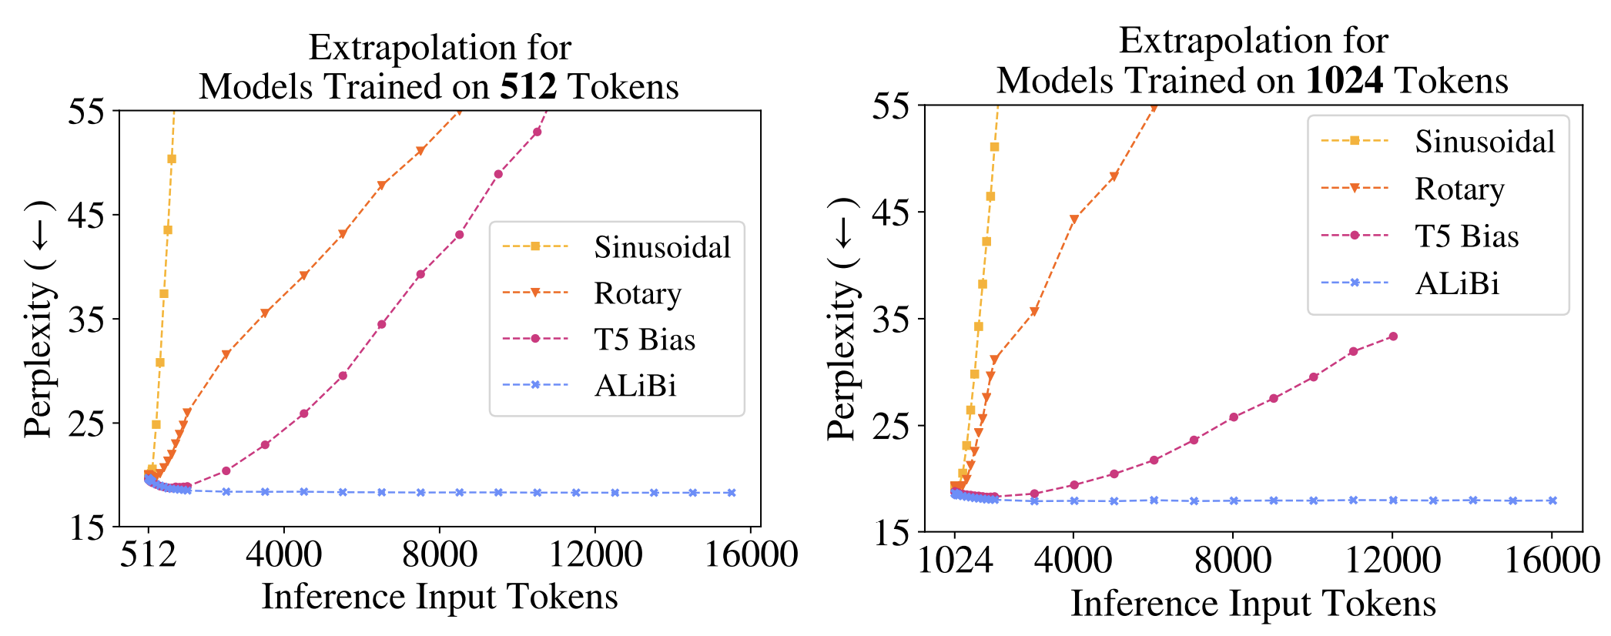
Direct Extrapolation
RoPE is not able to extrapolate to longer sequence, the PPL will increase dramatically.
Press, Ofir, Noah A. Smith, and Mike Lewis. "Train short, test long: Attention with linear biases enables input length extrapolation." arXiv preprint arXiv:2108.12409 (2021).

Slide 16
Position Interpolation
Instead of direct extrapolation of the attention score to s > L, we can renormalize the query/key function as:
It requires training on massive amount of data to converge.

Slide 17
Position Interpolation
Simple approach to train on 8K and then extend to 64K.
In standard RoPE, by default, the t is set to 0.
In E^LLM, we can select from a range {0, …, t_max}
We define a set of scale parameters {1, 2, …, g_max}

Slide 18
Augmentation & Re-distribution
To make the model H cover different position densities in training, we sample the scale parameter g_i from G for different iterations following a predefined probability distribution P
We observe that we can only focus on a small range of the position indices when we start from zero index (i.e., t = 0).
Attention Sink

Slide 19
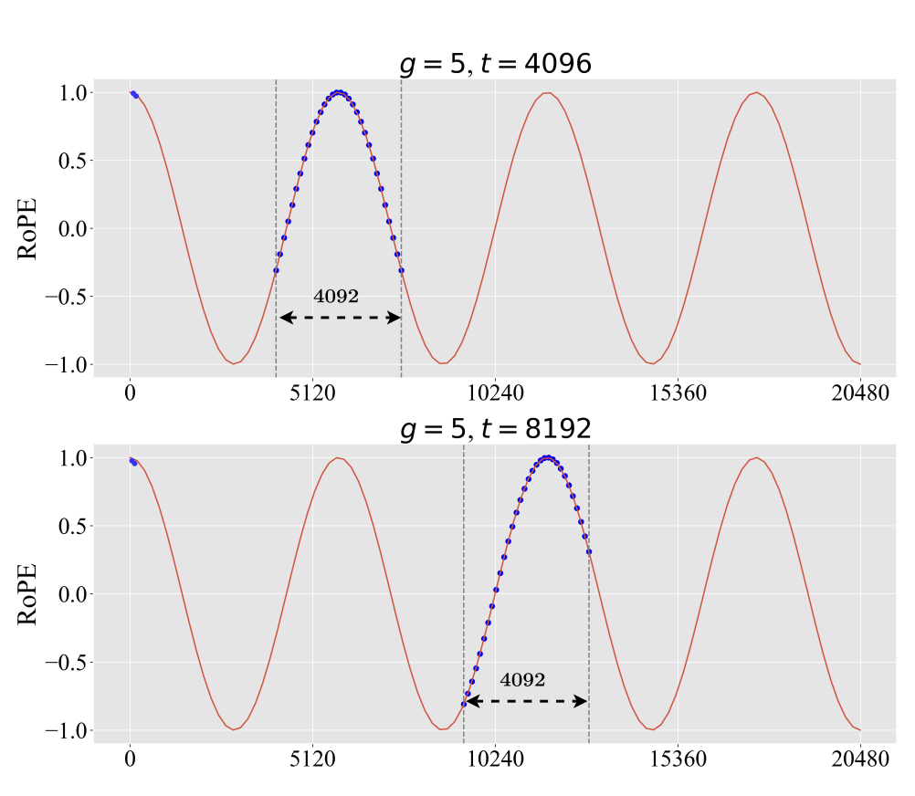
Sweeping different indices & scale
Generalize to different g
Generalize to different t
Attention Sink
Attention Sink

Slide 20
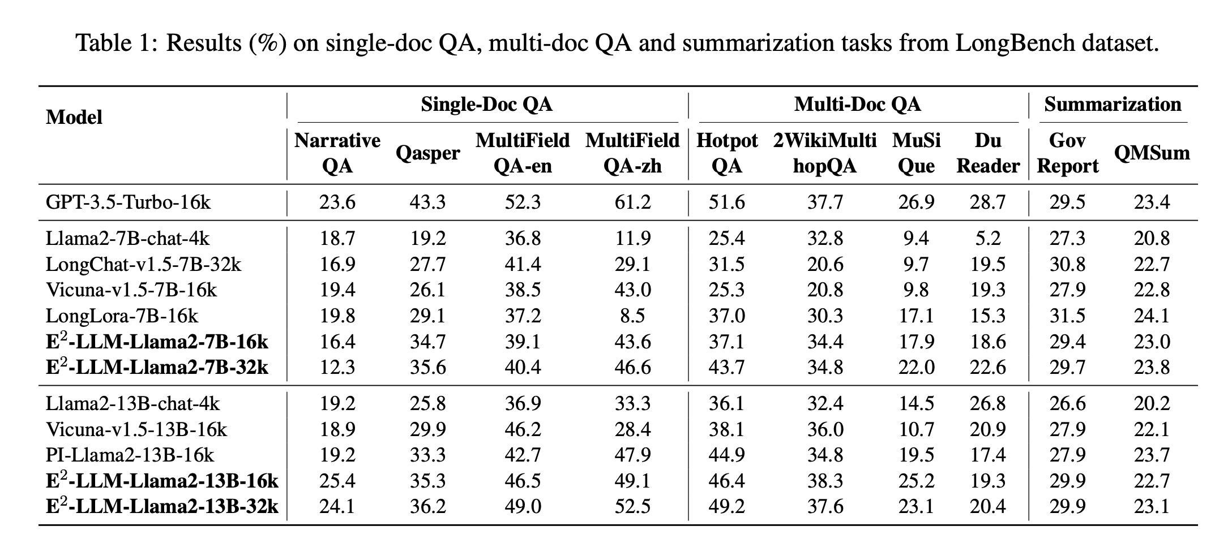
Extrapolation for Free

Slide 21
Recent work: Decreasing base frequency
Decreasing the rotation angle
Better data mix
Small Learning Rate for optimize
No sparse attention is needed
Train on 400B tokens
Xiong, Wenhan, et al. "Effective long-context scaling of foundation models." arXiv preprint arXiv:2309.16039 (2023).

Slide 22
Recent work: Extending LLM to 128K
Framework optimization
Decrease the base frequency
Long context ability is inherent in LLMs.
Only 10B tokens
Natural Sampling
Fu, Yao, et al. "Data Engineering for Scaling Language Models to 128K Context." arXiv preprint arXiv:2402.10171 (2024).

Slide 23
Recent work: Lost in the middle
Liu, Nelson F., et al. "Lost in the Middle: How Language Models Use Long Contexts. CoRR abs/2307.03172 (2023)." (2023).

Slide 24
Long-context LLMs Struggle with Long In-context Learning
Tianle Li, Ge Zhang, Quy Duc Do, Xiang Yue, Wenhu Chen

Slide 25
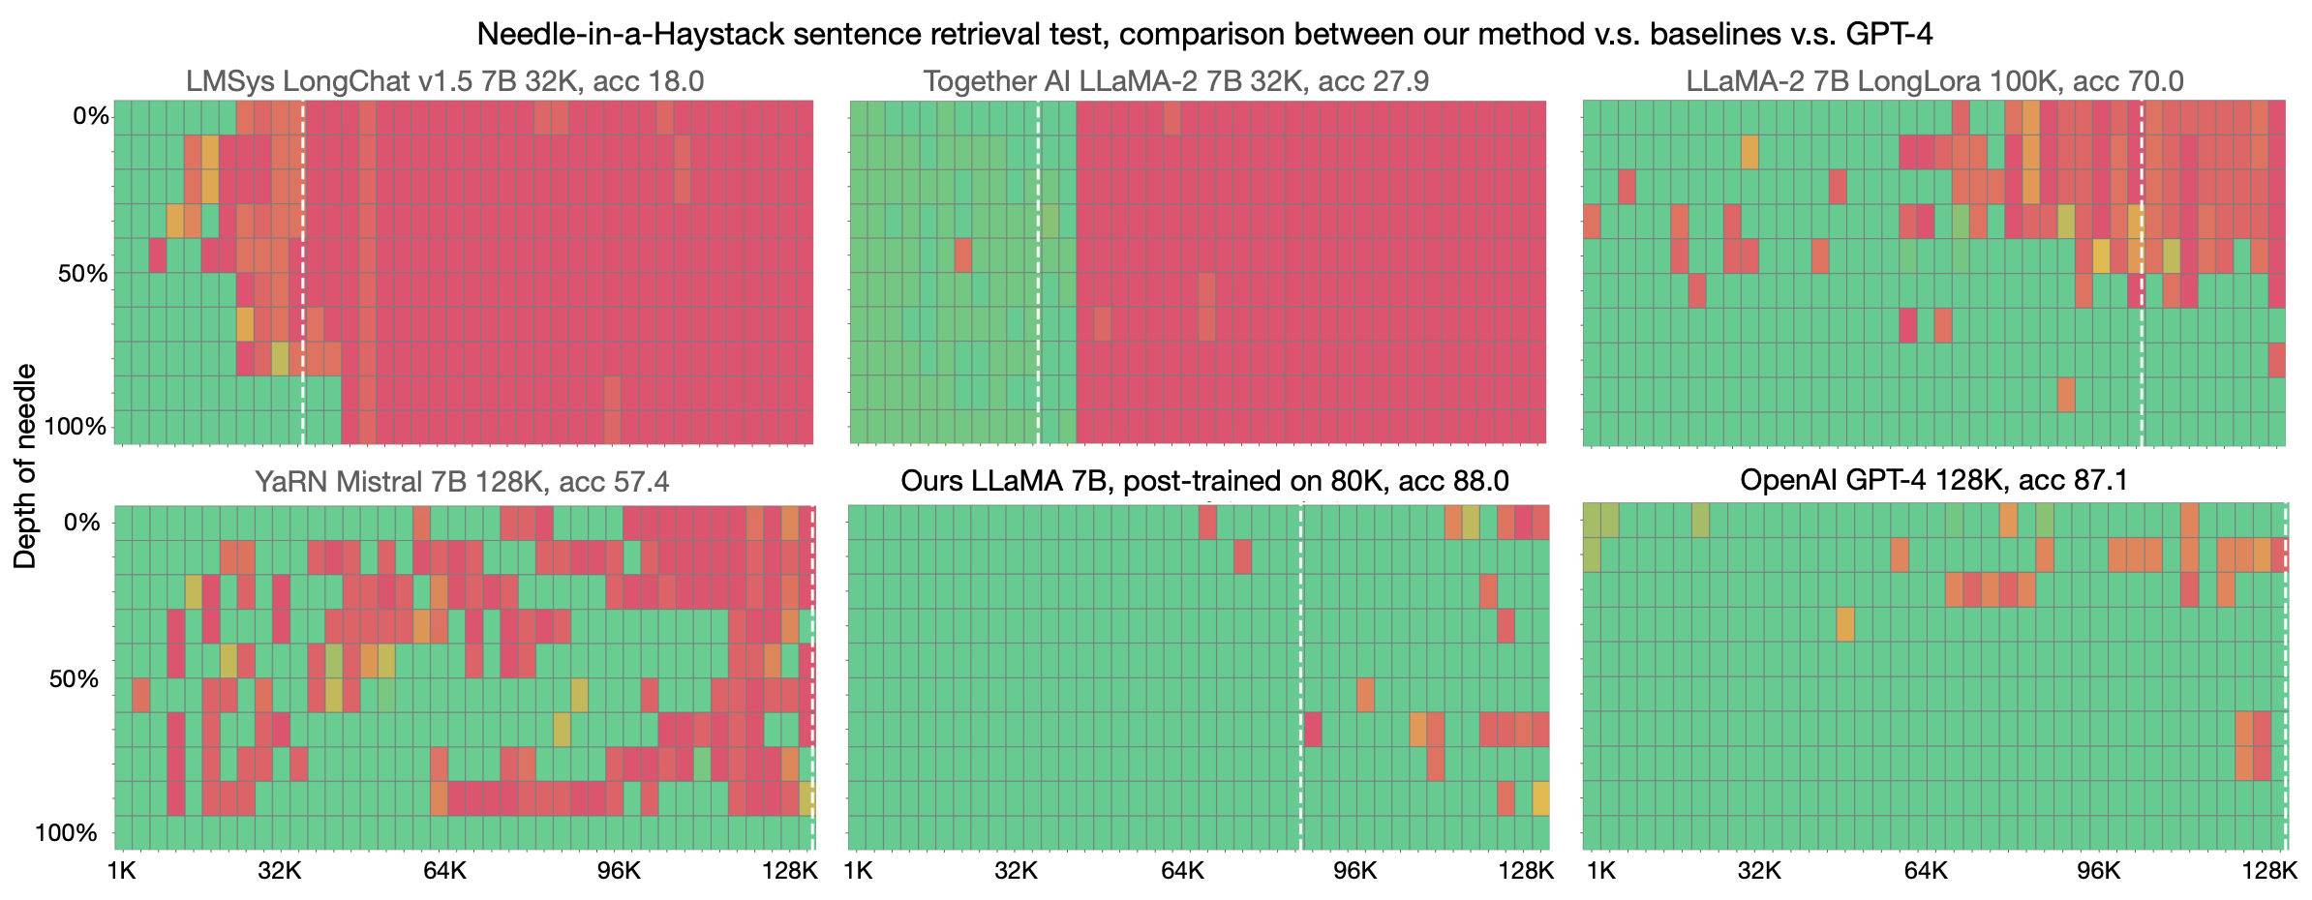
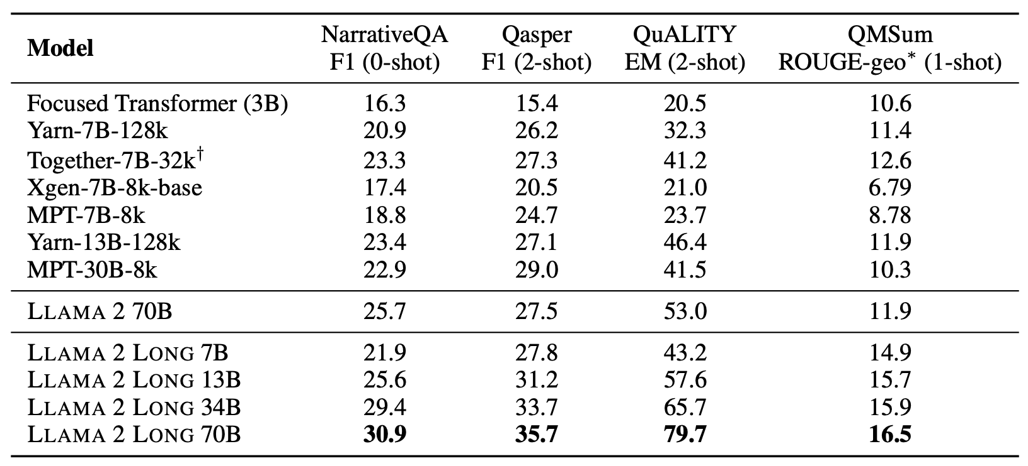
Long-context Evaluation

Slide 26
Major Evaluation for Long-context LLM
In-context learning aims to recognize the task definition from the prompt instead of doing similarity matching
LLMs do need to scan over the entire prompt to understand the label space and their nuances.
The tasks are normally uncommon, the labels can’t be predicted with the internal knowledge

Slide 27
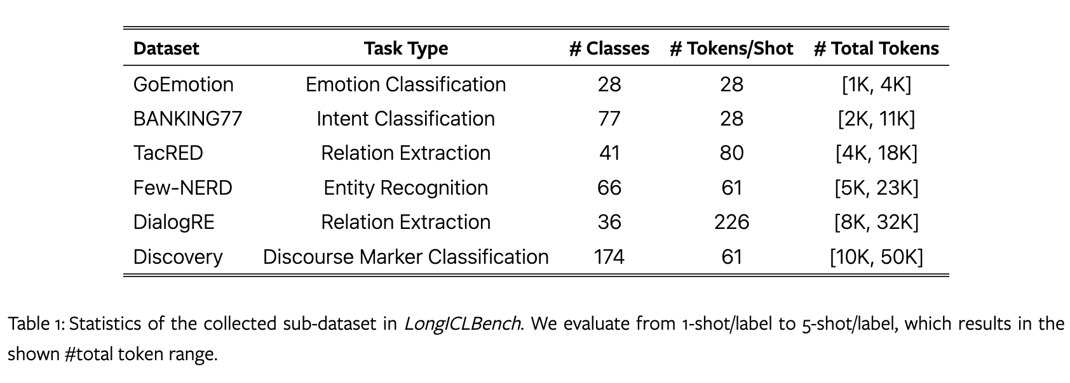
Dataset with Increasing Difficulty Level
Easy
Hard

Slide 28
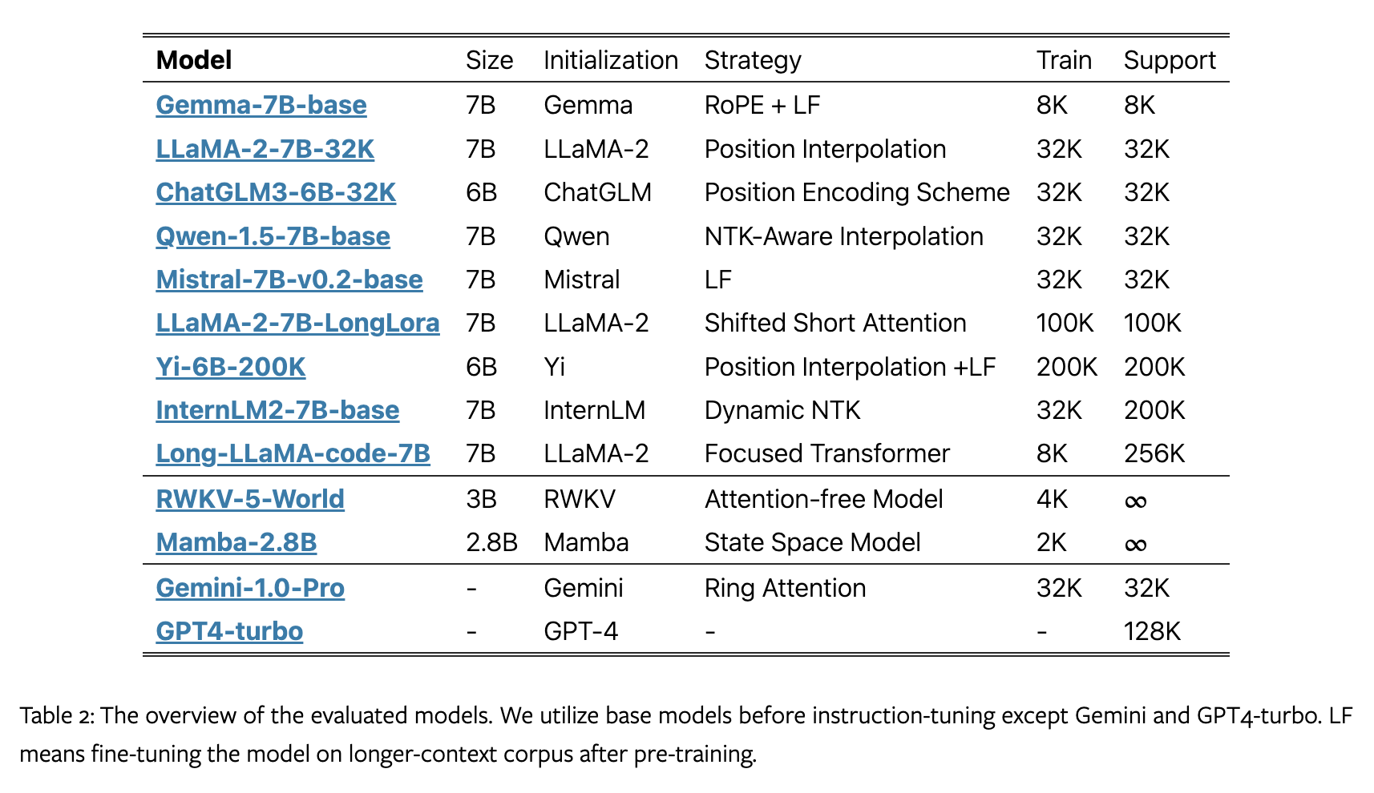
Evaluation on 13 Current Long-context LLMs

Slide 29
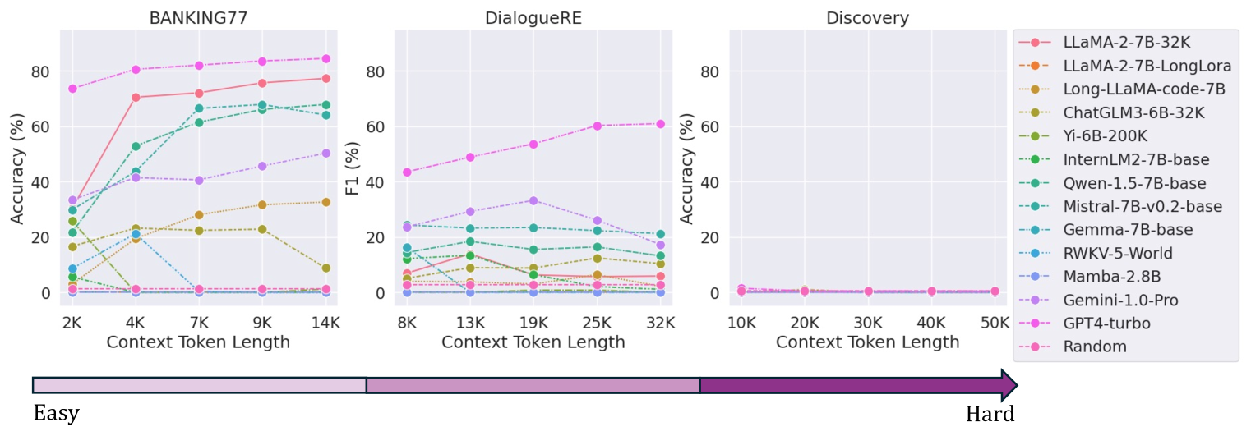
Detailed Model Performance w.r.t. Context Length
Limited performance gain or even a drop after a length threshold
Most difficult dataset, i.e. Discovery, makes all the models fail

Slide 30
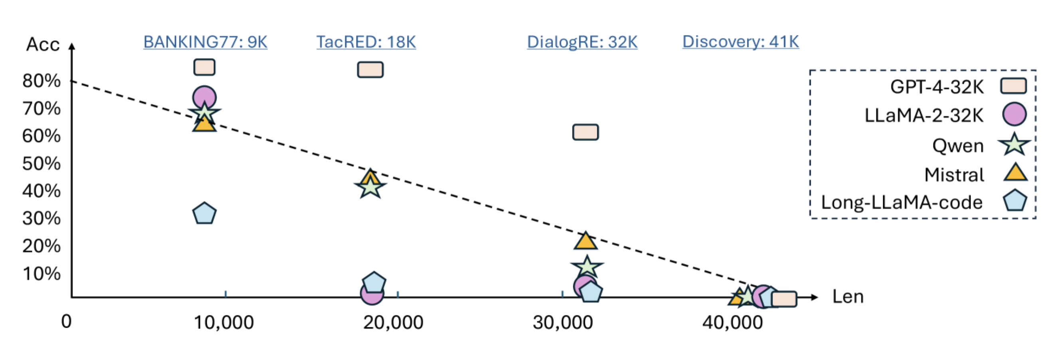
Overview of Model Performance at Task-level
The performance greatly decreases as the task becomes more challenging.
Some models like Qwen and Mistral decay linearly w.r.t the demonstration length.

Slide 31
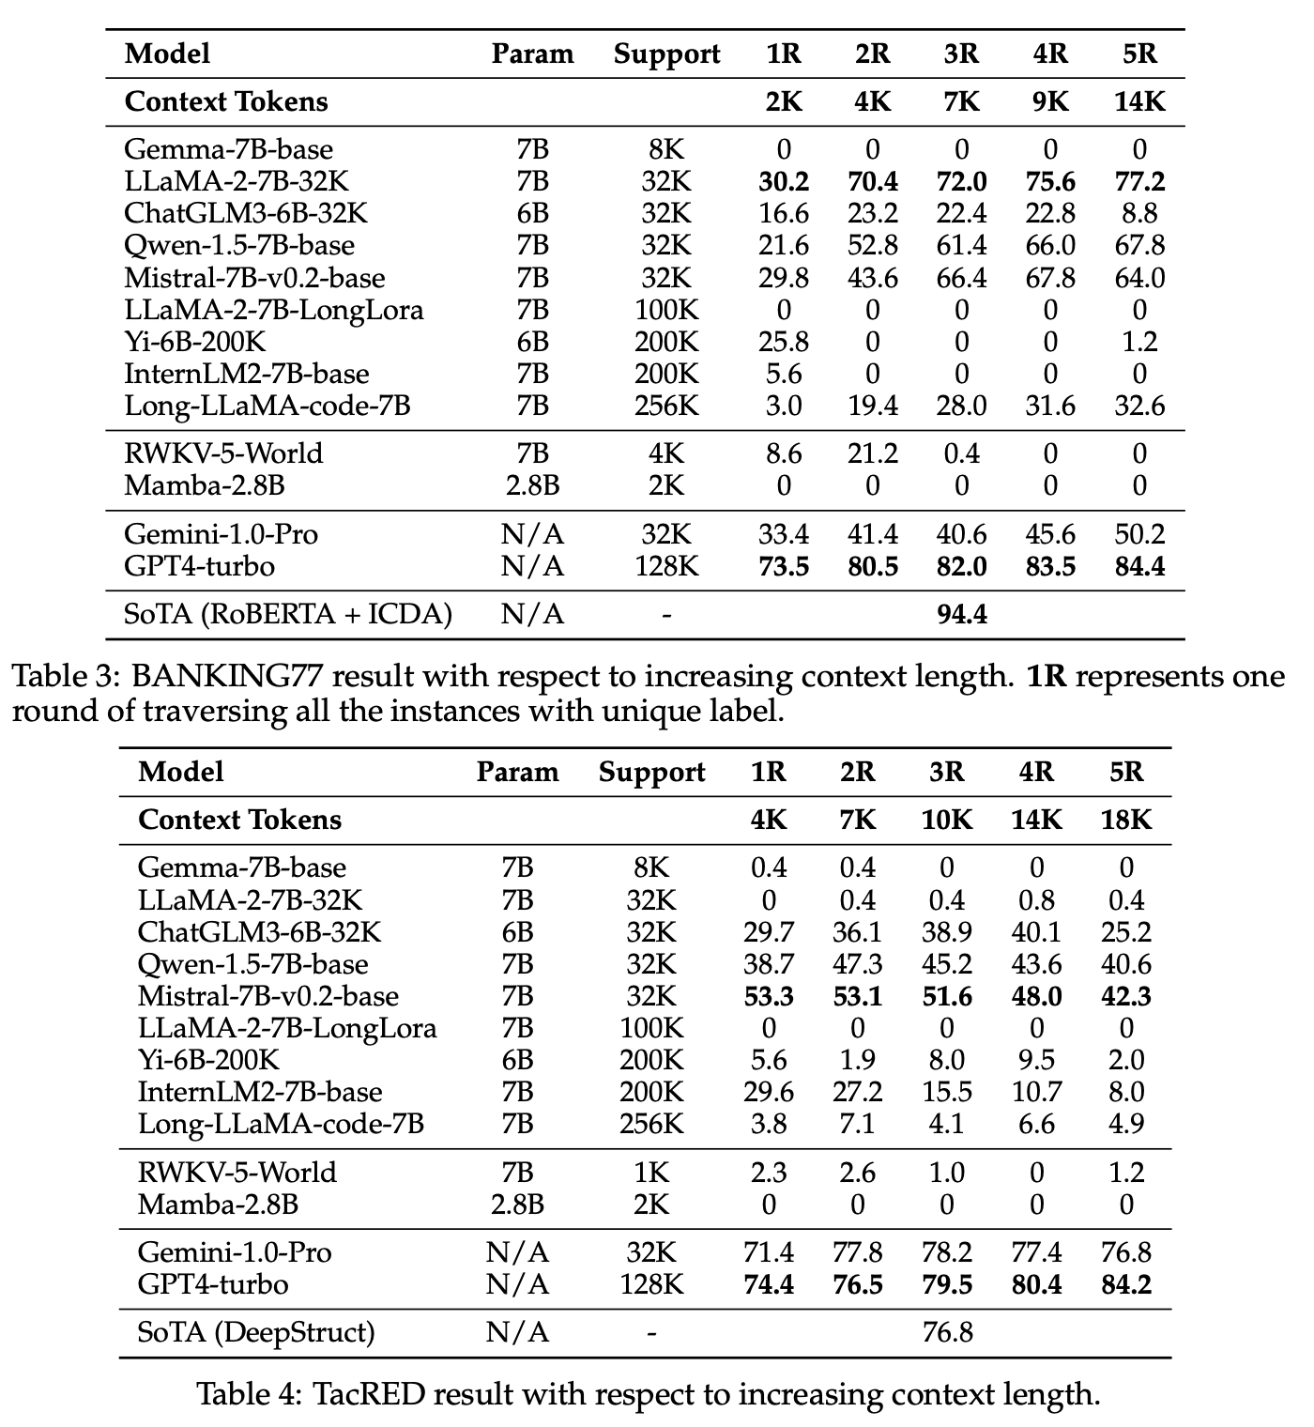
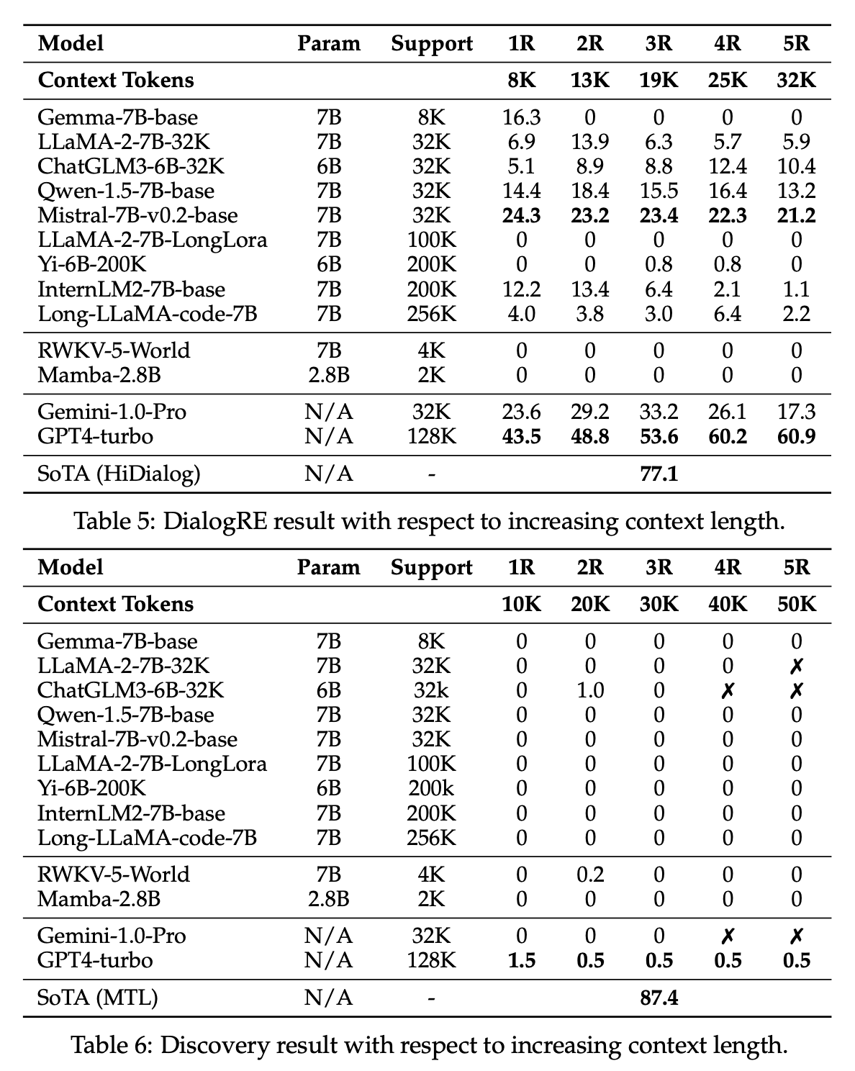
Phase change (Together LLaMA-2)

Slide 32
Phase change (Long LLaMA-2)

Slide 33
Phase change (GPT-4-turbo)

Slide 34
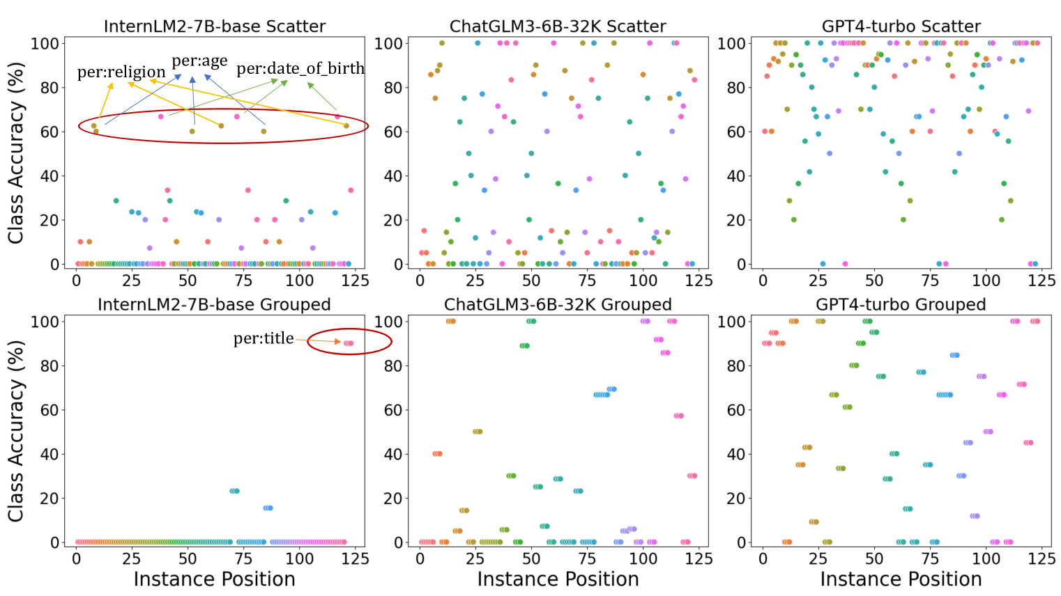
Result Analysis
There is an obvious performance drop after grouping the instances from the same class compared to randomly distributed
Some LLMs are very sensitive to the label position. There is a strong bias towards the label recency.

Slide 35
What happened when LLM fails?
Example: label 1, Example: label 2 …., Example: label K
P(label k) = 1/K
Example: label 1, Example: label 2 …., Example: label K
… [Round 2] Example: label k
P(label k) = 2/K
Example: label 1, Example: label 2 …., Example: label K
… [Round 2] [Round 3] Example: label k
P(label k) = 4/K
Example: label 1, Example: label 2 …., Example: label K
… [Round 2] [Round 3] [Round 4] label k
P(label k) = 100%

Slide 36
Takeaways
There is a notable decline in the performance of even the most advanced models like GPT4-turbo as the complexity of the tasks increases.
In the most challenging scenarios, especially those with 174 classes, models fail completely to discern subtle differences.
The performance of certain models is sensitive to the position of the instances in the demonstrations, leading to a significant drop when instances from the same class are grouped.

Slide 37
Ongoing Work
LongRAG:
Increasing Retrieval Unit Size + Long-context reader.
Significantly reduces the workload of IR.
Increasing factuality and consistency.
Long in-context tool use
API hub with massive functions.
Reason over large API documents to improve performance.

