Slide 1
Open Question Answering over Tables and Text
Wenhu Chen, Ming-Wei Chang, Eva Schlinger,
William Wang, William W. Cohen

Slide 2
Complex QA over Heterogeneous Web Knowledge
What is the home stadium of Lebron James during NBA season suspended by COVID?
Documents
Lists
Tables
Un-structured
Structured
6,216,701 pages
Notes:
In this section, we considering more complex multi-hop questions and we are using the heterogeneous raw data from the web.

Slide 3
Background: Text-based Question Answering
Which NBA season was suspended by COVID?
$$p_{start}$$
$$p_{end}$$
IR
Google BERT
2019–20
The 2019–20 NBA season was the 74th ... The regular season
began on October 22, 2019, and originally …. However, the season was suspended on March 11 as a result of the COVID-19 pandemic.
Notes:
Let me first go over the existing open question answering paradigm, which was mainly focused on only using the unstructured textual data. In this setting, a retriever scans over the web to select the most relevant passage as the support evidence. A reading comprehension model is used to predict the answer span.

Slide 4
Complex QA over Heterogeneous Web Knowledge
What is the home stadium of Lebron James in the NBA season suspended by COVID?
List of NBA Teams of Lebron James
1
The 2019–20 NBA season was the 74th ... The regular season
began on October 22, 2019, and originally …. However, the season was suspended on March 11 as a result of the COVID-19 pandemic.
2
Year | Team
2012-11 | Miami
2013-14 | Miami
2014-15 | Cleveland
2015-16 | Cleveland
2016-17 | Cleveland
2017-18 | Cleveland
2018–19 | L.A. Lakers
2019–20 | L.A. Lakers
3
The Los Angeles Lakers are an professional basketball team based in Los Angeles. The Lakers compete in the NBA as a member of the league's Western Conference Pacific Division. The Lakers play their home games at Staples Center
Answer: Staples Center
Notes:
However, the question might be deemed unanswerable by only looking into a few passages. If we go a extra mile to retrieve tables from the web, we are actually able to answer this given question.

Slide 5
Heterogeneous Information Integration
What is the home stadium of Lebron James in the NBA season suspended by COVID?
Unified QA Model
retrieve
integrate
Answer: 25.3
Challenges
Dataset
Integration

Slide 6
OTT-QA (Open-Table-Text) Dataset
Lebron James Career Statistics
NBA 2018-19 Season
Year | Team | BPG | PPG
2015–16 | Cleveland | .6 | 25.3
2016–17 | Cleveland | .6 | 26.4
2017–18 | Cleveland | .9 | 27.5
2018–19 | L.A. Lakers | .6 | 27.4
2019–20 | L.A. Lakers | .5 | 25.3
NBA 2019-20 Season
Cleveland Cavaliers
L.A. Lakers
NBA 2017-18 Season
(Q, A)
Annotation
Quality Control
OTT-QA
Size: 45K
Model
Human
Notes:
We collected our own dataset called OTT-QA, which consists of table crawling, passage linking. We provide both tables and text to the crowd-workers to let them write Q-A pairs, then we perform model-based and human-based quality control to make sure the questions require information integration and human-based grammaticality and fluency checking. Finally, we harvest a dataset consisting of 45K QA pairs.

Slide 7
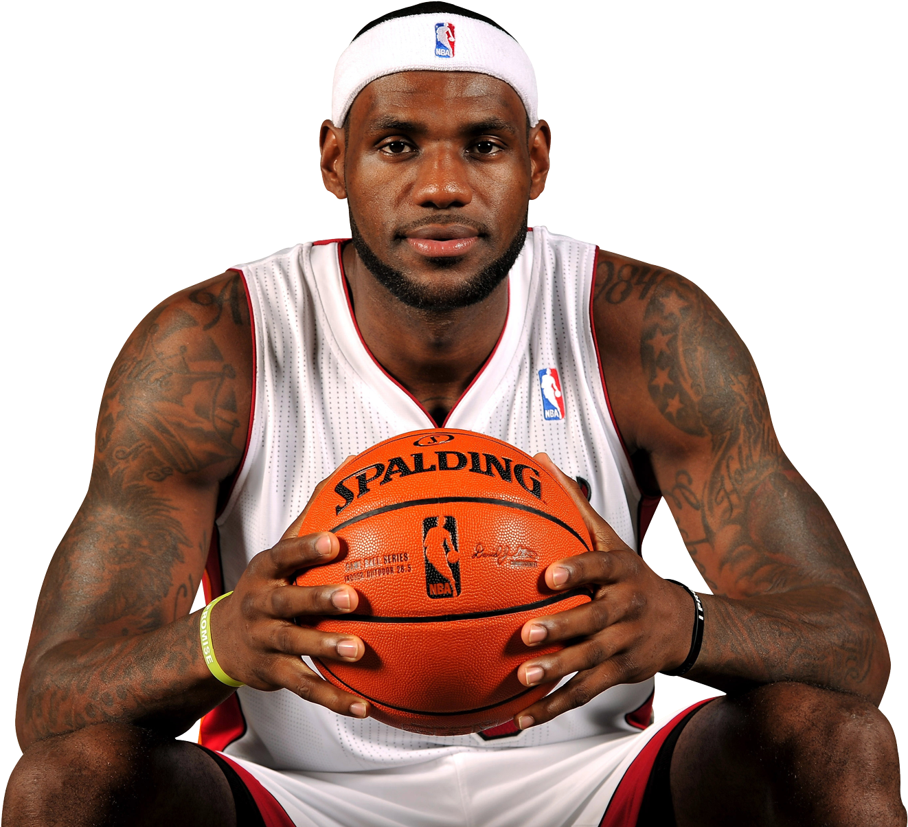
Retriever-Reader Framework
Q: What is the home stadium of Lebron James in the NBA season suspended by COVID?
Top-K
Retriever
Reader
Answer
Wikipedia Candidate Pool
$5M$ Passages
$\text{2}\text{M}$ Tables

Slide 8
Multi-Hop Retriever [Baseline]
Q: What is the home stadium of Lebron James in the NBA season suspended by COVID?
BERT Encoder
The 2019–20 NBA season was.... Suspended by COVID-19 pandemic.
1
BERT Encoder
Millions of Tables and Passages
Notes:
To learn

Slide 9
Multi-Hop Retriever [Baseline]
Q: What is the home stadium of Lebron James in the NBA season suspended by COVID?
BERT Encoder
Year | Team
2012-11 | Miami
2013-14 | Miami
2019-20 | LA Lakers
2
BERT Encoder
Millions of Tables and Passages
Notes:
To learn

Slide 10
Multi-Hop Retriever [Baseline]
Q: What is the home stadium of Lebron James in the NBA season suspended by COVID?
BERT Encoder
3
The Lakers play their home games at Staples Center
BERT Encoder
Millions of Tables and Passages
Notes:
To learn

Slide 11
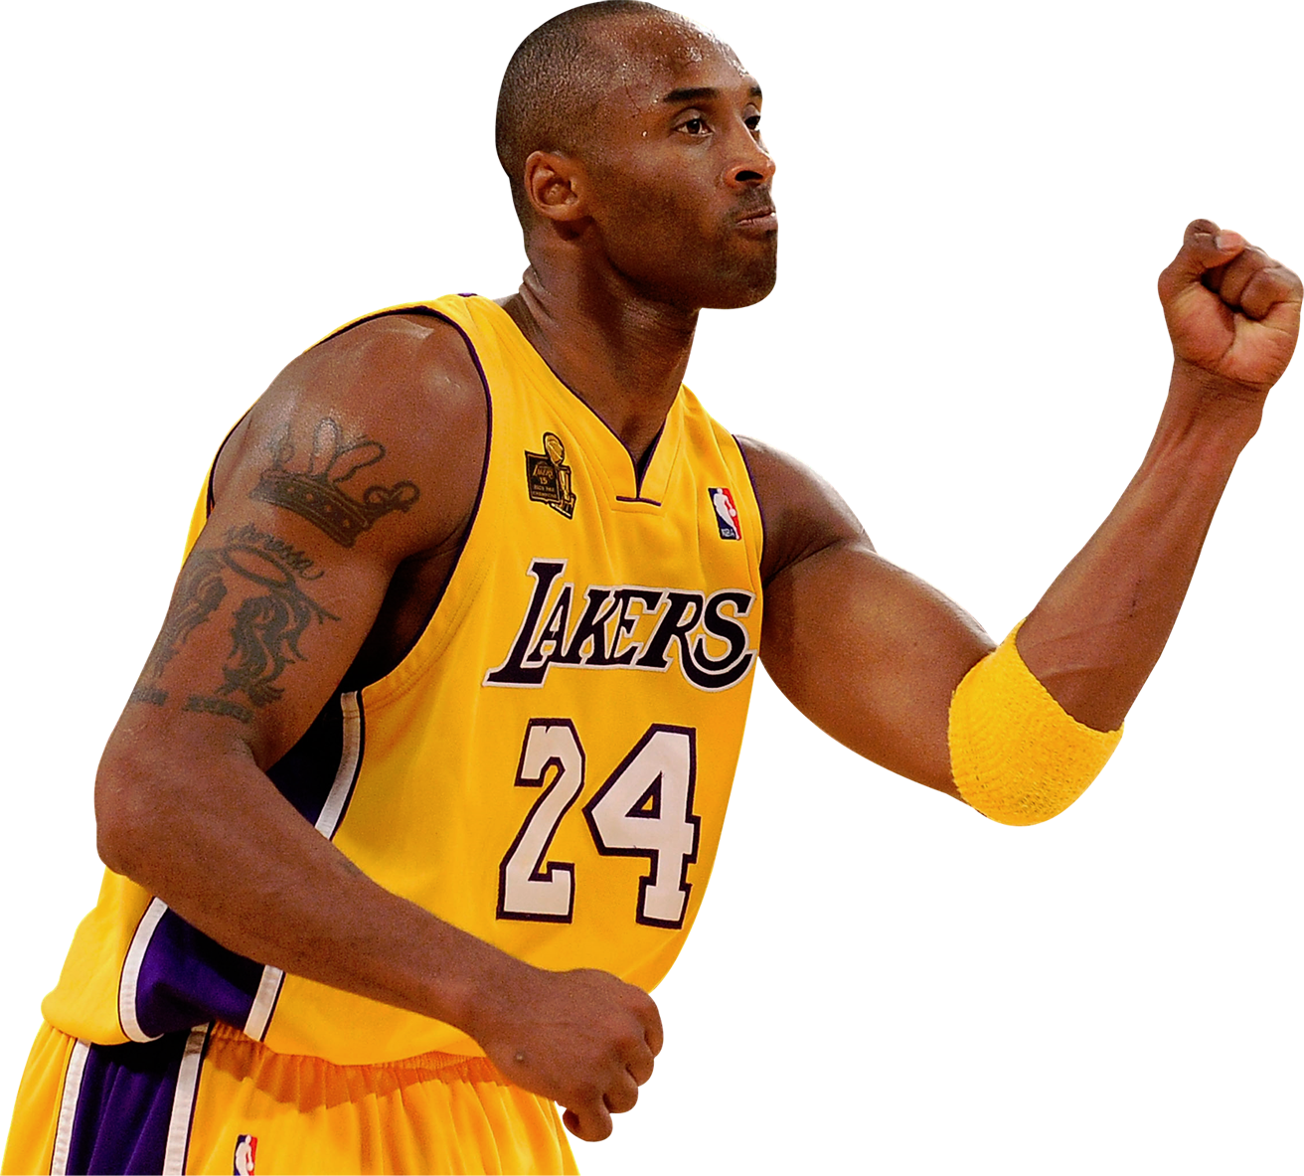
Multi-Hop Retriever [Baseline]
Teams
$$K_{3}$$
$$K_{2}$$
Coaches
$$K_{1}$$
question
COVID
Complexity:$𝒪\left(T+K_{1}T+K_{1}K_{2}T\right)≈𝒪\left(KT\right)$
${K≈K}_{1}{×K}_{2}×K_{3}$; T = BERT encoding + MIPS search time

Slide 12
Single-Hop Retriever [Ours]
Q: What is the home stadium of Lebron James in the NBA season suspended by COVID?
BERT Encoder
Complexity:
$𝒪(T)$ +$𝒪(1)$
$$K$$
BERT Encoder
Teams
Coaches
2019-20
Frank
Lebron
Stadium
COVD
Suspension
Staples

Slide 13
Full-Attention Reader [Baseline]
$$p_{start}$$
$$p_{end}$$
Google BERT
Complexity:
$$𝒪\left(L^{2}\right)=𝒪\left(K^{2}{\overline{B}}^{2}\right)$$
Slow! Memory Overflow!
$$L=K\overline{B}>4000$$
$K=50$: number of retrieved block
$\overline{B}≈96$: Average Length per block
Notes:
After we retrieve the top-K candidate blocks, we need to feed them to the neural extractive readers to extract the answer span from the retrieved blocks. However, since we are dealing with significant amount of blocks. If we concatenate all the document, the input sequence length can easily go beyond 4000, which is almost impossible for the reader to handle given its quadratic time complexity. Therefore, the existing frameworks usually decompose the long sequence into a set of smaller groups where each group contains less than 500 tokens. These smaller groups will be fed to the reader in parallel to extract the answer, the one with highest confidence will be used as the final prediction. This framework fails to model global context due to the lack of interaction between different groups, the prediction is basically local optimum.

Slide 14
Global-Local Sparse Attention
Local-Global
$$K^{2}\overline{B}$$
Global-Global
$$K^{2}$$
Global-Local
$$K\overline{B}$$
Local-Local
$$K{\overline{B}}^{2}$$
K Global
$$B_{1}$$
$$B_{2}$$
$$B_{K}$$
Complexity: $𝒪\left(K{\overline{B}}^{2}+K\overline{B}+ K^{2}+K^{2}\overline{B}\right) \sim 𝒪\left(K{\overline{B}}^{2}\right)$
Notes:
We use the global-local sparse attention mechanism to decrease the complexity to KxB^2.

Slide 15
Sparse-Attention Reader [Our Model]
$$p_{start}$$
$$p_{end}$$
Complexity:
$$𝒪\left(\frac{L^{2}}{K}\right)=𝒪\left(K{\overline{B}}^{2}\right)$$
Sparse-Attention
Fast! Memory Efficient!
$$L=K\overline{B}>4000$$
$K=50$: number of retrieved block
$\overline{B}≈96$: Average Length per block
Notes:
We use the sparse-attention mechanism, we can directly feed all the retrieved blocks to the reader without worrying about the memory overflow and speed. This framework has the advantage that the global context is modeled, the prediction is basically global optimum.

Slide 16
Experimental Results
OTT-QA Test Experimental Results (Accuracy)
27.2%
16.9%
13.4%
9.9%
9.8%
7.2%
4.6%
BM25
Text
BM25
Table
BM25
Hybrid
Multi-Hop
BERT
Single-Hop
BERT
Multi-Hop
Sparse-Att
Single-Hop
Sparse-Att
BM25 Baselines
Xiong et al. 2020
Ours
Single-Hop Retriever: ~8x faster than Multi-Hop Retriever
Sparse-Attention Reader: ~2x faster than BERT Reader
Notes:
We evaluate our model Single-R and Sparse-R on OTT-QA test split and our model is able to achieve significant performance gain. Besides, our model runs much faster than the baseline systems.

