Slide 1
Eliciting Symbolic reasoning capabilities from LLM with Program of Thoughts
Speaker: Wenhu Chen
Collaborations: Tianle Li, Xueguang Ma, Xinyi Wang, Alex Zhuang, William Cohen

Slide 2
Large Language Models

Slide 3
Large Language Models
Large Language Models has become the de-facto for many tasks.
Single model for all tasks.
Models use transfer learning to generalize.
Only a few examples are needed.
Models textual fluency and coherence perfectly.
Large Language Models
Not able to perform complex reasoning tasks like math problems.
Not able to solve perform highly symbolic reasoning like knowledge graph.

Slide 4
Reasoning Large Language Models
How to utilize LLMs to solve numerical reasoning tasks.
Math problem
Finance Problem
Data Science Problem
How to utilize LLMs to query large-scale knowledge base.
Extract information from KBs.
Answer questions regarding KBs.

Slide 5
Program of Thoughts Prompting: Disentangling Computation from Reasoning for Numerical Reasoning Tasks
Wenhu Chen, Xueguang Ma, Xinyi Wang, William Cohen
Arxiv 2211.12588

Slide 6
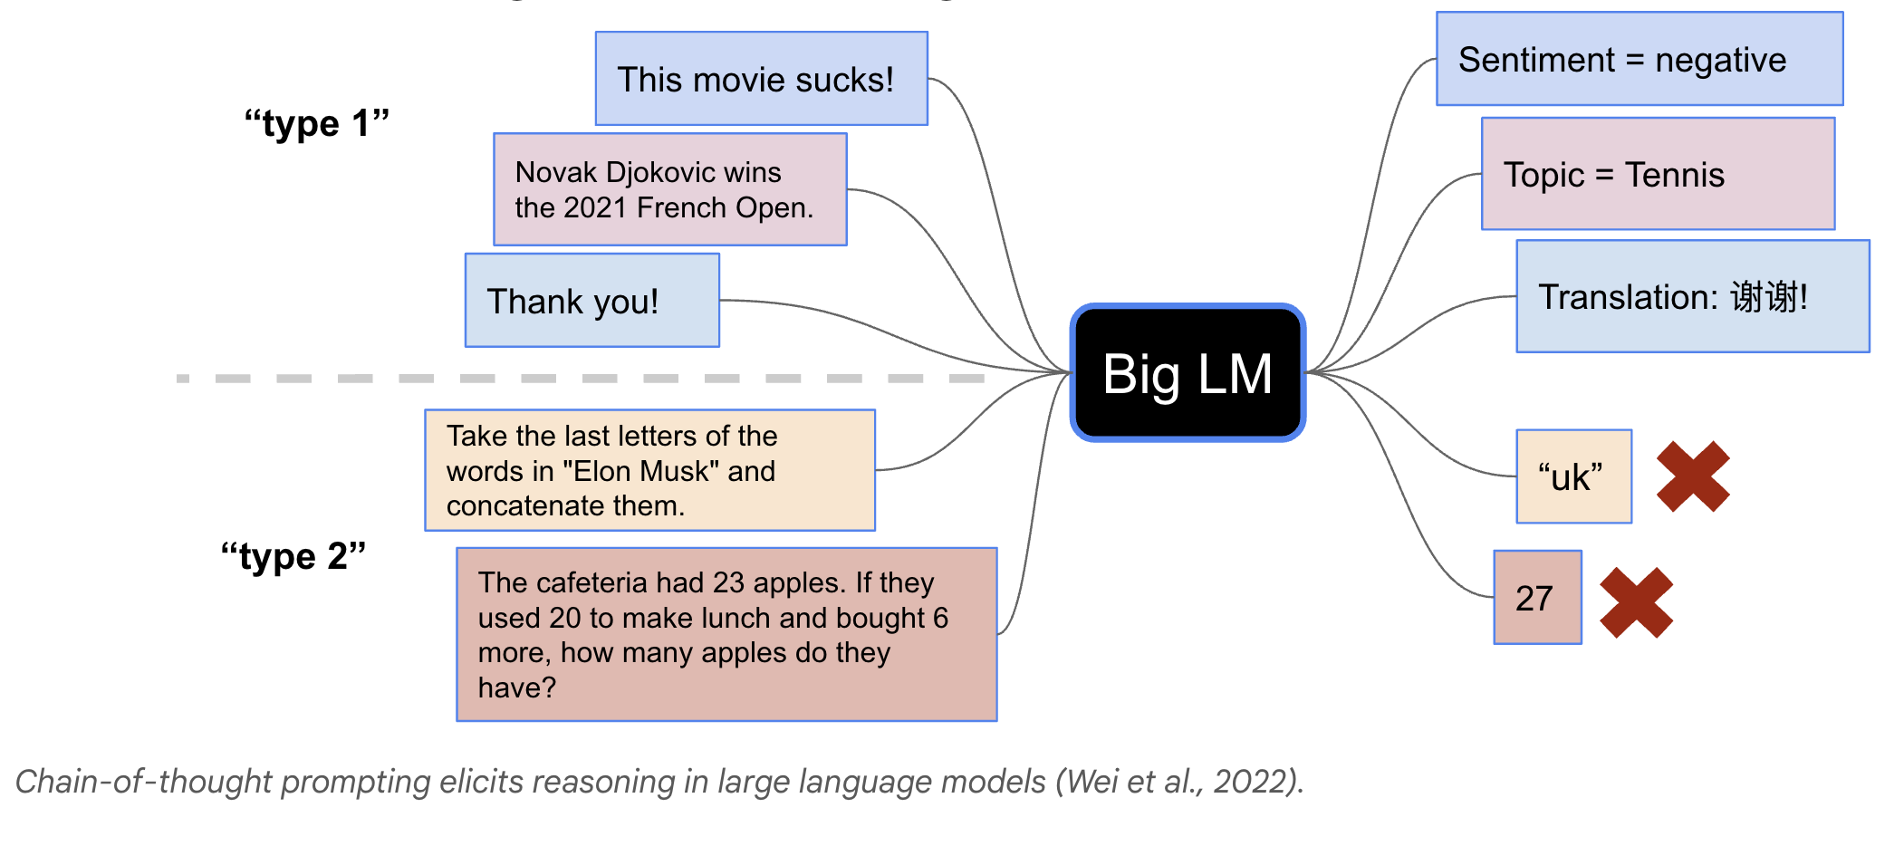
Direct Prompting in LLM

Slide 7
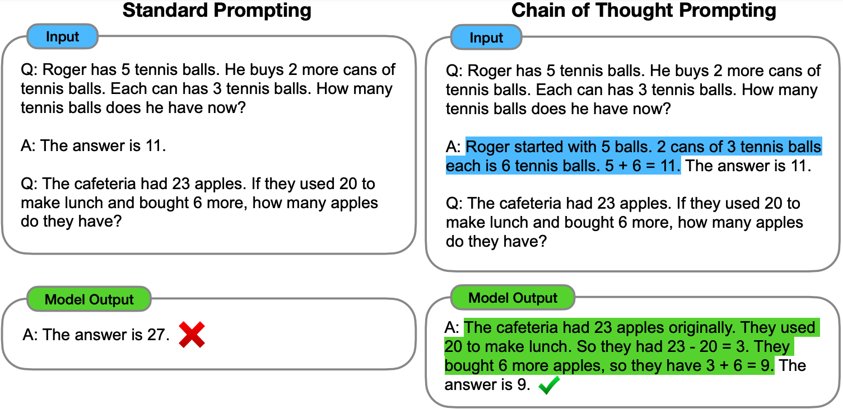
Chain of Thoughts in LLM

Slide 8
Chain of Thoughts in LLM

Slide 9
Chain of Thoughts in LLM
Relying on natural language to solve tasks.
Computation and Reasoning are both expressed in NL.
Some symbolic operations are too complex to be expressed with NL.
Some tasks require calling APIs to accomplish.
Let’s take a look at some cases.

Slide 10
Is NL the best reasoning means?
In Fibonacci sequence, it follows the rule that each number is equal to the sum of the preceding two numbers, what is the 50th number in Fibonacci sequence?
The first number is 0, the second number is 1, therefore, the third number is 0+1=1. The fourth number is 1+1=2. The fifth number is 1+2=3. The sixth number is 2+3=5. The seventh number is 3+5=8. The eighth number is 5+8=13.
..... (Skip 1000 tokens)
The 50th number is 32,432,268,459.

Slide 11
What about Programs as Thought
In Fibonacci sequence, it follows the rule that each number is equal to the sum of the preceding two numbers, what is the 50th number in Fibonacci sequence?
length = 50
fibonacci = np.zeros(length)
fibonacci[0] =0
fibonacci[1] = 1
for i in range(3, length):
fibonacci[i] = fibonacci[i-1] + fibonacci[i-2]
return fibonacci[-1]
Concise
Accurate

Slide 12
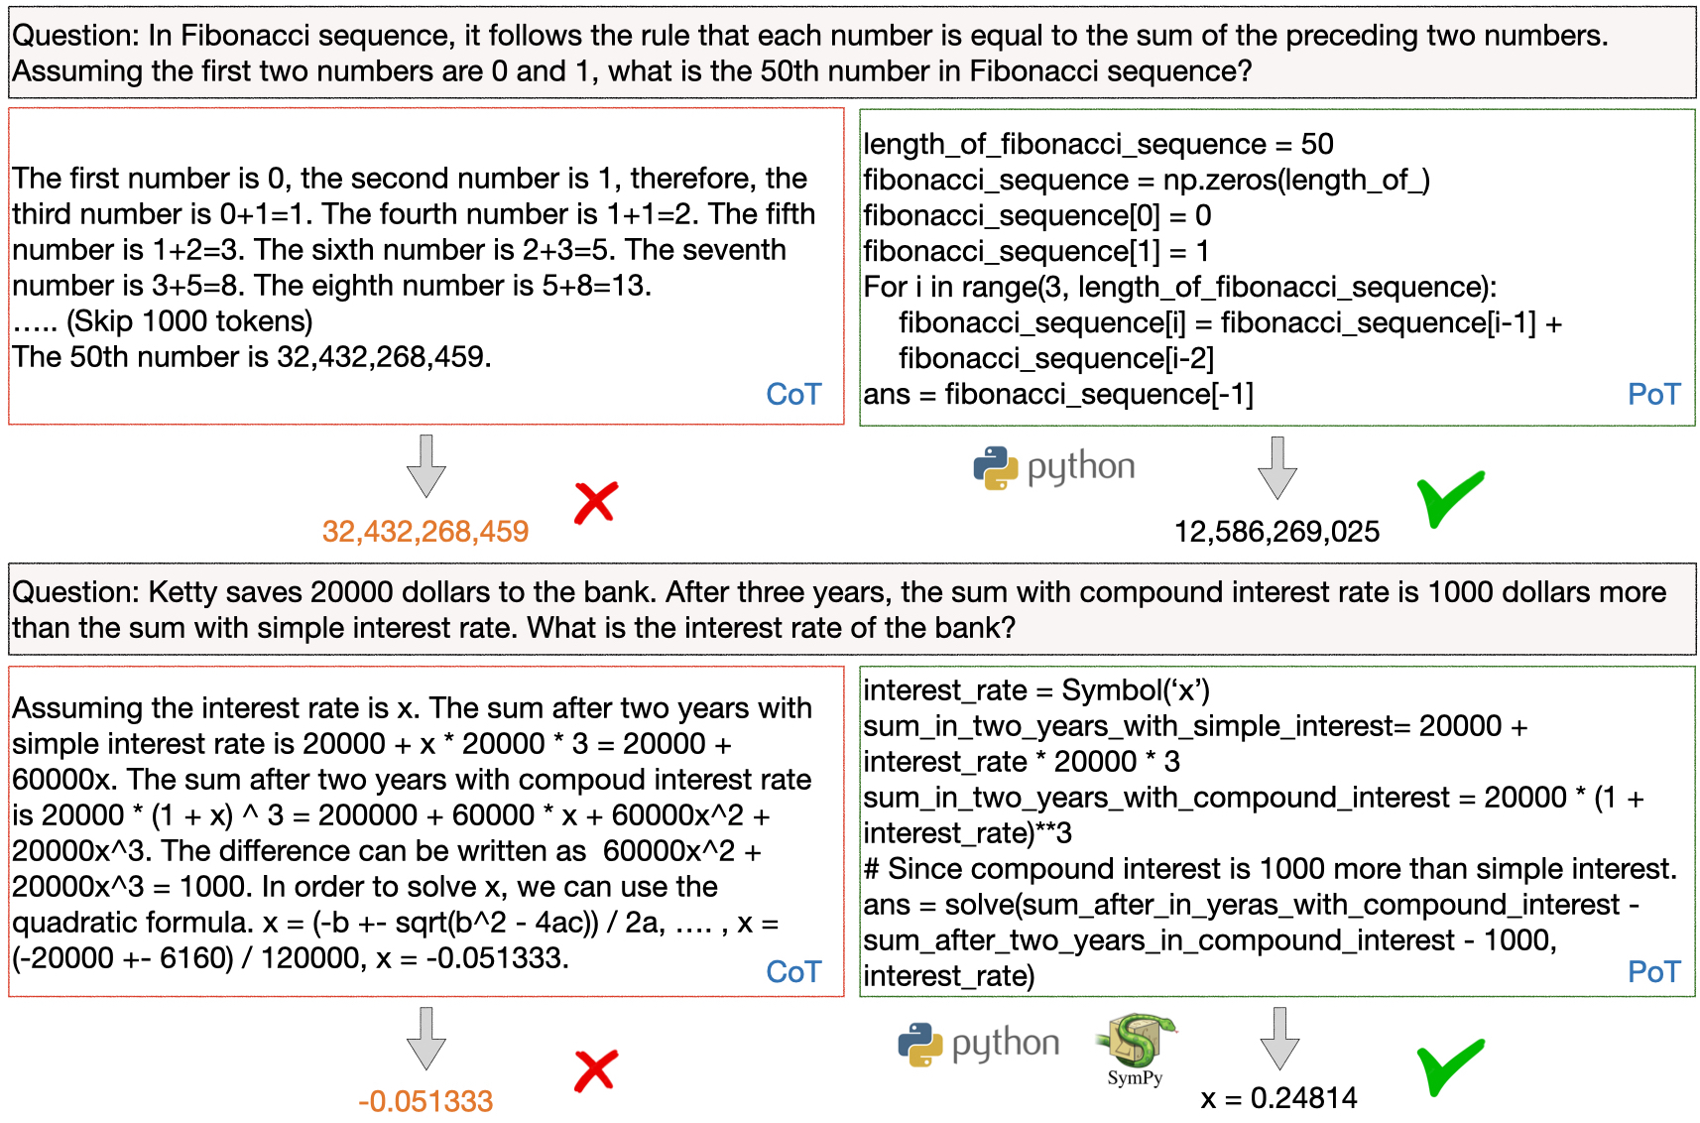
Program of Thoughts

Slide 13
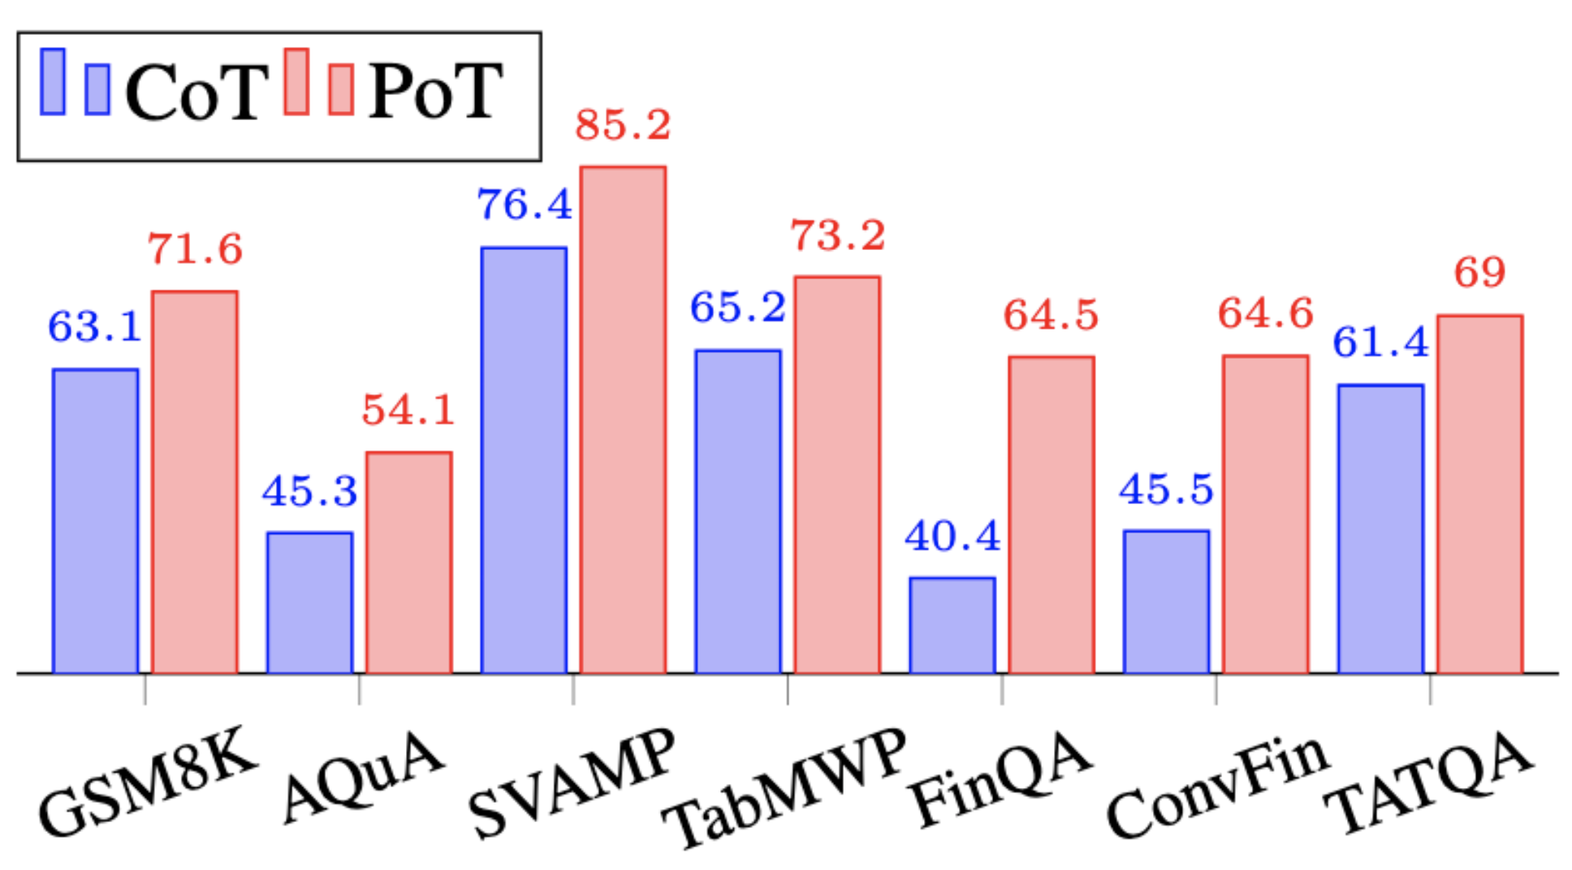
Few-Shot Results on Math Problem Dataset

Slide 14
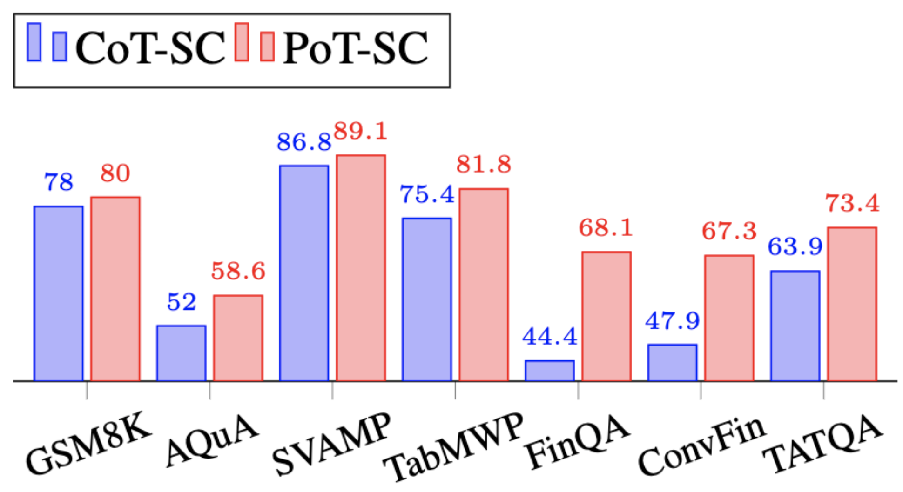
Few-Shot (SC) Results on Math Problem Dataset

Slide 15
Zero-Shot Evaluation

Slide 16
Zero-Shot Results on Math Problem Dataset

Slide 17
Ablation Studies
Meaningful Binding
length = 50
fibonacci = np.zeros(length)
fibonacci[0] =0
fibonacci[1] = 1
for i in range(2, length):
fibonacci[i] = fibonacci[i-1] + fibonacci[i-2]
return fibonacci[-1]
No Binding
x0 = 0
x1 = 1
for _ in range(2, 50):
tmp = x0 + x1
x0 = x1
x1 = tmp
return x1

Slide 18
Takeaways
Program-of-thoughts can disentangle the computation process from the reasoning process, where the computation is done via executor.
Such disentanglement can significantly boost the performance.
Program-of-Thoughts achieve state-of-the-art performance on all of the math problem datasets.

Slide 19
Few-shot In-context Learning for Knowledge Base Question Answering
Tianle LI, Xueguang Ma, Alex Zhuang, Yu Gu, Yu Su and Wenhu Chen
Proceedings of ACL 2023

Slide 20
Symbolic Reasoning (Knowledge Graph)
Question: What is the xbox 360 controller game version that supports the europe region?
Xbox 360 Controller
Supporting game versions
Video Game Version
Regions
Europe
Logical Forms: (AND cvg.game_version (AND (JOIN cvg.game_version.regions m.02j9z) (JOIN (R computer.computer_peripheral.supporting_game_versions) m.05mzkx7)))

Slide 21
Existing Problem of the Current Methods
Data intensiveness: larger knowledge bases require ever larger quantities of annotated data to allow fine-tuned models to generalize well over them.
2) Dataset specificity: For relatively small-scale KBQA datasets, the fully-trained models tend to overfit to a specific schema, and they can hardly generalize to new questions in unseen domains.
Crucial to devise a new framework that can work in both low-resource and training-free settings in KBQA

Slide 22
KBQA with Large Language Model
KB-BINDER pipeline:
Stage 1: Generate the drafts as preliminary logical forms
Stage 2: Bind the drafts to the executable ones with entity and relation binders grounded on the knowledge base

Slide 23
Overview of KB-BINDER
Given a question, the LLM will first generate its corresponding preliminary logical forms as the drafts, imitating the exemplary demonstration.
Then the entity and relation binders will operate on the drafts to ground the entities and relations on KB respectively, which produces the final candidates.

Slide 24
Draft Generator
In-context learning with Codex
Randomly sample N examples from the training set as the <Question, Logical form> pair exemplars
The generated draft is not guaranteed to be executable. However, drafts can reveal the structural relationships among mentioned entities in a semantically reasonable way

Slide 25
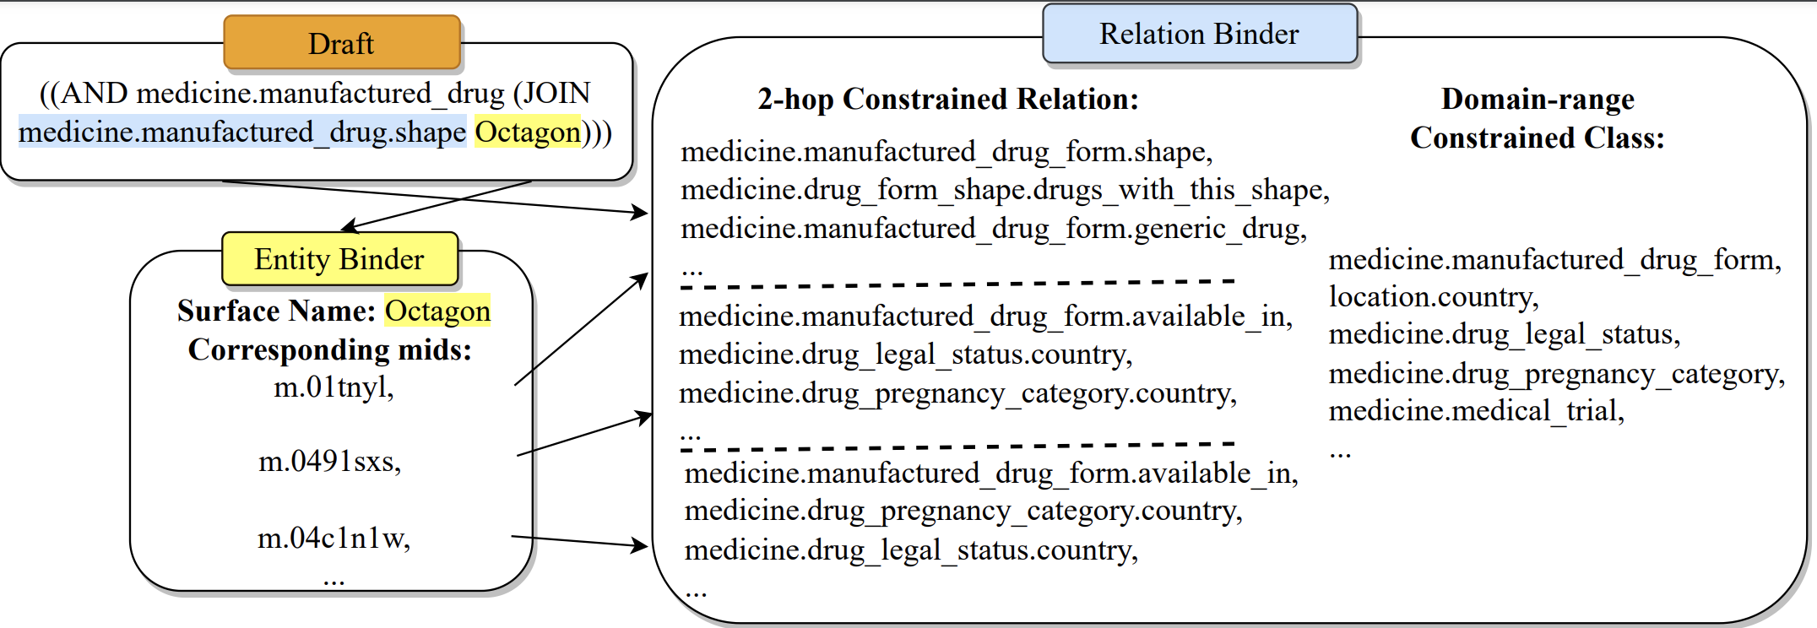
Knowledge Base Binder
Entity Binder
- Extract their surface names from the generated drafts
- Utilize BM25 to retrieve the most similar existing ones in KB
Relation Binder
- Utilize the generated relational items and bound entities to recognize the relations.

Slide 26
Decoding the answer
Majority Voting
answer

Slide 27
Experimental Datasets
GrailQA: I.I.D., Compositional, and Zero-shot
WebQSP: I.I.D
GraphQA: Compositional
MetaQA: Specific to movie domain

Slide 28
KB-BINDER Results & Baselines

Slide 29
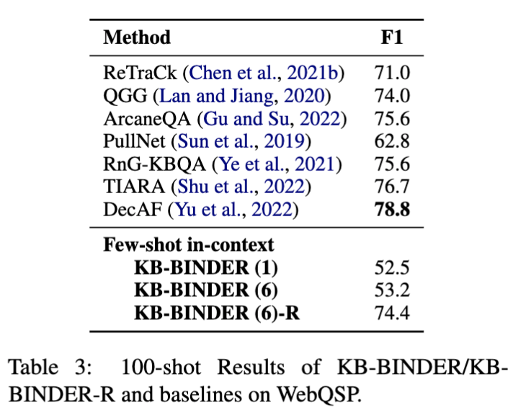
KB-BINDER Results & Baselines

Slide 30
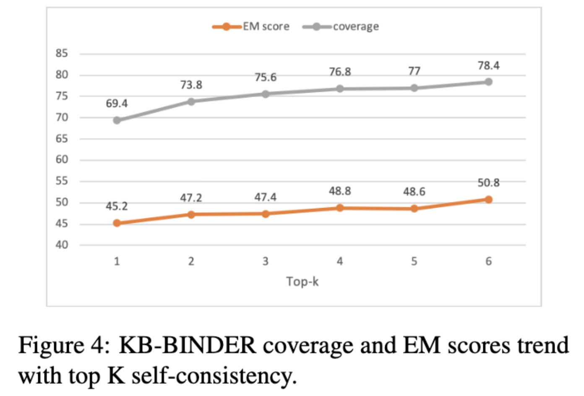
Analysis on Shot Number and Self-consistency
Test on 500 randomly sampled questions from the dev set of GrailQA.

Slide 31
Takeaways
KB-BINDER leverages LLM and a “generate-and-bind” pipeline to achieve a training-free paradigm for KBQA
KB-BINDER and its derivatives achieve strong performance on all the commonly-used KBQA datasets we select, and we hope it can set a strong baseline for future work on KBQA with a low-resource setting.

